Slide 1
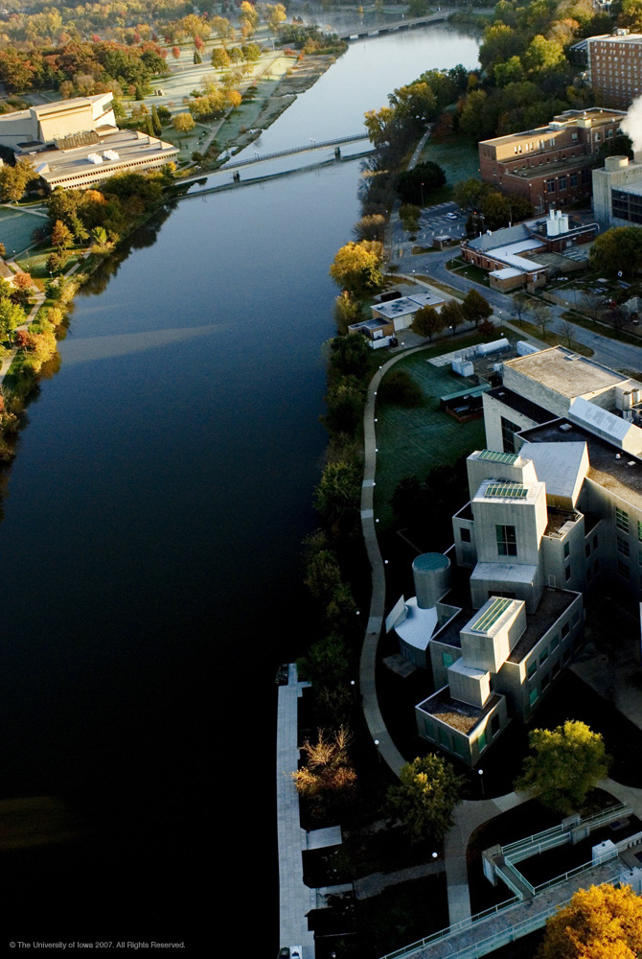
Promotion
and
Tenure
Peter Snyder
Associate Dean
for Faculty

Slide 2
When am I ready for promotion?
Assistant to Associate Professor
  Required in the final probationary year of a tenure track appointment (year 6 or 8)
  “Tenure Clock”
Associate to Full Professor
  Often after 6-7 years in rank but no specific time frame
Other options (early promotion): higher expectations
  - The Department recommends
  - The faculty member requests review

Slide 3
Reasons to extend tenure clock
Automatic
  - COVID19: 1 year for assistant professors in rank
  during 2020-21 academic year
  - Addition of minor child (1 year per child, up to 2)
  Need to make a request
Discretionary
  - Extenuating circumstances that slow progress
  (e.g. prolonged health issues)
  - Requires approval from department chair, dean,
  and provost

Slide 4
What are expectations for promotion?
To Associate Professor with Tenure
- Evidence of high quality teaching
- Establishing a record of productive scholarship
- Appropriate level of academic and/or professional service
- Promise of promotion to professor
To Professor with Tenure
- Continued evidence of high quality teaching
- Established record of productive scholarship
- Unmistakable national/international reputation
- Appropriate level of service

Slide 5
Research Track
No tenure clock or requirement for promotion
Focus is on research/scholarship
- Teaching and service not required (although will
be considered if present)
Not necessary to have independent funding
- Should be co-investigator
Unmistakable national/international reputation
- For Promotion to Professor

Slide 6
What is Tenure?
Promotion to Associate Professor confers Tenure
Tenure protects academic freedom
  - Academic freedom to pursue and publish research
  and to discuss course subject matter without interference
  (but can’t introduce subject matter with no relation
  to the subject)
Appointment length is indefinite
  - Post-tenure reviews (5 years)
  - Not a “job for life.” May be terminated for policy
  violations, failure to meet written standards,
  or financial exigency.

Slide 7
What do I need to do for promotion process?
Decide whether to apply for promotion—late spring
Compile and submit promotion packet—late summer
Provide updates for new papers, grants, etc.
As department and college reviews are completed, provide
input as requested

Slide 8
Promotion
Materials
Aug
Promotion
Committees
Sept-Oct
Sept
Vote, report
Department
DCG
Nov
Vote
DEO
Decision, report
Executive
Committee
CCG
Jan
Vote, report
College
Dean
Decision, report
Provost
Decision
Promotion
Process
Regents
May

Slide 9
Putting Together a Promotion Packet
CV in CCOM format
Personal statement (teaching, scholarship, service)
Sample teaching materials
- 4-5 of your best examples
Learner evaluations
- Who keeps these?
Peer evaluations of teaching

Slide 10
Putting Together a Promotion Packet
Publications (pdfs)
- 5 most representative (best)
Potential external reviewers (8-10)
- Names, titles, contact info., relationship
- External to UI
- Above your current rank
- Conflicts of interest (must not be mentor, collaborator/coauthor, friend, etc.)

Slide 11
CV
Make sure it is up to date!
CCOM format
Annotate bibliography
- indicate contributions to papers where you are not first/last author (co-first, co-corresponding, middle)
Indicate role on grants
Indicate which talks were invited vs. submitted abstract
Indicate role on committees (e.g. chair vs. member)

Slide 12
Personal Statement
Brings your CV to life—very important!
Not to exceed 8 pages
- Teaching: up to 3 pages
- Scholarship: up to 3 pages
- Service: up to 2 pages (clinical and committees/etc.)
Address any issues that you think reviewers may raise
Include future plans and goals

Slide 13
Evaluation of Teaching
Classroom (lectures, small group), clinical, lab/bench
Review of teaching materials
- Course materials
- Presentations/lectures (e.g. Powerpoint slides)
- Lecture handouts
Quantity relative to peers
Quality relative to peers (“effective teacher”)
- Learner evaluations (you need to review them!)
- Peer evaluations
- Teaching awards
- Activities to improve

Slide 14
Evaluation of Scholarship
Discovery and dissemination of new knowledge
- Papers
Driving force behind work
- Independence
Funding to carry out the work
- R01, VA Merit, equivalent
- Some work doesn’t require funding (uncommon)

Slide 15
Evaluation of Scholarship
Quality/impact (number, journals, scope)
- number depends on field, journals
Focus
- Clear theme, developing an area, moving field
forward
Independence
- Authorship order, funding (PI), external reviews
Sustained productivity
- lack of gaps, ongoing funding
National/International reputation
- for promotion to professor

Slide 16
Evaluation of Service
Internal- Department, College, University
- Committees
- Mentoring
External
- Society committees, leadership
- Editorial boards, journal reviewer
- Study sections, grant reviews
Clinical service

Slide 17
Department Process
Materials gathered by faculty (Aug 1)
Potential reviewer names gathered from faculty, in
collaboration with chair/division director (Aug 15)
- Department may add names (with faculty approval)
- Letters are solicited by department (don’t contact
potential reviewers)
Material is compiled and moved to the department
review committee (Sept 15th)

Slide 18
Department Process
Department review committee assesses teaching,
scholarship, and service (September-October)
Review and Vote by Department Consulting Group
- All department tenure track faculty above rank
Report written
- faculty may review and correct factual errors
DEO forwards recommendation to the college

Slide 19
College/University Process
Materials (teaching, scholarship, service) reviewed by
the CCOM Executive Committee (Nov-Jan)
Executive Committee makes a recommendation to the
dean
Dean makes recommendation to the provost (Feb)
Consideration by the Iowa Board of Regents (May)
Promotion takes effect July 1

Slide 20
How to Get Help
CCOM policies and procedures
https://medicine.uiowa.edu/facultyaffairs/faculty/promotion-and-tenure
Talk to leadership (DEO, division director, vice chair
for faculty)
Talk to mentor or recently promoted faculty
Office of Faculty Affairs and Development
ccom-ofad@healthcare.uiowa.edu
Promotion and Tenure website
https://webapps1.healthcare.uiowa.edu/PromotionTenure

