Slide 1
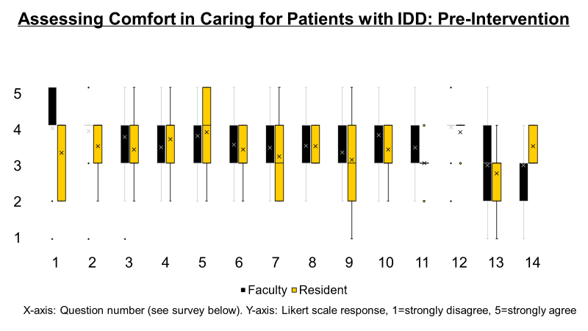
Improving Communication and Care for Patients with Intellectual and Developmental Disabilities in
Family Medicine Residency Training (ICC4IDD)
Meghan Connett, MD; Jason Wilbur, MD; Brigit Ray, MD, MME; Scott Larson, MD
For more, contact:
Jason-Wilbur@uiowa.edu
Meghan-Connett@uiowa.edu
Purpose of the Innovation
Persons in Iowa with intellectual and developmental disabilities (IDD) are more likely to have poor health as compared to the general population.
We created this curriculum to improve health equity for adults with IDD.
The curriculum includes modules, lectures and in-person Standardized Patient (SP) learning experiences to prepare family medicine residents to deliver optimal care for adults with IDD.
Curriculum Goals
Learn to interact comfortably and respectfully with people with IDD and adjust communication style and approach to accommodate the needs of people with IDD
Learn to integrate care for those with IDD into a busy clinic flow
Provide educational interventions that target the abilities and interests of people with IDD
Curriculum Formation
Didactic curriculum over 9 months with lectures by experts, caregivers and people with IDD with 12 hours of dedicated s and modules
Topics for Didactics and Modules
Bone health Community resources Family support Gastric tubes Growth Granulation tissue Guardianship | Medical equipment Menstrual suppression Nutrition Obtaining a trach aspirate in office Office set-up to support ID Transition to adult care
Assessing Comfort in Caring for Patients with IDD: Survey Prompts
I feel comfortable communicating with adult patients with intellectual disabilities.
I feel comfortable examining an adult patient with an intellectual disability.
I feel able to provide excellent primary care to adult patients with intellectual disabilities.
I feel able to coordinate care for adult patients with intellectual disabilities.
I feel I have a basic understanding of the health disparities affecting adult patients with intellectual disabilities.
I feel I have a firm understanding of the barriers impacting delivery of primary care to adult patients with intellectual disabilities.
I feel I am able to identify potential strategies for overcoming the common barriers to providing adequate health care to adult patients with intellectual disabilities.
I feel I have the tools to adequately obtain an appropriate history from an adult patient with intellectual disabilities.
I feel I understand the communication preferences of adult patients with intellectual disabilities.
I feel able to facilitate effective triadic communication with adult patients with intellectual disabilities and their care givers.
I feel I have the tools to troubleshoot obstacles in order to provide excellent primary care to patients with intellectual disabilities.
I feel able to provide appropriate preventative care to patients with intellectual disabilities.
I feel I know what resources are available to assist me in deciding which screening tests are appropriate for my adult patients with intellectual disabilities.
I feel the amount of training I am receiving in residency will allow me to adequately care for patients with intellectual disabilities.
Photo permission given by Charles Connett
Simulated Patient Experience
Family Medicine residents participate in three simulated patient experience two times per year during protected academic half day.
SP experiences created and performed by people with IDD (no actors) and caregivers. SPs will be compensated for their time.
Simulation performed in the hospital simulation center with feedback from those with IDD after each session.
Cases include communication devices, exam for someone in wheelchair, working with direct service provider, sexual care and satisfaction, transitions of care, care of tubes, and more
Conclusions and Next Steps
11 residents and 30 faculty completed the survey, demonstrating similar levels of comfort in caring for patients with IDD, with neither group having a high degree of comfort.
Currently, didactic presentations occur regularly in the conference schedule.
SP recruitment is underway.
First SP case-based simulations will occur in June 2022.
Post-intervention surveys will be administered later in 2022.
SP and learner satisfaction will be assessed.
Acknowledgements: Elise Barlow and Parang Kim for assistance in creation of Qualtrics surveys, spreadsheets, and graphics.
Funding Source: UIHC GME Innovation Grant 2021
References: (1) Health Status by Disability Status chart from Iowa Department of Public Health, Disability Status in Iowa, 2016. (2) Survey published by Rebecca Lara, Greater Lawrence Family Medicine Residency on STFM Resource Library 2013.

