Slide 1
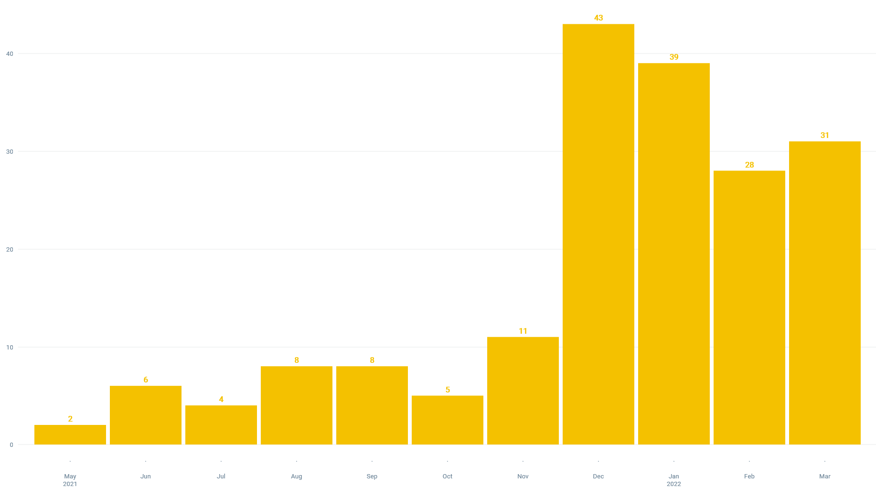
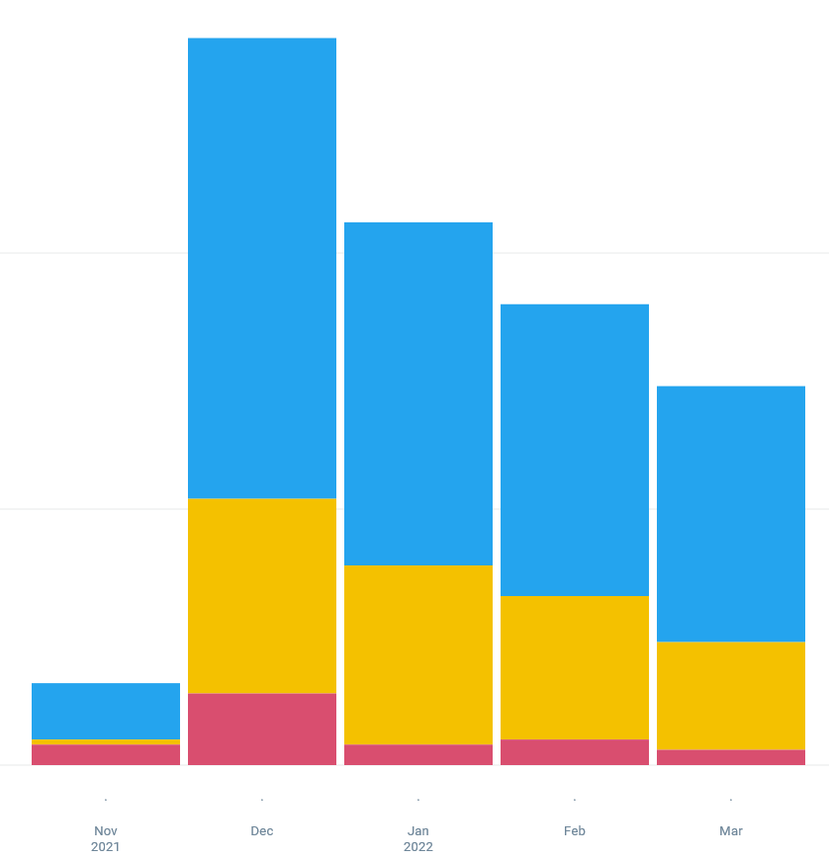
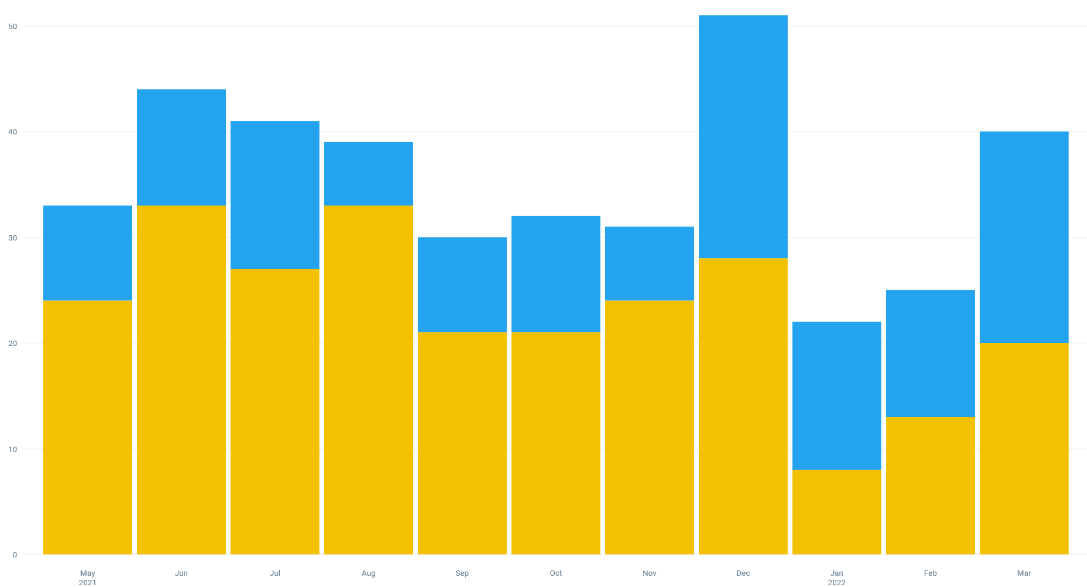
Traditional Education vs the Use of Clinical Decision-Making Tools to Improve Rates of Appropriate Naloxone Prescribing
Elizabeth Cramer MD¹, Brigit E. Ray MD MME¹, Ethan Kuperman MD², James M. Blum MD³, Alison Pauley MSN RN⁴,
Sarah Hacker⁴, Nathan Meyer⁴, Nader Shakir DO¹, Harris Syed MD¹
¹Department of Family Medicine; ²Department of Internal Medicine; ³Department of Anesthesia; ⁴HCIS; University of Iowa Hospitals and Clinics, Iowa City, IA 52242
Introduction
The CDC estimates that 93,000 Americans died of an overdose in 2020, with 74% of deaths attributed to opioid overdose. The opioid antagonist, naloxone, plays an essential role in evidence-based strategies for decreasing opioid-related fatalities but remains under-prescribed. In 2018, clinicians only provided 1 naloxone prescription for every 69 high-dose opioid prescriptions. The 2018 CDC recommendations are to prescribe naloxone to the following patients:
PATIENTS AT HIGH-RISK OF OPIOID OVERDOSE WHO SHOULD BE PRESCRIBED NALOXONE (CDC 2018)
Patients with history of overdose
Patients with history of substance use disorder
Patients prescribed higher opioid dosage (>50 MME/day), or concurrent benzodiazepine use are present.
C
Results
Provider action:
43
BPA Override
Opened SmartSet
Canceled BPA
Lecture Date
BPA Date
39
28
31
A
B
27%
B
33%
31%
28%
8
8
11
6
4
5
Nov 2021 | Dec | Jan 2022 | Feb | Mar
2
BPA Efficiency (% of total firings opening the SmartSet) by Month
Nov 2021-March 2022
May 2021 | Jun | July | Aug | Sept | Oct | Nov | Dec | Jan 2022 | Feb | Mar
Methods
*August 2021: Traditional lecture-based education and e-mail dissemination with review of CDC recommendations, naloxone prescribing information, administration, and patient education to Family Medicine faculty and residents.
*November 2021: An Epic®-based Best Practice Alert (BPA) was created and triggered for criteria below. The BPA directed providers to a SmartSet with a pre-populated naloxone prescription and patient education information.
May 2021 | Jun | July | Aug | Sept | Oct | Nov | Dec | Jan 2022 | Feb | Mar
Total Number of New Naloxone Prescriptions Written in FM by Month
May 2021-March 2022
A vs B: p=0.19 A vs C: p=0.02* B vs C: p=0.01*
Conclusions
The BPA alone significantly improved naloxone prescribing rates. It is possible that the combination of the two approaches together, lecture followed by BPA, was complementary for this effect.
In addition to increasing the total number of naloxone prescriptions, it appears the BPA had a nearly significant effect on decreasing the likelihood of high-risk opioid prescriptions written without a naloxone co-prescription.
The efficiency of the BPA has not decreased significantly over time and bears further study. The instances of BPA override should be further examined to determine if further modification is needed to the BPA, or if further clinician education is needed.
50
With Naloxone
Without Naloxone
40
BPA Patient Inclusion Criteria
All of these:
Patient without naloxone Rx
Appointment status = ARRIVED (so it will not fire before patient is present)
Patient does not have hospice, palliative, or end-of-life problem detected in problem list
Patient does not have hospice admission detected in past year
Patient does not have palliative specialty appointment detected in past year
AND
On signing an opioid order, patient has 1 or more of the following:
Benzodiazepine prescription detected
Muscle relaxant oral prescription detected
Opioid use disorder problem active or PMH for opioid use disorder
Opioid overdose problem active or PMH for opioid overdose
Opioid Prescription MME per day threshold >= 90
OR
On signing benzodiazepine or muscle relaxant order:
Patient has opioid prescription signed in the past 3 months
30
20
10
D
E
F
For references, supplementary info, and contact information please refer to the QR code:
0
May 2021 | Jun | July | Aug | Sept | Oct | Nov | Dec | Jan 2022 | Feb | Mar
Number of High-Risk (MEDD>90) Opioid Prescriptions Written With and Without Naloxone
Co-Prescription by Month May 2021-March 2022
Total High-Risk Prescriptions Written: D vs E: p=0.45 D vs F: p=0.65 E vs F: p=0.89
%High-Risk Prescriptions Written Without Naloxone: D vs E: p=0.70 D vs F: p=0.09 E vs F: p=0.05

