Slide 1
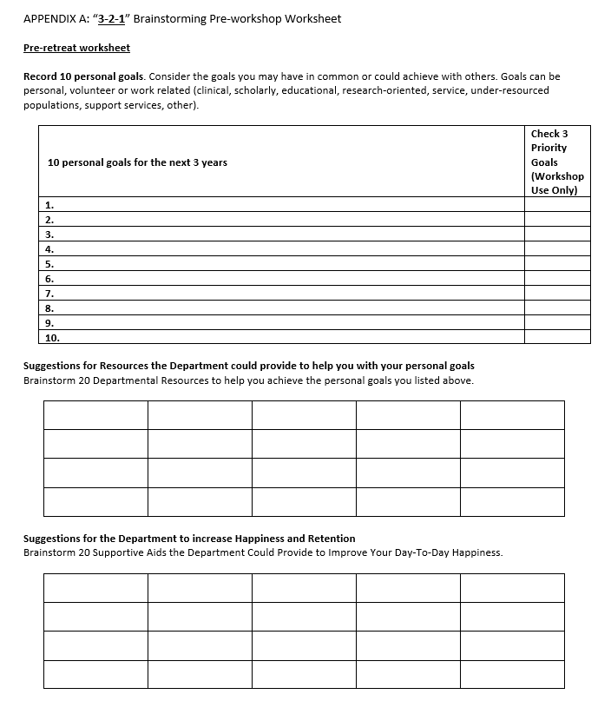
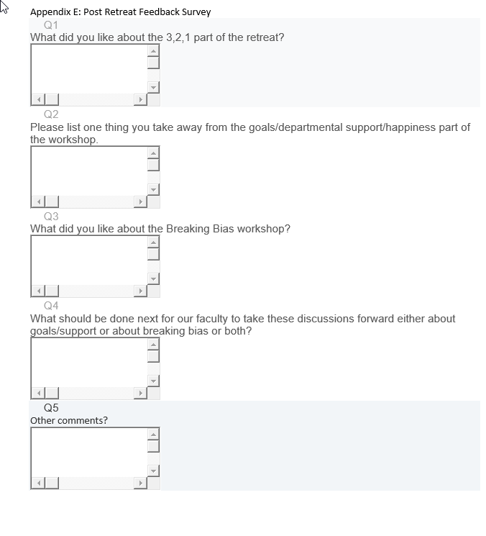
Advancing Collaboration and Networking in an
Academic and Family Medicine Department with a Developmental Retreat
Jane Fischer, MD, Meghan Connett, MD and Kelly Skelly, MD
The University of Iowa Carver College of Medicine, Department of Family Medicine
BACKGROUND
RESULTS (CONTINUED)
The current value of COLLABORATION in interprofessional patient care and teamwork is well documented.
Little is written about the benefits of collaboration on personal outcomes such as HAPPINESS and institutional outcomes such as FACULTY RETENTION.
2 Two departmental resources needed
Themes- examples
Department – Improved mentorship and collaboration opportunities
Technology / Wellness - More IT support opportunities, Mental Health Day / month
Research – Dedicated time, Research coordinator
Systems – Foster exchange with other institutions
Also Clinical Care and Service Themes
PURPOSE
1 One way to increase happiness
Themes- examples
Department – Support for morning after call
CME & Research – Advertise PI projects for ABFM certification
Clinic – Epic refresher course
Also Wellness and Systems Themes
Goal is for participants to DESCRIBE:
- 3 NEW connections with Family Medicine faculty
1 future goal supported by department resources
1 way the department can actively support faculty
METHODS
POST SURVEY RESPONSES
3 2 1 Faculty Retreat
“Nice way to learn about our colleagues, relaxing, fun. Gave us a chance to brainstorm ideas as a group to come up with our goals - personal and departmental”
“I enjoyed working in a smaller group. That was more effective than it would have been with the full faculty.” Comments suggested that more time would have been effective, stating “We could have honestly spent more time on the goals discussion. Each of us only named 1-2 of our goals.”
Attendees also noted, “Group Interaction, Resources and Happiness survey was most beneficial. Personal goals not as helpful although needed to do the resources, but we all strayed from the goals and said what we needed for Resources even if not personal goal related”
“We all have similar goals and frustrations! We are better as a whole than separate! There are some FANTASTIC ideas our colleagues have…”
Retreat = promote connections / collaboration
Before retreat:
Each participant developed:
10 PERSONAL goals for the next three years
20 DEPARTMENTAL resources desired to attain goals
20 IDEAS for the department to increase retention and overall happiness
Small groups used a “3-2-1” approach
Collaborating to create
three personal goals
two necessary departmental resources
one idea to increase happiness
Post retreat:
Goals were analyzed for common themes and integrated with comments from a post-evaluation survey.
CONCLUSIONS
3
2
1
Results revealed:
Most faculty desire more IT and scholarly activity support
Further research is needed to determine if CONNECTEDNESS within a department can promote PRODUCTIVITY, improve TEACHING techniques and RETAIN FACULTY
HYPOTHESIS: ongoing efforts will support and hopefully eventually reveal concrete evidence of these ideas
RESULTS
3 Three personal goals
Themes (examples)
Department – Apply for promotion
Education – Inc. research knowledge
Research – Work w/ PharmD to publish
Wellness – Retirement transition
Also Volunteer, Service & Clinic Themes
REFERENCES
1. Barsoumian AE, White BK, Yun HC. Teaching Antimicrobial Stewardship to Infectious Disease Fellows Through Simulated Interdisciplinary Scenarios. MedEdPORTAL. 2018;14.
2. Bronander K. Simulated Case of Pulmonary Embolism. MedEdPORTAL. 2009;5.
3. Crow S. Critical Synthesis Package: Index for Interdisciplinary Collaboration (IIC). MedEdPORTAL. 2015;11.
4. Kusnoor AV, Gill AC, Hatfield CL, et al. An Interprofessional Standardized Patient Case for Improving Collaboration, Shared Accountability, and Respect in Team-Based Family Discussions. MedEdPORTAL. 2019;15:10791.
5. Lairamore C, George-Paschal L, McCullough K, Grantham M, Head D. A Case-Based Interprofessional Education Forum Improves Students' Perspectives on the Need for Collaboration, Teamwork, and Communication. MedEdPORTAL. 2013;9.
6. Liederman Z, Tse B, Slapnicar C, et al. Improvement in Hematology Interprofessional Care: Simulation With an Emphasis on Collaboration. MedEdPORTAL : The Journal of Teaching and Learning Resources. 2020;16:11050-11050.
7. Richmond A, Burgner A, Green J, et al. Discharging Mrs. Fox: A Team-Based Interprofessional Collaborative Standardized Patient Encounter. MedEdPORTAL. 2017;13.
8. Wellmon R, Knauss L, Gilin B, et al. Use of a Video-Based Case Study to Promote Interprofessional Learning and Collaboration Skills. MedEdPORTAL. 2013;9.
9. Liederman Z, Tse B, Slapnicar C, et al. Improvement in Hematology Interprofessional Care: Simulation With an Emphasis on Collaboration. MedEdPORTAL. 2020;16:11050.
10. Darbyshire D, Gordon M, Baker P, Agius S, McAleer S. Systematic review of interventions to encourage careers in academic medicine. Medical teacher. 2018:1-7.
11. Frantz JM. A Faculty Development Strategy Among Academics to Promote the Scholarship of Research. Vol 42012.
CONTACT INFORMATION
jane-fischer@uiowa.edu

