Slide 1
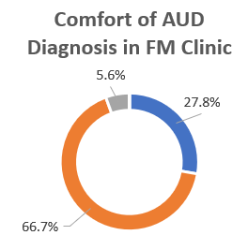
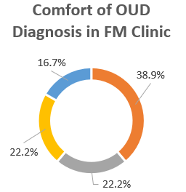
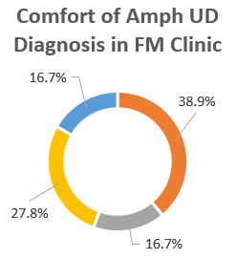
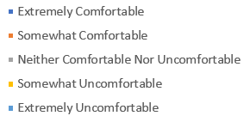
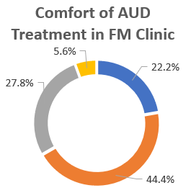
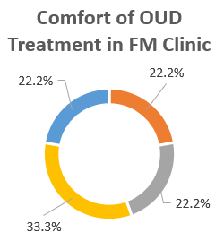
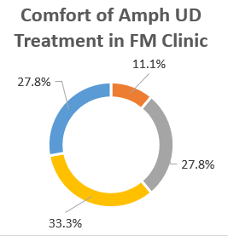
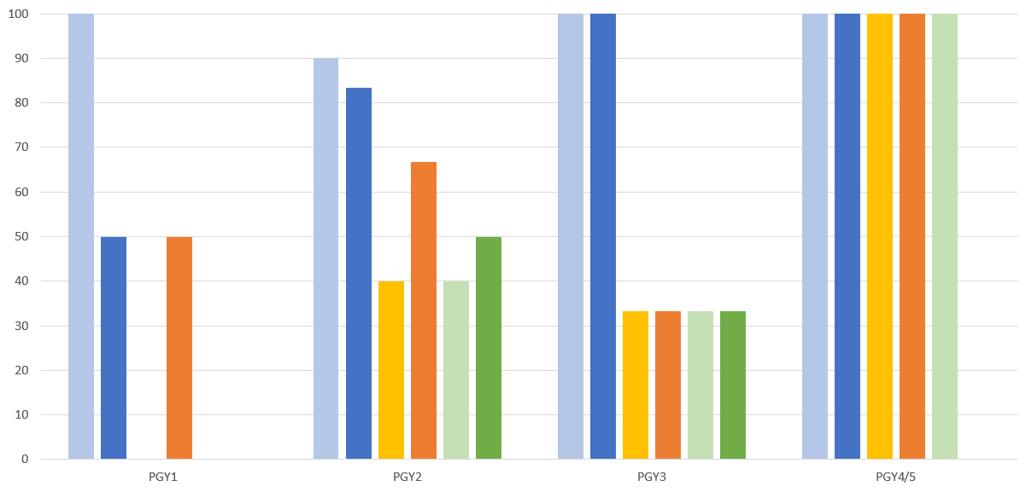
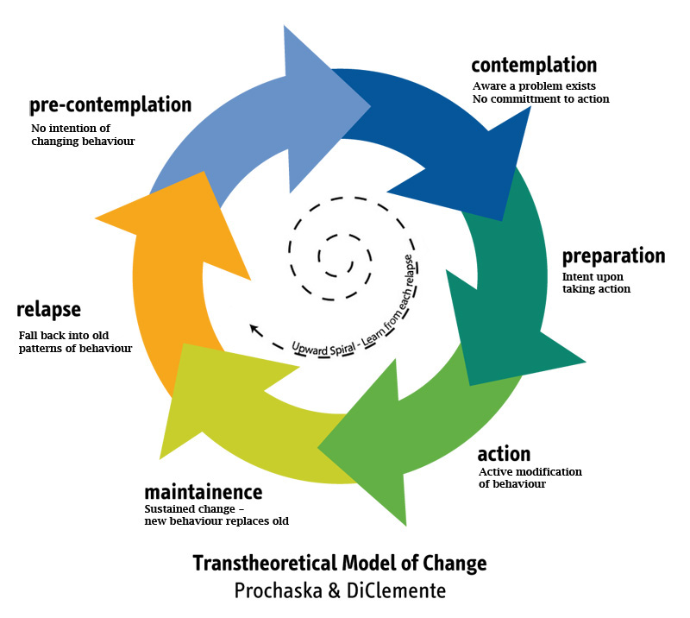
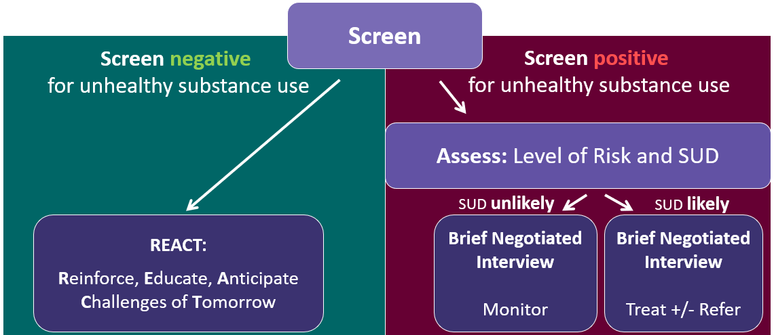
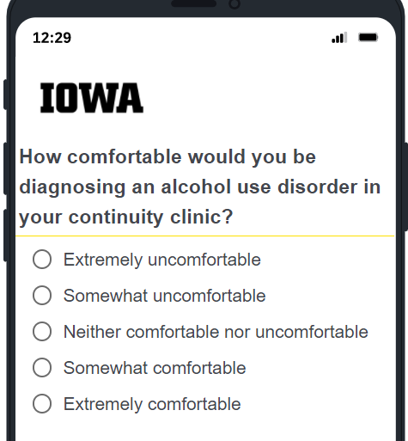
Addiction Screening, Diagnosis and Treatment in the Primary Care Clinic
Incorporation of the Brief Negotiated Interview
Nader Shakir, DO
Nicole Woodson-DeFauw, MD
Introduction
Substance use disorders (SUDs) are pervasive and have a large economic, social, and public health impact. As a result, screening, diagnosis and treatment of substance use disorders is vital aspect of public health, and primary care physicians, with their close patient relationships. The AAFP has recommended and recently updated Addiction Medicine curriculum for Family Medicine residencies. Brief Negotiated Interviews (BNI) have been demonstrated to be efficient ways to broach substance use in primary care.
IMPACT OF SUDs:
>85,000 deaths a year in the US are directly attributed to alcohol use
The total "economic burden" of prescription opioid misuse alone in the US is $78.5 billion a year
Methamphetamine use increased by 43% and overdose deaths due to psychostimulants other than cocaine (largely methamphetamines) increased by 180% in a five-year period ending in 2019
Results
Of 26 FM/FMP residents, 19 completed the pre survey and 12 completed the post survey
95% stated that they wanted to learn more about SUD diagnosis & treatment
Next Steps
This project was helpful for developing a curriculum/workshop that can easily be incorporated into Chronic Diseases block or an Academic half-day. The data overall was insufficient to demonstrate truly significant changes in practice and further longitudinal assessment will be needed to assess long-term practice change, however, preliminarily the results suggest overall increase in comfort level with the diagnosis and treatment of SUDs with better access to training materials and workshops.
A few additional thoughts given the post survey results:
>90% expressed interest in Suboxone waiver training and for it to be incorporated into the behavioral health curriculum
>50% expressed interest in an Addiction Medicine track
100% expressed interest in a quick sheet/handout outlining SUD diagnostic criteria, treatments, and BNI for reference (we are creating and distributing this based off of the workshop)
>90% expressed interest in a longitudinal addiction medicine didactic series (~1 lecture per month) relating to the theme of didactic topics that month
Lack of change in number treated is concerning, and points to greater importance of identifying ways to encourage SUD treatment implementation in FM clinic.
Preliminary Level of Comfort for the Diagnosis and Treatment of Substance Use Disorders
Methods and Materials
We set out to assess UIHC Family Medicine resident interest in addiction medicine, evaluate their current comfort level in the diagnosis and treatment of common SUDs (alcohol, opioid, and amphetamine), and the frequency of diagnosis and treatment of patients over the last 3 months. We identified these with the use of a preliminary survey of residents.
Our intervention included a workshop with PGY2s during the Chronic Diseases month, during which we reviewed common screening methods for SUDs, presented the DSM-V diagnostic criteria, and practiced use of BNI in the primary care setting. We then assessed impact of the workshop by comparing pre and post surveys for the PGY2s and utilized other classes as non-matched controls.
Percentage of Residents by Class Pre/Post – Somewhat/Extremely Comfortable
Acknowledgments
A special thank you goes to Monika Jindal, MD for assisting and guiding us in the development and implementation of the project, as well as Alison Lynch, MD, MS for advising regarding areas of evaluation and developing ideas for assessment.
So much thanks also goes to the FM/FMP residents who participated in the workshop and completed the surveys for making this possible.
*PGY1 & PGY4/5 levels may be skewed due to limited number of responses
Post-Workshop
The post-workshop survey did demonstrate increase in resident comfort levels for diagnosis (90% down to 83%) & treatment (60% up to 83%) of AUD, diagnosis (40% up to 67%) & treatment (0% up to 50%) of OUD, and diagnosis (40% up to 50%) & treatment (10% up to 50%) of amphetamine use disorder for the PGY2 class as compared to the pre-workshop survey. Self-reported comfort levels remained relatively stable for these for the other residency classes that did not participate in the workshop.
There was also an increase in the PGY2 reported number of patients diagnosed in clinic with SUDs in the last 3 months, but little change was noted in number treated.
References
AAFP Recommended Curriculum Guidelines for Family Medicine Residents - Substance Use Disorders
Boston University Clinical Addiction Research and Education (CARE) Immersion Training 2021- Brief Negotiated Interview.
UpToDate - Clinical assessment of substance use disorders article accessed Oct 2021

