Slide 1
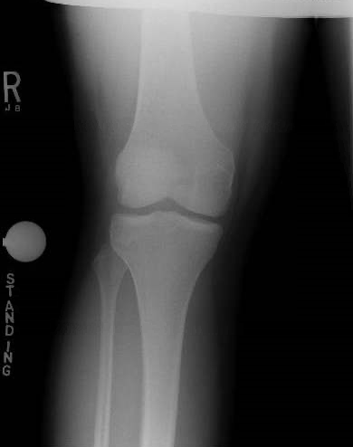
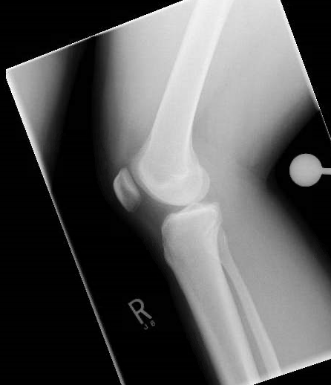
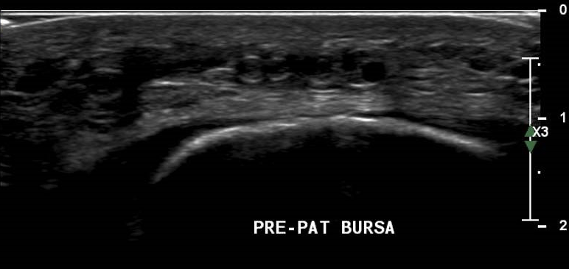
Chronic Knee Pain After A Motor Vehicle Accident: Dying For Answers
Stephen L. Peery, MD, Timothy W. Thomsen, MD
UI Sports Medicine – University of Iowa, Iowa City, Iowa
History
Physical Examination
Differential Diagnosis
17-year-old previously healthy male, presents to the Sports Medicine Clinic one week after an MVC with right knee pain.
An MRI showed no ligamentous injury. He was instructed to work with physical therapy.
Three months later, he presents to clinic again with continued pain, swelling and instability of the knee. He did not go to physical therapy, and was again encouraged to do so.
He presents to clinic again at the clinic for persistent pain seven months after the MVC. He reports the pain is worse just medial to the patella. He endorses worsening pain when standing and walking up stairs. The knee intermittently becomes swollen, red and warm. He denies popping or locking of the knee.
Seven months after MVC
Vitals: BP: 150/93 HR: 93 BMI: 40.47
Right knee
Visual inspection: No erythema, ecchymosis, swelling, or atrophy.
Palpation: No tenderness along the patella tendon or quadriceps tendon. No medial or lateral joint line tenderness. Some medial and lateral peripatellar soft tissue tenderness. There is a mobile object superior to patella that is tender to palpation.
Range of motion: 150 degrees of flexion and extends past 0 degrees.
Special testing: Lachman, anterior and posterior drawer negative. Varus and valgus stress test negative. McMurray’s negative with medial and lateral stressing. Patella apprehension negative.
Strength: 5/5 knee flexion and extension.
Neuro: Sensation is grossly intact.
Prepatellar bursitis
Hematoma
Lipoma
Fat necrosis
Retained foreign body
Imaging
Right Knee Plain Films
Ultrasound of the Right Knee
Photo of excised tissue
Unremarkable for fracture, dislocation and soft tissue abnormalities.
Arrows indicating multiple non-compressible anechoic spherical bodies located in the pre-patellar bursa.
Multiple fatty bodies and firm fat removed from Morel-Lavallée lesion.
Final Diagnosis
Fat necrosis
Treatment
Week #2
Month #3
Months #7 – #8
Week #1
Months #9 – #10
He returns to sports medicine with continued knee pain and intermittent swelling. He did not attend PT.
He presents to sports medicine. He stopped going to physical therapy due to knee swelling and pain.
He complains of acute right knee pain. X-ray is negative for fracture and dislocation.
Point of care ultrasound shows a minimal amount of fluid in the pre-patellar bursa.
He is given a compression sleeve and is instructed to go to PT.
A mobile body palpated on knee exam.
Diagnostic ultrasound shows spherical bodies consistent with calcified fat necrosis.
Head and maxillofacial CTs are negative.
Superficial firm fatty tissue was resected.
Multiple fatty bodies and deep firm fat necrosis were removed from within the Morel-Lavallée lesion.
High speed motor vehicle collision. He is ambulatory on scene.
PCP refers patient to sports medicine due to continued pain.
He elects to have plastic surgery excise the fat necrosis
He has a palpable defect on exam and there is concern for possible quad tendon injury.
MRI demonstrates intact quad tendon. No other intraarticular pathology noted.
He is instructed to go to PT.
Take-Home Message
Morel-Lavallée lesions are commonly associated with shear force. It is a closed degloving injury that separates the dermis from the underlying fascia. Blood, lymph and fatty debris collect in the lesion. If undiagnosed, it can lead to chronic swelling and fat necrosis. Treatment consists of non-surgical management, aspiration or surgical debridement.

