Slide 1
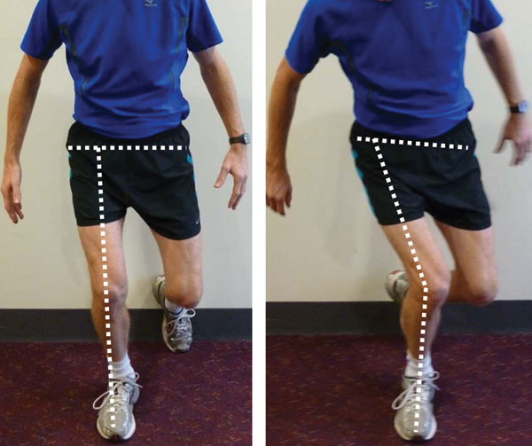
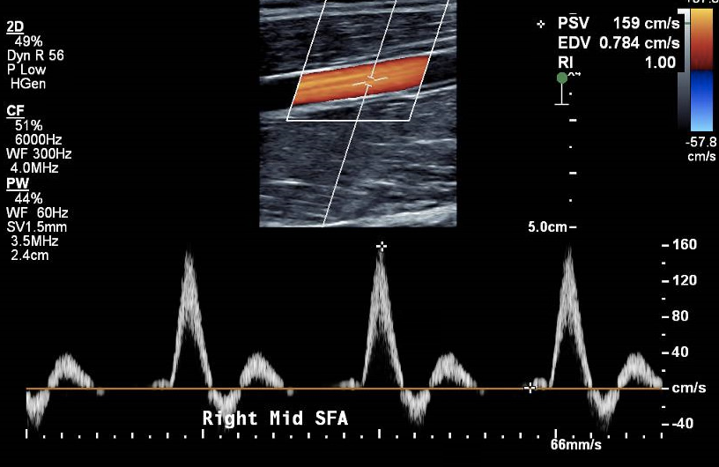
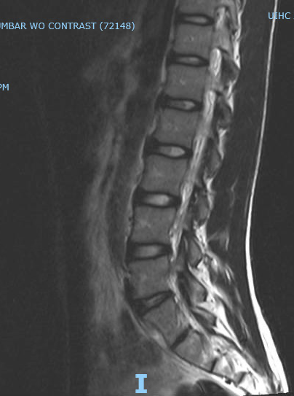
Exertional Right Leg Numbness In High Level Distance Runner
Josh Schulte¹, Tyler Slayman, MD¹
1. UI Sports Medicine – University of Iowa Hospitals and Clinics, Iowa City, Iowa
History
Physical Examination
Differential Diagnosis
17 y.o. male high school distance runner with PMHx of heart murmur and ITBS, presents with a chief complaint of 3-year insidious onset, atraumatic worsening right lateral leg numbness with activity. States this feels different than previous ITBS. Symptoms are only present with high intensity and longer workouts (5:45 mile for more than 2-3 miles). Symptoms start as vague lateral thigh numbness that radiates anteriorly and proximally the further he runs, climatically he "loses control of his leg and becomes weaker". If he stops and stretches, symptoms are relieved temporarily. He denies symptoms below the knee. Symptoms resolve 5-10 minutes after exercise, and he may have asymptomatic periods lasting weeks to months.
Normal general physical exam, normal right leg inspection.
Mild discomfort over LFC with palpation. Nontender over ITB, GT and TFL.
Normal ROM, strength, gross neurological exam bilaterally, and special maneuvers
Dynamic knee valgus on single leg squat bilaterally R>L
Iliotibial Band Syndrome
Meralgia paresthetica (MP)
Chronic Exertional Compartment Syndrome
External Iliac Endofibrosis
Lumbar radiculopathy
Tests and Results
Lumbar MRI - normal.
Gait analysis - Minute 14 of 18, running at a sub-6-minute mile pace, there was minor exertional gluteal weakness causing limited hip abduction on the symptomatic side. Thus, the planted right leg crosses midline more than left, followed by onset of symptoms.
Diagnostic ultrasound of right thigh and knee- normal to sonopalpation at LCFN.
Right leg arterial ultrasound - normal.
CTA for external iliac artery endofibrosis evaluation - normal.
NCS/EMG - normal.
Labs - normal
Return to Play
Outcome
He has returned to full participation in off-season, high school distance running training.
During the workup, the patient had decreased symptoms. He is using a percussion massage device on his TFL, with relieved symptoms. Now he is not experiencing symptoms during his workouts. We believe he could benefit from comprehensive PT, working to create balance in activation patterns. PT will strengthen, stabilize, and mobilize the muscles associated with the lumbar spine, the hip, and legs.
Final Diagnosis
Entrapment of LFCN of the thigh due to overactivation of the tensor fascia lata, secondary to hip abductor weakness
Take Home Message
On-going research related to exertional leg pain has produced an array of diagnoses, including stress fractures, compartment syndromes, nerve compression/MP, and vascular abnormalities(1). However, most of these diagnoses would yield a positive finding during the workup. One of these diagnoses, MP, typically yields a positive finding on NCS after the presentation of lateral thigh sensory deficit(2). Yet, there is scant research related to exertional MP as most diagnoses are made in obese or post-surgical patients. Given the variable course of the LFCN and the typical sensory nerve deficit, this case may add evidence that MP could be seen during exertion with resolution of symptoms at rest.

