Slide 1
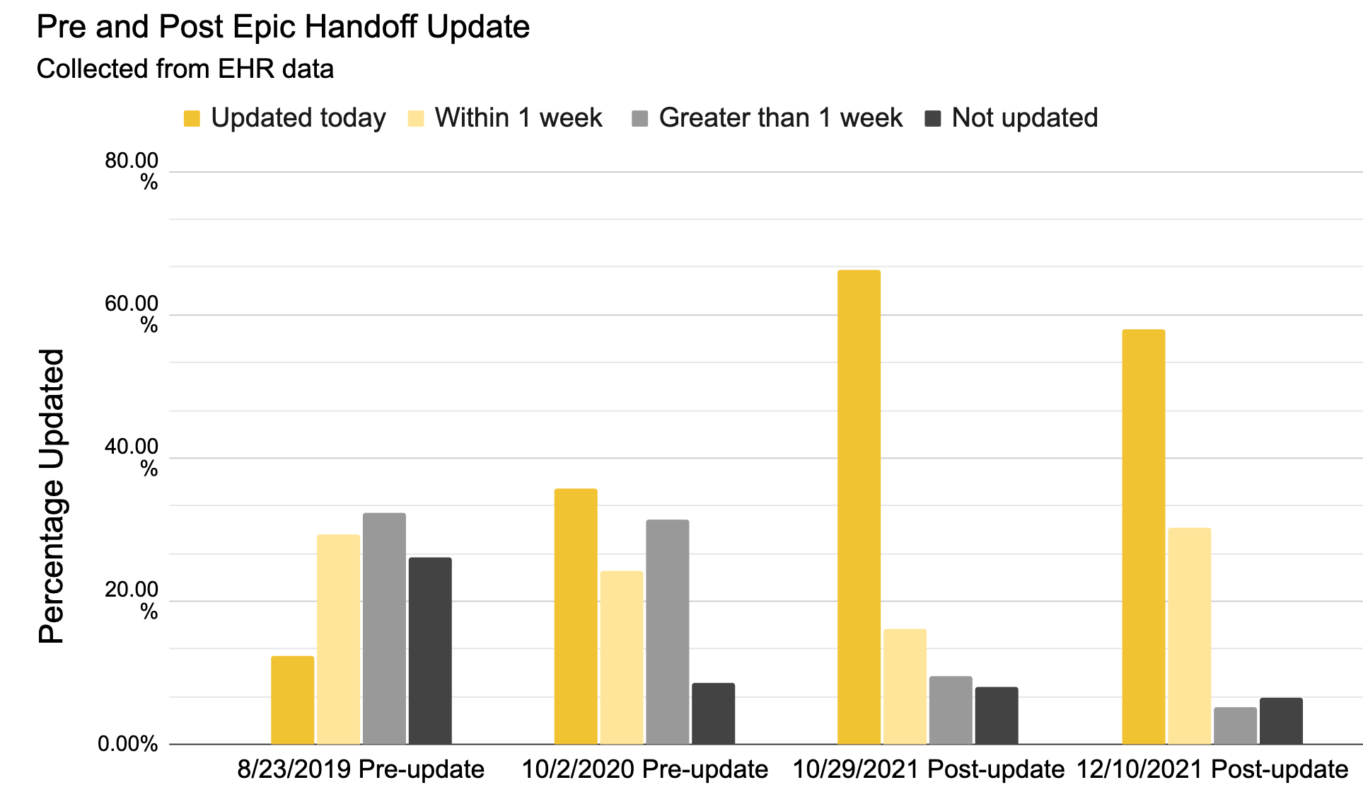
Epic® Update of the UIHC Inpatient Psychiatry Units' Handoff Tool
Kate Jarvis, MD and Nicole Woodson-DeFauw, MD
Family Medicine Psychiatry Residency, University of Iowa Hospitals & Clinics, Iowa City, IA
Background
Plan
Discussion
-Inpatient psychiatry handoffs were seldom updated
-Lacked the relevant information to make on call decisions
-Inpatient family medicine handoff tool is used as a daily round tool; progress note generator and handoff to the on-call team.
"The Problem"
Two handoffs between short-call and overnight call resident
86+ psychiatry inpatients making verbal handoff too lengthy
Relevant information for all teams
EHR barriers
refreshing daily, not linked to progress note, duplicating work
PSYCH-PASSO
Patient Summary
XX yo female/male/nonbinary admitted on date for ***
Situation awareness
observation status; hold; voluntary; (for EDO could be level)
Y whY(still) here
medication titration; need safety plan; placement; needs psych bed; detox
Co-morbidities
Heart disease, diabetes, kidney disease, seizures, asthma, HTN
Hemodynamics
stable, unstable
Pharmacology/PRNs
Medication list; ok to give benzo; no benzo; redirect; AWS; avoid:
Action list
follow up Am labs; follow up PM labs; call family; touch base w/ SW
Specifics
Behavior plan, recent seclusion or restraints, any visitor restrictions
Synthesis
if asks to leave: get a hold; safety plan
Overnight events
Leadership preference was not to convert the handoff to generate daily progress notes which ultimately limited incorporation into the daily workflow
After updates and resident staff education; we increased handoff daily completion by an average of 38%
We received 16 pre survey and 12 post survey responses from residents
While there was an increase in percentage completed, residents reported there was still a high percentage of times that it was not updated when they needed it.
Overall, resident satisfaction still low due to the time it takes to complete and not being part of the daily workflow
Aim
To use the Family Medicine inpatient handoff tool as a template to increase the use of the Psychiatry handoff tool by 50% over three months by the on-call Psychiatry residents.
Future Directions
Meet with more stakeholders to discuss how best to Incorporate into daily workflow
Reduce redundancies by removing the 'Synthesis" heading
Increase Resident education on importance of handoff tool by incorporating a session into resident orientation
Materials and Methods
Identifying the problem
Survey Junior residents to poll main uses as well as barriers
Survey Inpatient Staff for main printed/rounding uses
Collected time stamps from handoffs of each patient
Problem solving
Leadership preference was not to convert handoff to generate daily progress notes
Literature Search for effective handoff strategies
Found an article that used the acronym PSYCH-PASS for a verbal handoff for their on-call teams
Meetings w/ stakeholders to incorporate new tool
Decided to use the pneumonic PSYCH-PASSO to incorporate overnight events
Roll out
Presented new tool and handoff importance for transitions of care to inpatient staff and resident led meetings
Follow up
Post survey on resident satisfaction
Recollected stamps from handoffs of each patient
Results
References
Asch, D. A., & Parker, R. M. (1988). The Libby Zion case. New England Journal of Medicine, 318(12), 771–775. https://doi.org/10.1056/nejm198803243181209
Patel, D.A., Arshed, A., Woulfe, J. et al. “PSYCH-PASS”: the Development, Adaptation, and Implementation of a Psychiatric Handoff. Acad Psychiatry 43, 503–506 (2019). https://doi.org/10.1007/s40596-019-01068-0

