Slide 1
Between a Shock and a HLHard place
Special ID Grand Round
Christine Cho
Corey Parlet
12/1/2016

Slide 2
No disclosure

Slide 3
Just another septic arthritis…..
32 yof with history of SLE (methotrexate+hydroxychloroquine), asthma, and hypertension presenting with right knee pain x 1 week after a fall.
10/14/2016: fall and subsequent right knee pain
10/20/2016: OSH. Right knee aspiration TNC=43,000 (95% PMN), RBC=26000, negative crystals. Started vancomycin+pip/tazo+clindamycin
10/20/2016: arthroscopic I&D. cultures no growth.
10/21/2016: hypotensive shock on pressors. Transferred to UIHC
Notes:
Genesis west: operative note showed hyperemic synovium and a lot of murky synovial fluid. Large lavage was performed.

Slide 4
Past Medical History:
SLE
Fibromyalgia
Hypertension
GERD
Asthma
Morbid obesity
Medication:
Methotrexate IM 25mg weekly
Hydroxychloroquine 200mg twice daily
Aspirin 81mg daily
Metoprolol 20mg twice daily
Folic acid
Loratidine/ranitidine
Omeprazole
Iron supplement
gabapentin
Social history:
denies tobacco, alcohol or illicit drug use. Sexual history unknown
Family history:
heart failure in mother
Allergy:
sulfa, codeine, hydrocodone
Past Surgical History:
Cholecystectomy
Cesarean section
Tubal ligation
Coronary angiogram and left ventriculogram (6/7/2016 at age 32)
EGD/colonoscopy
Notes:
SLE: diagnosed in 2012. (+ANA/oral ulcers/pericarditis/malar rash/photosensitivity). Methotrexate+hydroxychloroquine+folic acid. Last flare was 3 months ago (prednisone). No history of joint pain

Slide 5
UIHC course…
10/23/2016: respiratory failure requiring intubation. Levophed requirement trending up. ID consult
10/24/2016: renal failure started on CRRT. repeat right knee aspiration done. TNC=31,870 (95%), RBC=1,612,000
10/25/2016: CT chest/abdomen/pelvis
10/27: CT right leg
10/25-10/29: Levophed requirement trending down but worsening fever and leukocytosis.
10/31/2016: OR for open I&D and Immunology consult
Notes:
CT c/a/p (10/25): no PE. Grossly stable mixed groundglass and interstitial prominence in the lungs, consistent with infiltrate vs pulmonary edema. Very minimal inflammatory changes around the second portion of duodenum suggests a mild duodenitis. No large foci of inflammation, abscesses or other areas of inflammation. Mild enlargement of the main pulmonary artery, consistent with pulmonary hypertension.
CT leg (10/27): mild to moderate fluid in the suprapatellar pouch of the right knee with evidence of chronic synovitis. Nonspecific finding, indolent infection cannot be excluded. Trace pelvic ascites
OR: hematoma both superficial and deep to the fascia. No purulence present. Extensive debridement. Pathology showed granulation tissue with chronic inflammation and scant admixed neutrophils. No typical histologic features of IgG4-mediated sclerosing disease. Right knee tissues (10/31): no growth
Immunology: Henter’s criteria as updated in 2004 for primary HLH in children (used for secondary HLH by proxy)
1. Fever ≥38.5°C
2. Splenomegaly- CT at OSH with spleen documented as 11cm
3. At least two cytopenias:
Hemoglobin <9 g/dL
Platelets <100,000/microL
Absolute neutrophil count <1000/microL.
4. Hypertriglyceridemia (fasting triglycerides >265 mg/dL) and/or hypofibrinogenemia (fibrinogen <150 mg/dL)
5. Elevated soluble CD25 ( IL-2 receptor alpha) two standard deviations above age-adjusted laboratory-specific norms
6. Low or absent NK cell cytotoxic activity
7. Ferritin >500 ng/mL This ferritin is an acute phase reactant which different from the iron storage ferritin in that it is non-glycosylated. The glycosylated ferritin test is only available as a research tool and is not yet available for diagnostic purposes.
8. Hemophagocytosis in bone marrow, spleen, lymph node, or liver.
Our patient: 5/8. fever, splenomegaly, 2 cytopenia, hypertriglyceridemia (290 while on propofol), ferritin (60820)

Slide 6
Pip/tazo
Vancomycin
Clindamycin

Slide 7
Microbiology:
Right knee aspirate (OSH 10/20 both aspiration and intra-operative): no growth
Blood culture (OSH): Coagulase negative Staphylococcus (only 1 set drawn)
C.difficile toxin (10/21): negative
Blood culture (10/21): no growth
Blood culture (10/22): no growth
Influenzae A/B (10/22): negative
BAL (10/24): negative for routine cultures, Legionella
Gonorrhoea PCR (10/24 endocervical): negative
Right knee joint (10/24): many PMN, no organisms. No growth
HIV (10/25): negative
Cryptococcal serum antigen (10/25): negative
Blood culture (10/27): no growth
Blood culture (10/29): no growth

Slide 8
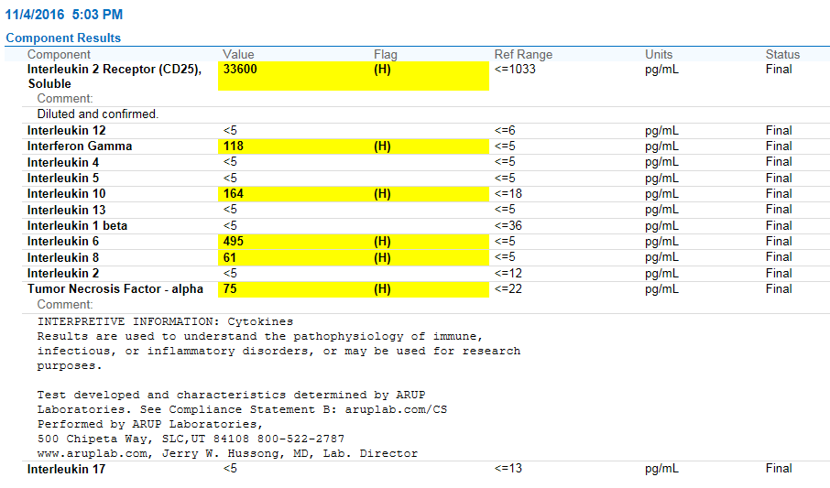

Slide 9
Questions
What is toxic shock syndrome?
What is the role of the super-antigen to pathogenesis?
What are host/pathogen factors dictating infectious outcome?
What are therapeutic interventions available and being experimentally pursued?

Slide 10
Questions
1. What is Toxic shock syndrome?
2. What is the role of the super-antigen to pathogenesis?
3. What are host/pathogen factors dictating infectious outcome?
4. What are the therapeutic interventions available and being
experimental pursued?

Slide 11
Toxic shock syndrome (TSS)
An acute life threatening illness usually precipitated
Staphylococcal aureus or Streptococcus pyogenes
infection
Diagnostic criteria
-High Fever
-Hypotension
-Multi-organ failure
-Rash
-Desquamation of feet and palms
Hallmarks of a “cytokine storm”

Slide 12
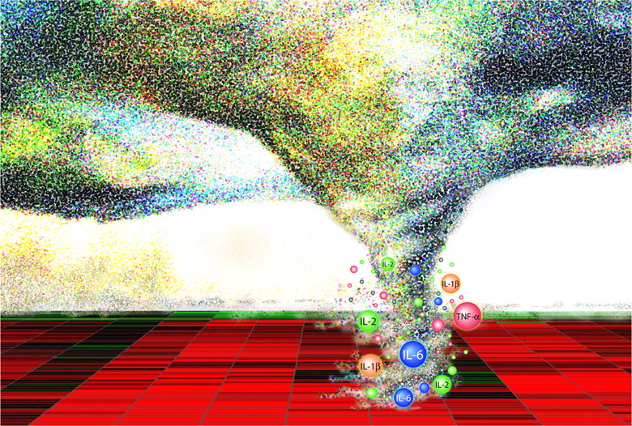
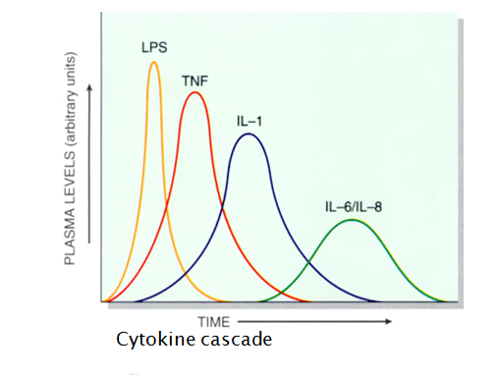
Cytokine storm
Cytokine Storm: excessive/uncontrolled release of inflammatory cytokines
Cytokine storms are associated with a wide variety of infectious and non-infectious diseases-etiological agents are often difficult to differentiate clinically
Jennifer R. Tisoncik et al. Microbiol. Mol. Biol. Rev. 2012;76:16-32
Medicineebbs.com.

Slide 13
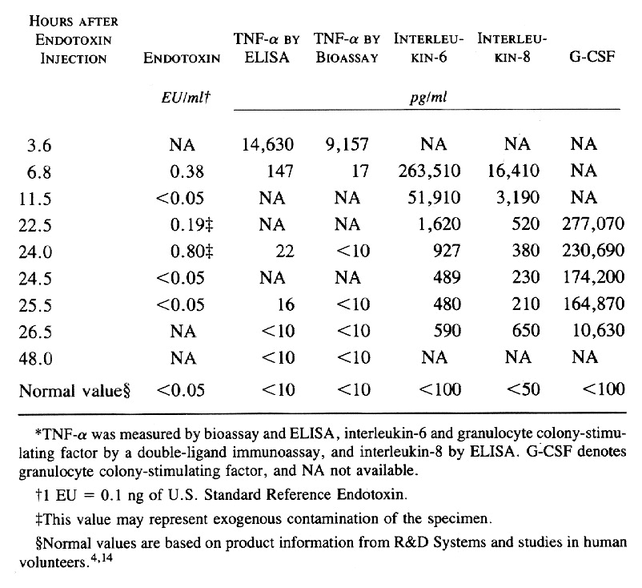
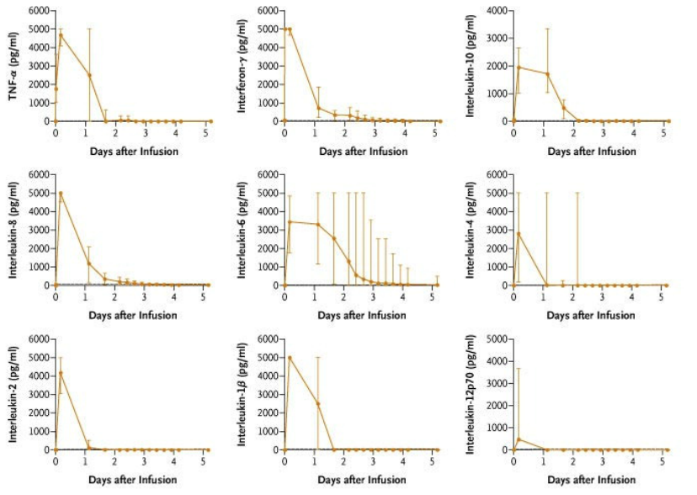
da Silva AM et al. N Engl J Med 1993;328:1457-1460.
Clinical course of cytokine storm following single dose exposure to potent immunogenic stimuli
LPS
CD28 Agonist
Suntharalingam G et al. N Engl J Med 2006 ;355:11018-1028.

Slide 14
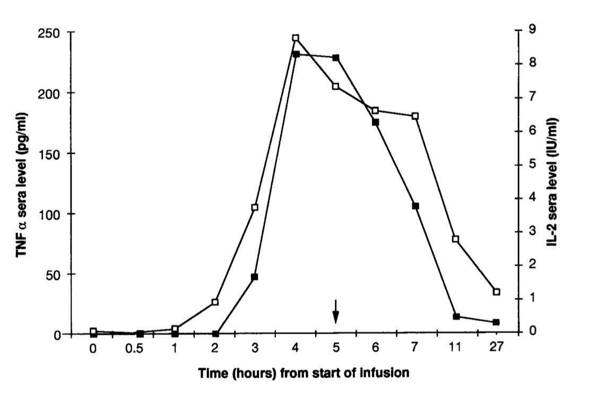
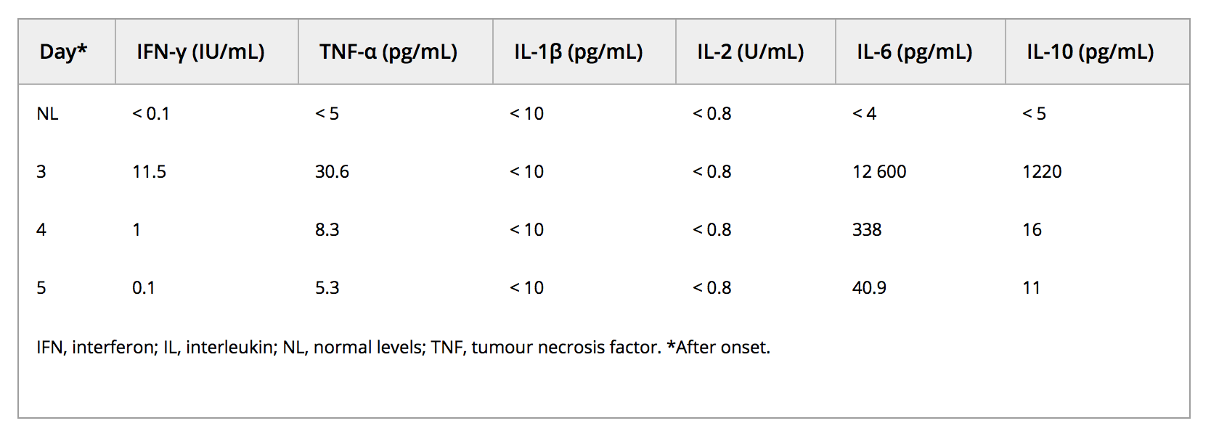
Clinical course of cytokine storm following exposure to S .aureus super antigen
Seishima et al. Clin Exp derm. 2009
Giantonio et al. J Clin Oncol. 1994-2007. 1997

Slide 15
1. What is Toxic shock syndrome?
2. What is the role of the super-antigen to pathogenesis?
3. What are host/pathogen factors dictating infectious outcome?
4. What are the therapeutic interventions available and being
experimental pursued?

Slide 16
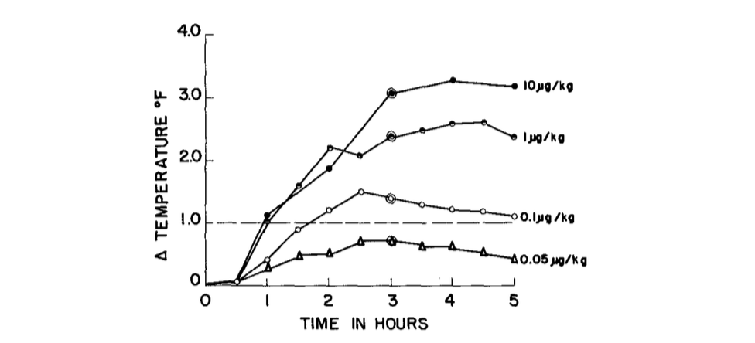
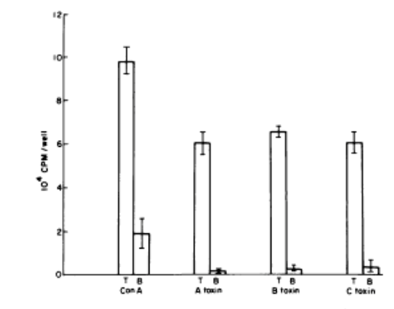
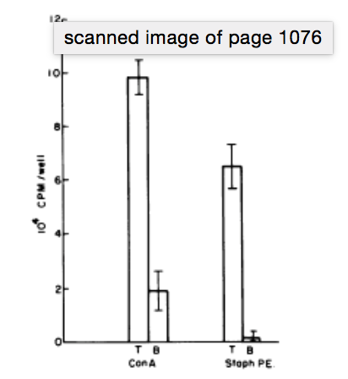
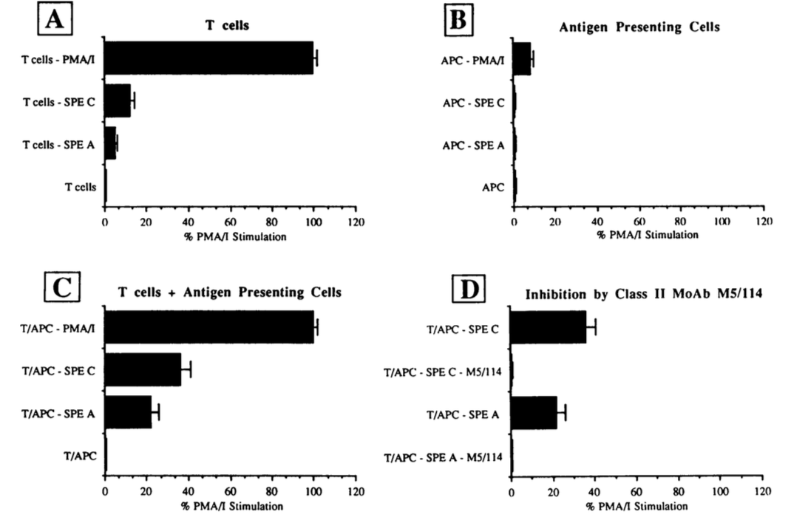
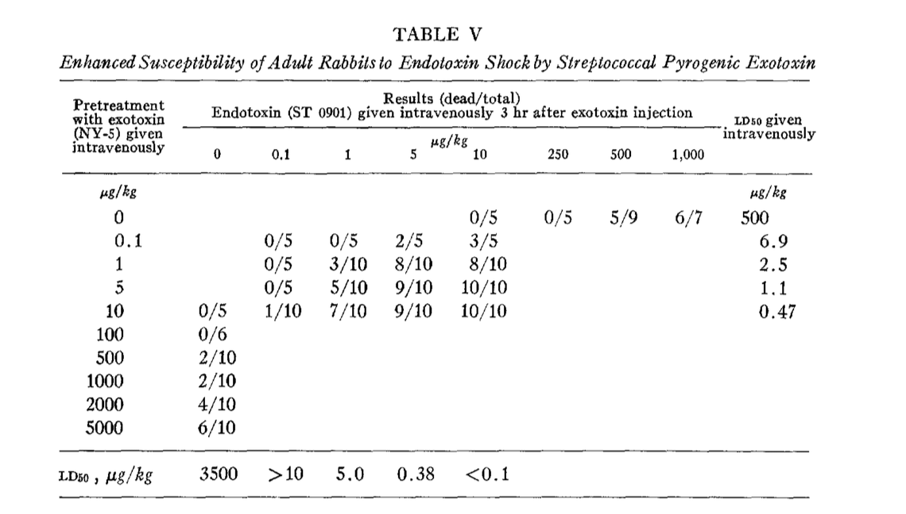
Super-antigen mediated pathology depends on T cells and accessory cells (APCs)
Schlievert, Schoettle, Watson. Infect Immun 1979 1075-1077
Watson & Kim J Exp Med, 1970
Leonard, Lee, Jenkins, Schlievert. Infect Immun. 1991 .1210-1214

Slide 17
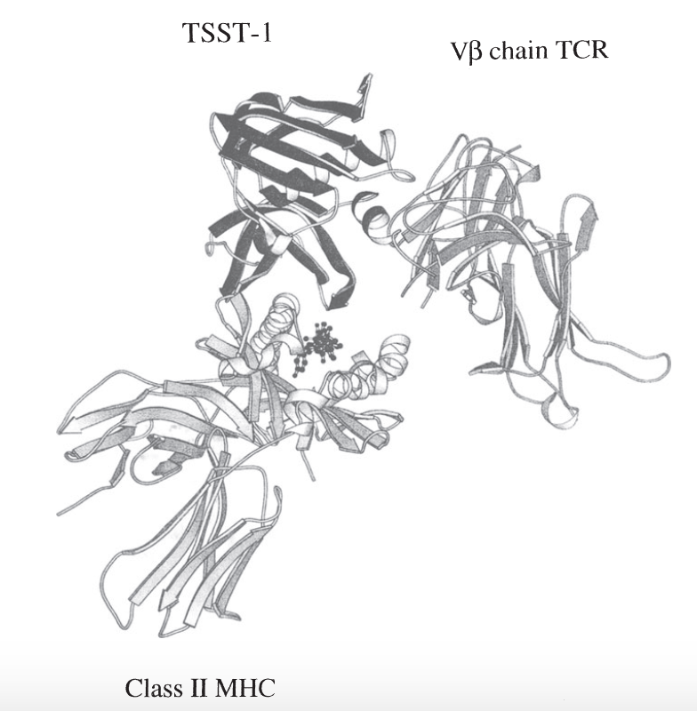
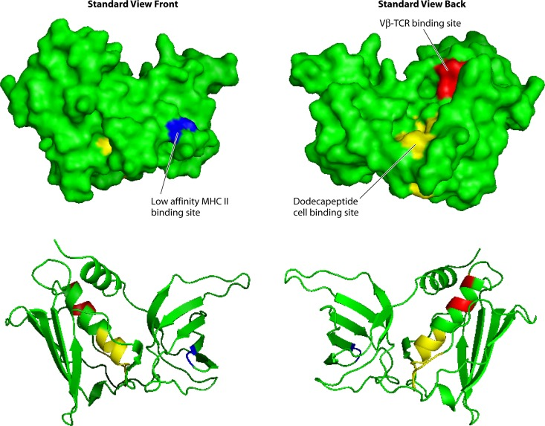
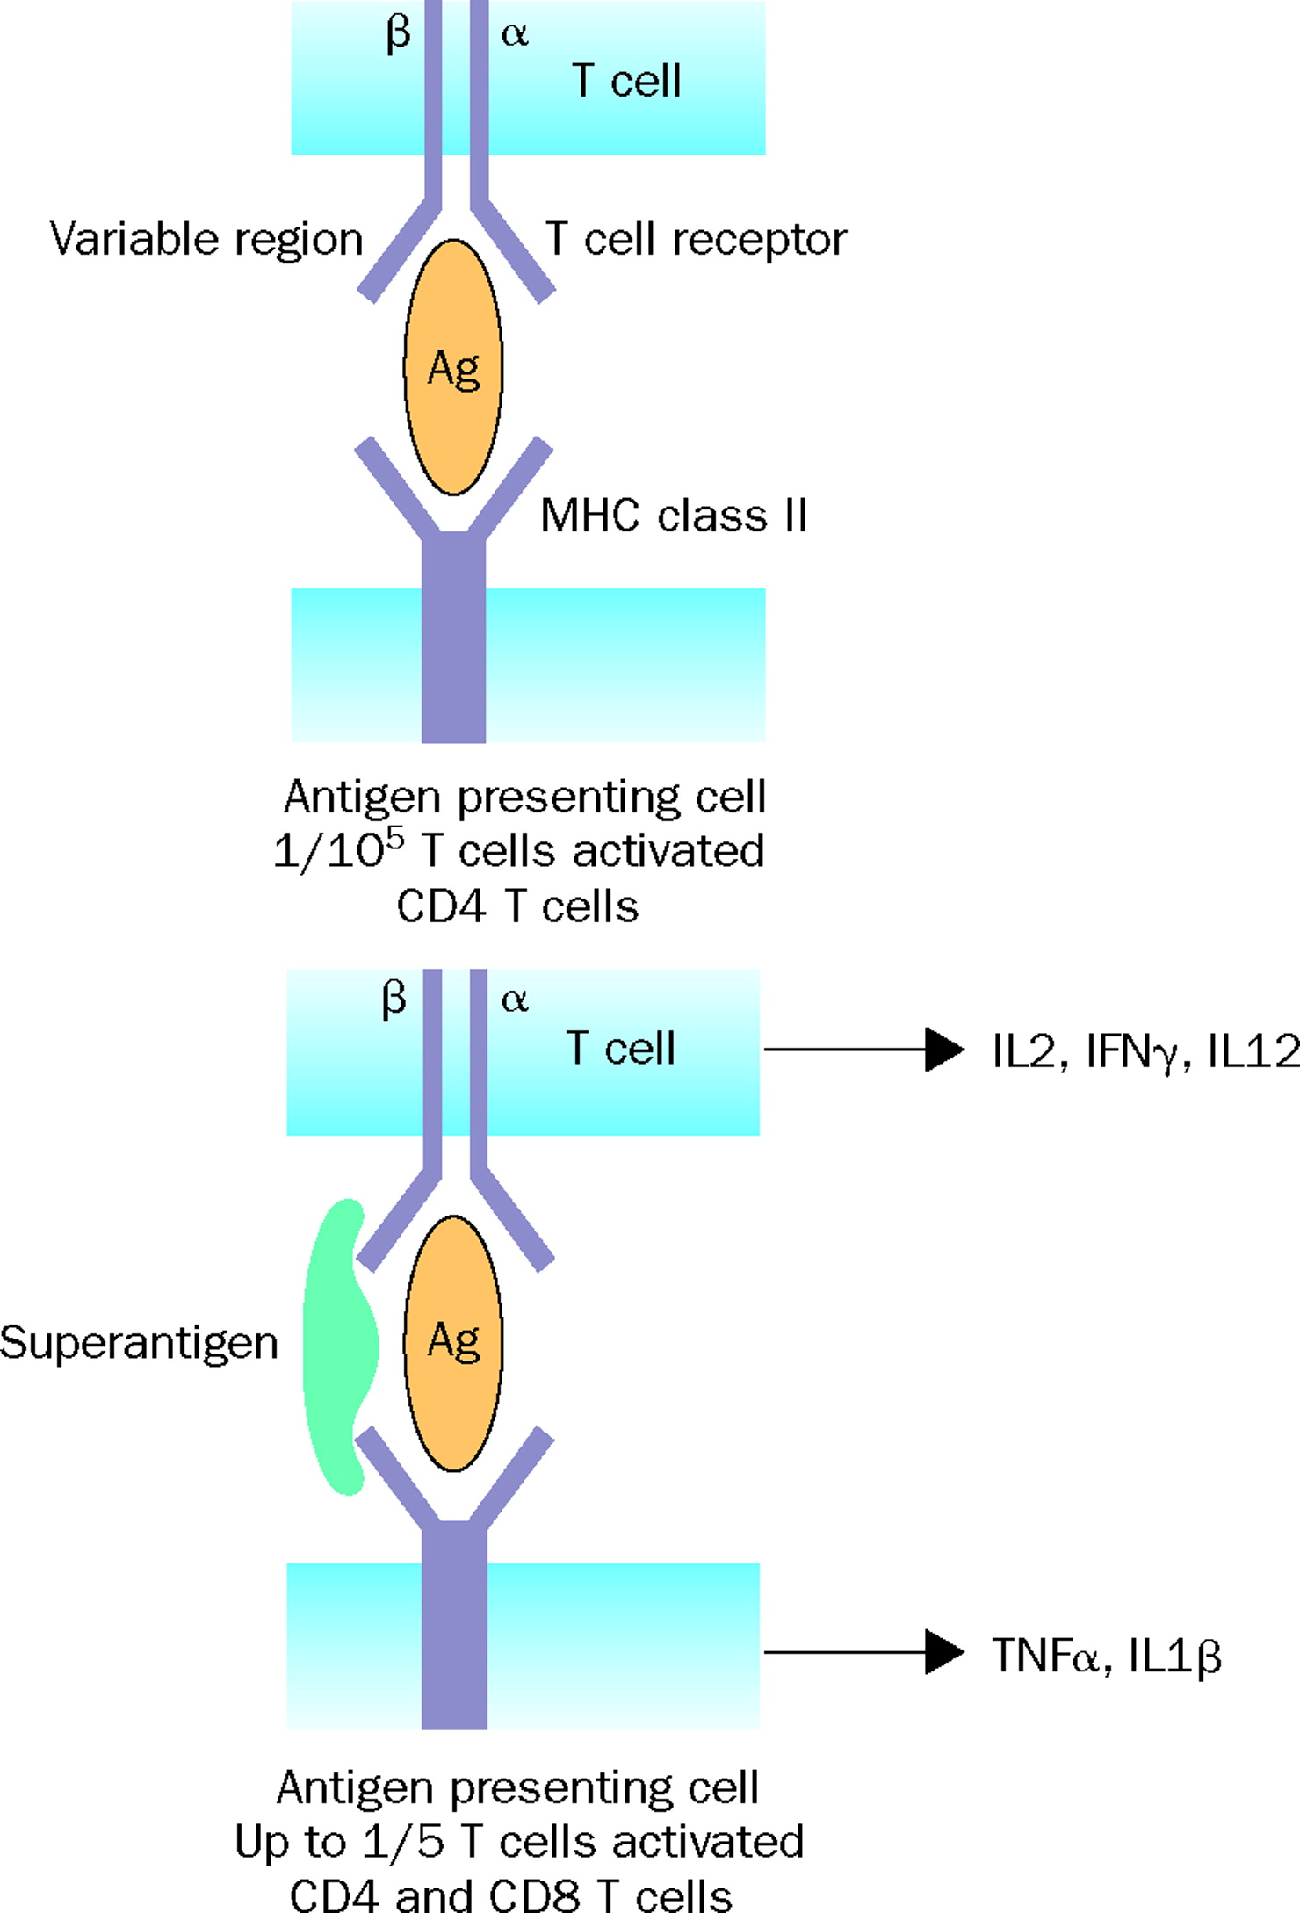
Super-antigens mediate T cell receptor/MHC II cross-bridging
Dinges et al. Clin Micro Rev. 2000
Spaulding et al. Clinical microbiology Reviews. 2013
Lleweyn and cohen Lancet
Infectious Diseases. 2002

Slide 18
1. What is Toxic shock syndrome?
2. What is the role of the super-antigen to pathogenesis?
3. What are host/pathogen factors dictating infectious outcome?
4. What are the therapeutic interventions available and being
Pursued experimentally?

Slide 19
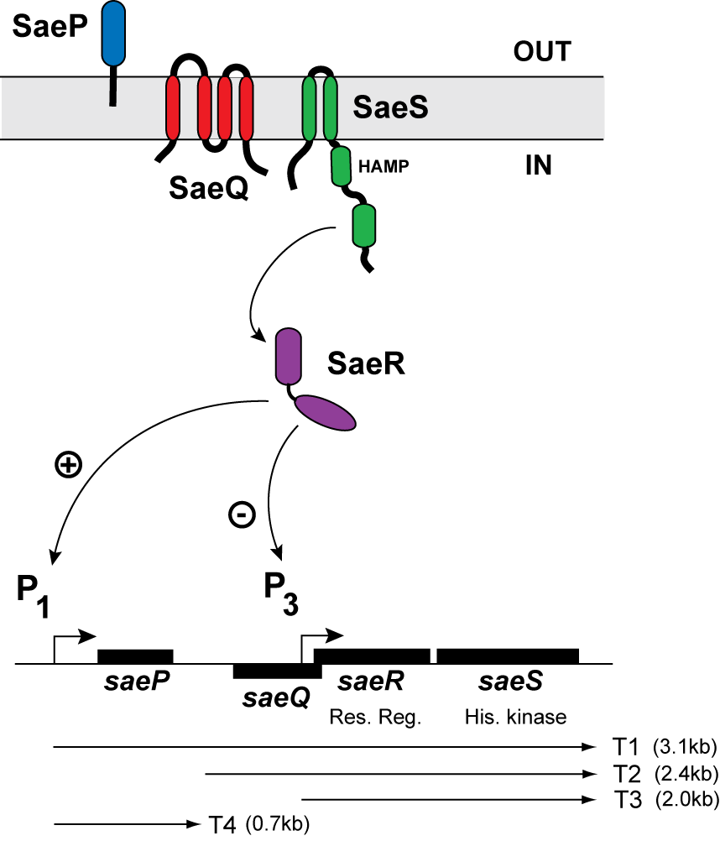
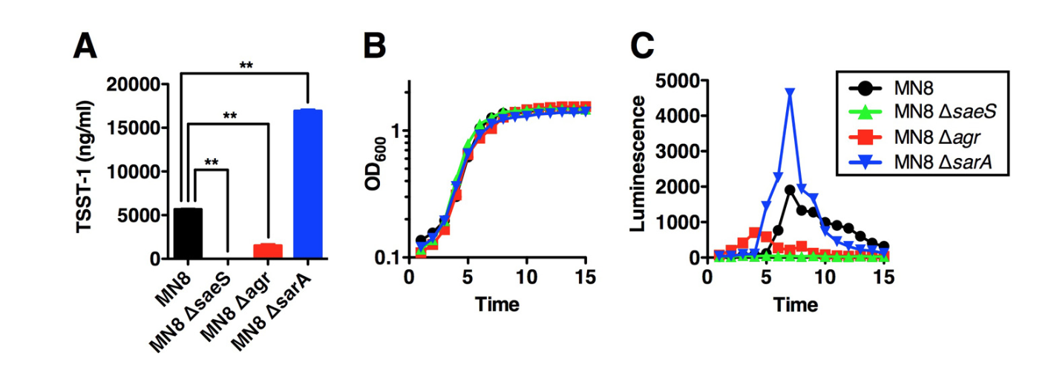
Super antigen regulation
Baroja et al. J Bact. 2016
Virulence factor
induction

Slide 20
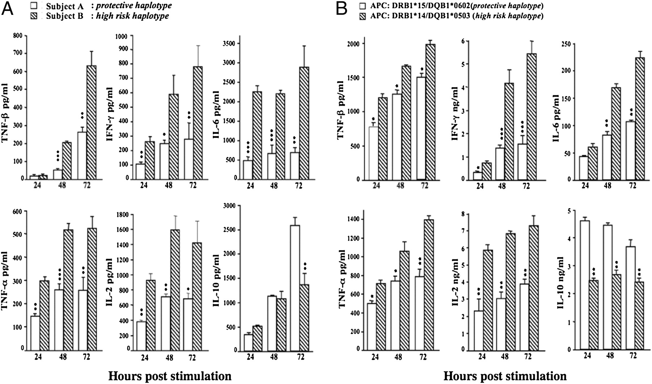
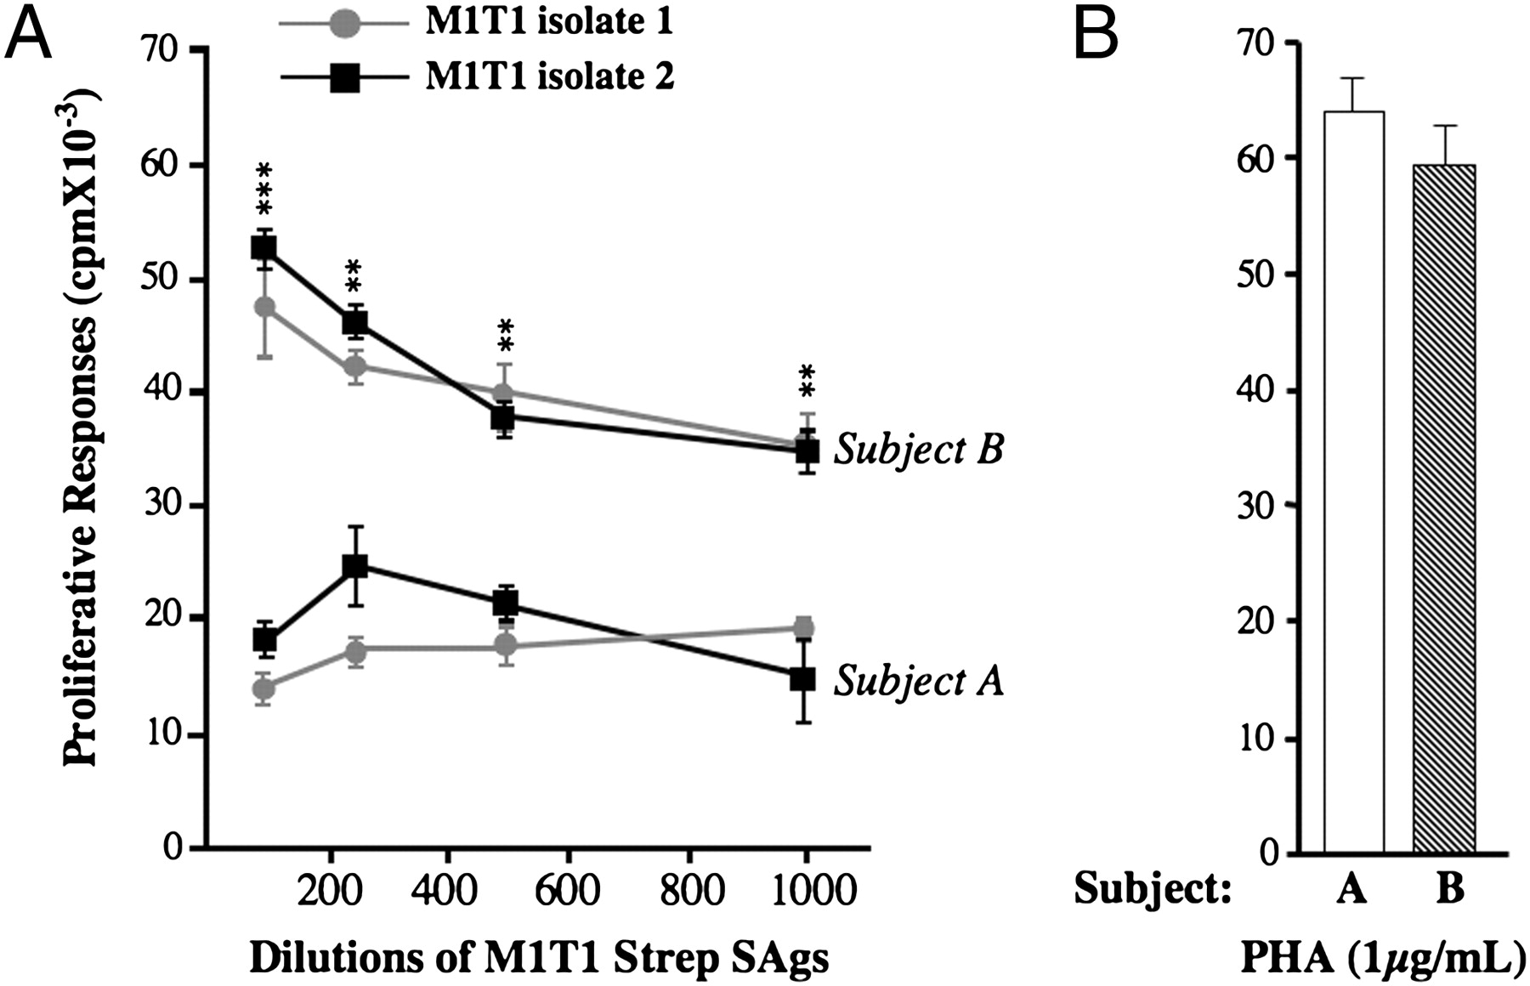
Genetic background of the host MHC CL II
Individual variation in proliferative responses to the native mixture of Strep-SAgs secreted by M1T1 GAS isolates from severe and nonsevere invasive streptococcal cases.
©2011 by American Association of Immunologists
Mohammed M. Nooh et al. J Immunol 2011;186:3156-3163
Notes:
In addition to inherent and environmental factors, host genetic
variations play an important role in susceptibility and outcomes
of virtually all infectious diseases
Individual variation in proliferative responses to the native mixture of Strep-SAgs secreted by M1T1 GAS isolates from severe and nonsevere invasive streptococcal cases. PBMCs (2 × 105/well) from subject A (expressing STSS-protective HLA-II alleles) and from subject B (expressing STSS high-risk HLA-II alleles) were stimulated in triplicate with the indicated serial dilutions of the native mixture of SAgs secreted by M1T1 isolate 1, recovered from a severe invasive STSS case (gray circle), by isolate 2, recovered from a nonsevere invasive case (black square), or by PHA (1 μg/ml). Experiments were repeated at least six times. Data shown are mean ± SD. **p < 0.01, ***p < 0.001. To ensure reproducibility, experiments were also repeated with two additional subjects: subject C (DR15/DQ6) and subject D (DR14/DQ5). Data, shown in Supplemental Fig. 1, demonstrate the reproducibility of differences in SAg responses when presented by DR15/DQ6 versus DR14/DQ5 haplotypes.

Slide 21
HLA type alters super antigen-mediated pathogenesis
Differential HLA toxicity
Krogman et al. 2016 doi: 10.1111.HLA

Slide 22
1. What is Toxic shock syndrome?
2. What is the role of the super-antigen to pathogenesis?
3. What are host/pathogen factors dictating infectious outcome?
4. What are the therapeutic interventions available and being
experimental pursued?

Slide 23
Therapeutic strategies
Antibiotics
Intravenous immunoglobulin (IVIG) therapy
Vaccines
Peptide Antagonists
Notes:
Recent studies have undertaken the development of toxoid vaccines that may protect against the immunobiological effects of PTSAgs, presumably through antibody neutralization.^{8 and 9} For example, we have developed a series of toxoids of SPEs A and C. These toxoids are not biologically toxic in standard animal models of TSS, and they are not superantigenic when tested against mouse and rabbit splenocytes and human peripheral blood mononuclear cells. The toxoids are highly effective, however, in inducing toxin-specific neutralizing antibodies capable of neutralizing superantigenicity and protecting animals from TSS. Such studies highlight the importance of neutralizing antibodies against these toxins in protecting against PTSAg-induced illnesses, and furthermore, indicate the potential importance of the use of IVIG in management of patients with these illnesses. With regard to IVIG use, it is important to note that nearly all IVIG preparations have high titers of antibodies capable of neutralizing PTSAgs. The IVIG preparations have not been tested for antibodies against recently described PTSAgs such as SEs G, I, and K-P.

Slide 24
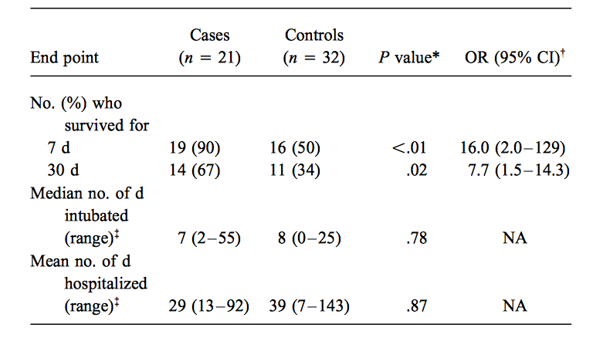
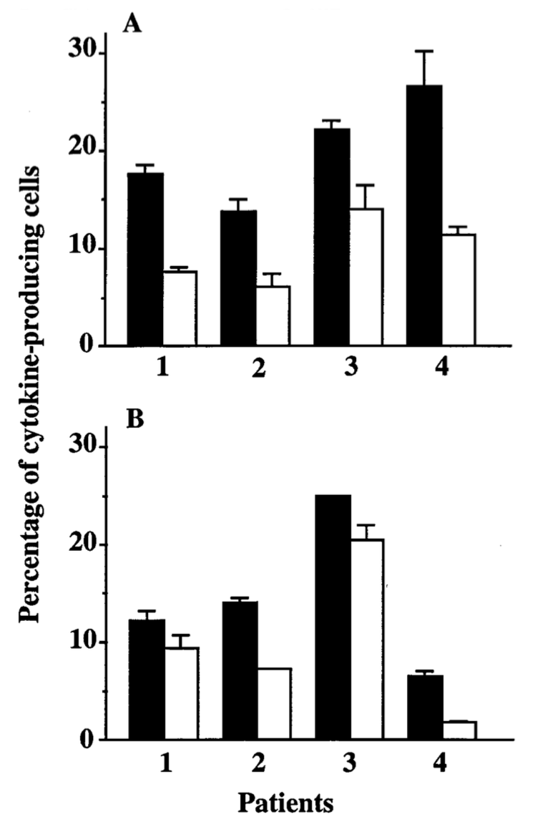
IVIG
Qual et al. Clin infect dis. 210-1214. 1991
Notes:
Inhibition of mitogenicity of bacterial culture superna- tants by plasma from patients with streptococcal toxic shock syndrome who were treated with (cases, l) and without (controls, 􏰈) intrave- nous immunoglobulin (IVIG). Supernatants from infecting strains of group A streptococci were used to stimulate peripheral blood mononu- clear cells from a healthy individual. Cells were cultured in 10% fetal calf serum in the presence or absence of 1% patient plasma and stimulated with 1% supernatant produced by the infecting group A streptococcus isolate. Post–IVIG 1 Å plasma sample obtained within 24 hours of the completion of the first IVIG infusion; post–IVIG 2 Å plasma sample obtained within 24 hours after the second IVIG infusion. There was no difference in the mitogen-neutralizing capacity at baseline for cases and controls (P Å .20, Wilcoxon rank-sum test); however, post–IVIG plasma had significantly greater neutralizing capacity than did pre–IVIG plasma (P Å .004, Wilcoxon signed-rank test).
nhibition of cytokine production in peripheral blood mo- nonuclear cells from patients with streptococcal toxic shock syndrome following intravenous immunoglobulin treatment. Peripheral blood mononuclear cells obtained from the same patient before (􏰇) and after (􏰆) intravenous immunoglobulin treatment were fixed on glass slides and stained with monoclonal antibodies specific to IL-6 (A) and TNF-a (B). Cells displaying dense juxtanuclear staining after application of an avidin-biotin label were visually quantified as the mean percentage of cytokine-producing cells { SD. IL-6 production was significantly (for each patient, P õ .05 by the t test) reduced in all four patients; TNF-a production was significantly reduced in pa- tients 2, 3, and 4 (P õ .05).

Slide 25
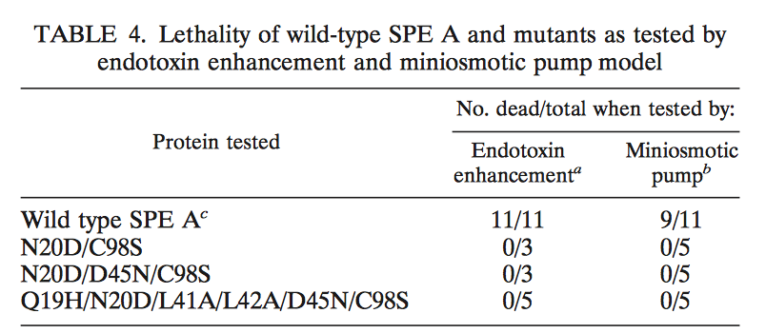
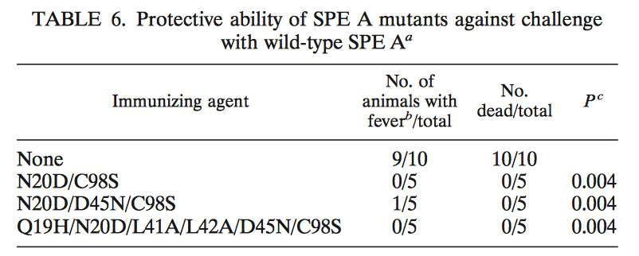
Vaccination
Roggiani et al. Infect Immun. 2000 .5011-5017

Slide 26
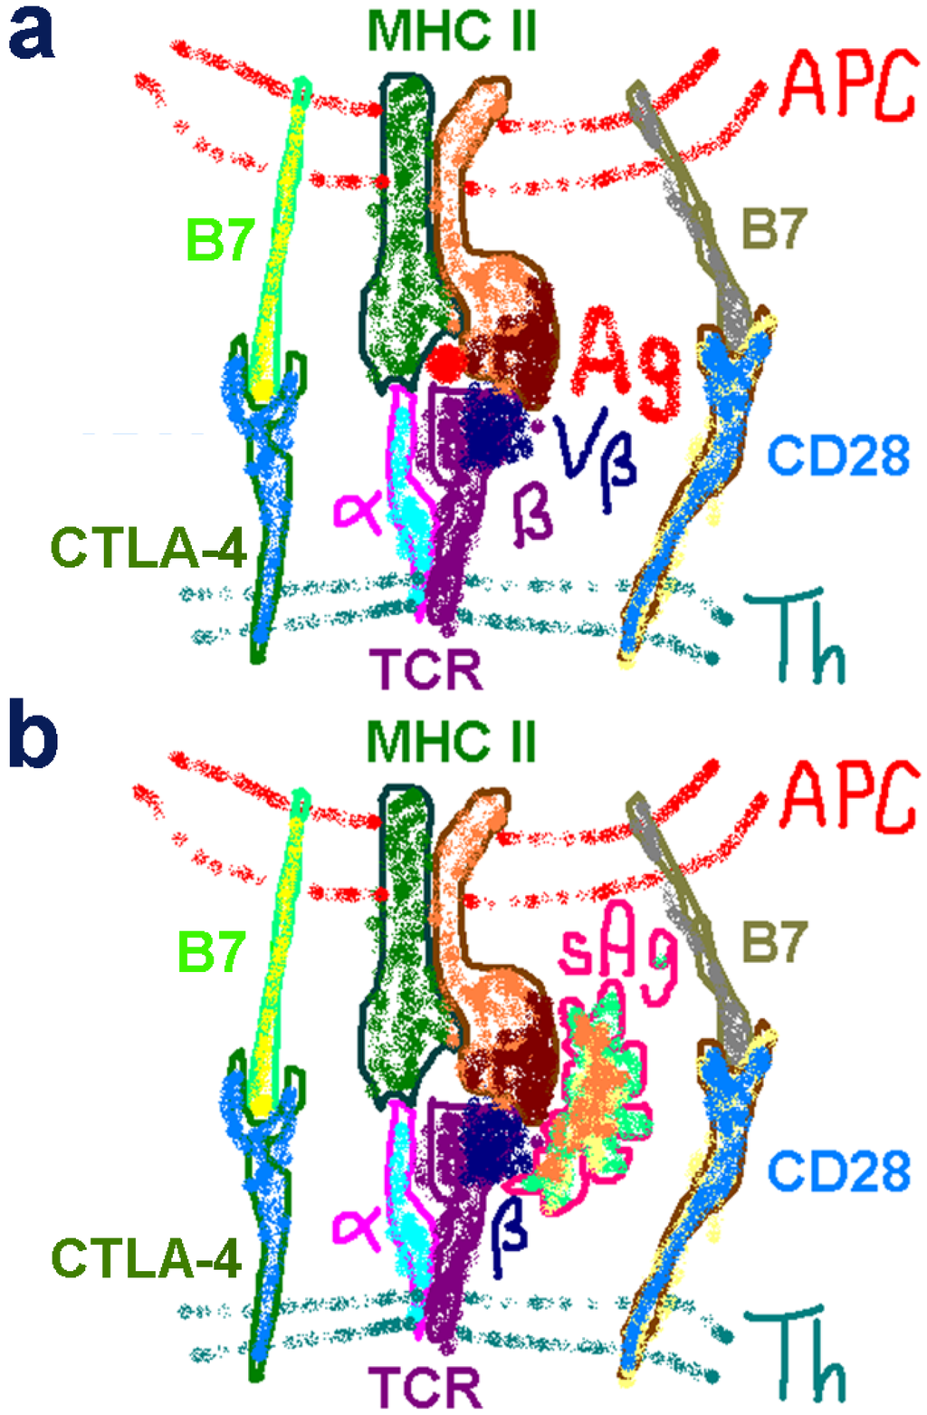
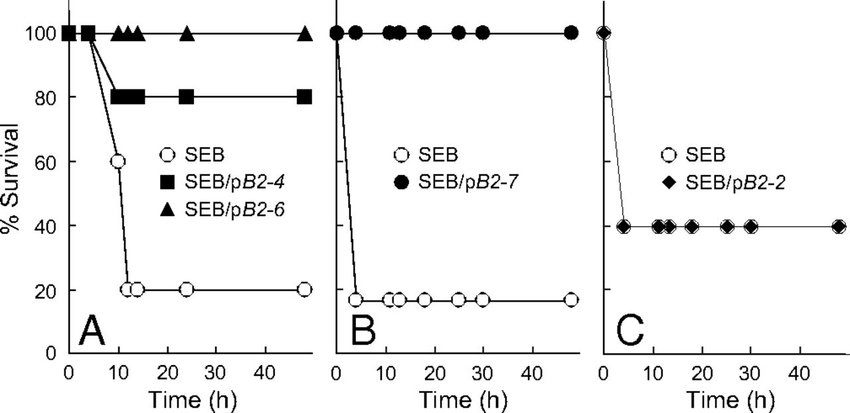
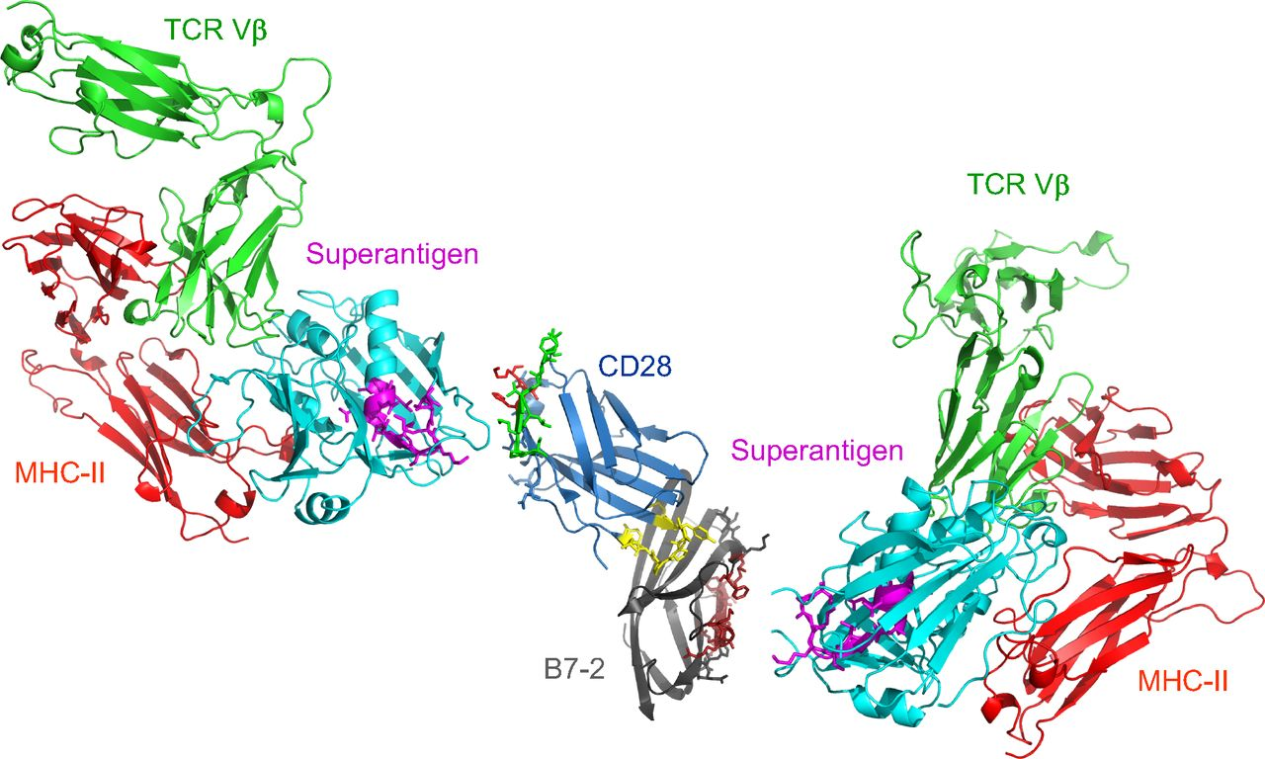
Peptide mimic inhibits super antigen mediated bridge between B7-2 and CD28.
Kaempfer et al. toxins. 2013
Revital Levy et al. PNAS 2016;113:E6437-E6446
©2016 by National Academy of Sciences
Notes:
Schematic model for superantigen action, requiring direct binding of superantigen to costimulatory receptors B7-2 and CD28. Two superantigen molecules (cyan) (SEC3, a close relative of SEB) in complex with TCR Vβ (green) and MHC-II (red) extracellular domains (1jck.pdb, wherein SEB/MHC-II structure is superimposed on SEC3/TCR Vβ structure) (30) engage, through their freely accessible β-strand/hinge/α-helix domain (magenta) (12), the homodimer interface of B7-2 on the right (dimer interface residues within pB2-4, pB2-6, and pB2-7 are in brown) and the homodimer interface of CD28 on the left, respectively. Because the CD28/B7-2 complex structure remains unresolved, CD28 (1YJD.pdb) (15) was superimposed on CTLA-4 in the CTLA-4/B7-2 complex (1I85.pdb) (Fig. 4A); green and red CD28 dimer interface residues correspond to p2TA and p1TA (only HVK was resolved), respectively. Extracellular domains of CD28 and TCR are oriented such that they enter the T cell at the top, and those of the B7-2 and MHC-II molecule are oriented such that they enter the antigen-presenting cell at the bottom.

Slide 27
Back to our patient
10/31/2016: OR for I&D→all cultures no growth
11/1/2016: lactic acid continues to increase from 3.4 to 16 then to 23. while her WBC trends as shown below:
8.0
6.7
7.0
21.7
69
26.5
51
33.5
41
Notes:
OR: hematoma both superficial and deep to the fascia. No purulence present. Extensive debridement. Pathology showed granulation tissue with chronic inflammation and scant admixed neutrophils. No typical histologic features of IgG4-mediated sclerosing disease. Right knee tissues (10/31): no growth

Slide 28
11/1/2016: lactic acid continues to increase from 3.4 to 16 then to 23. while her WBC trends as shown below:
8.0
6.7
7.0
21.7
69
26.5
51
33.5
41

Slide 29
11/1/2016: lactic acid continues to increase from 3.4 to 16 then to 23. while her WBC trends as shown below:
11/1/2016 at 1529: ventricular tachycarida→CPR→PEA arrest
11/1/2016 1550: time of death
8.0
6.7
7.0
21.7
69
26.5
51
33.5
41

Slide 30
Autopsy-preliminary
Suspected sepsis, etiology unclear
Anasarca,
Reticular pattern of skin discoloration on the distal extremities
Right knee joint with blood clots and early hemorrhagic granulation tissue (s/p surgical debridement)
Marked pulmonary congestion and edema (1540 g combined lung weight)
Bilateral cortical renal hemorrhages
Marked softening and slight darkening of the internal organs
Splenomegaly (760g)
Microbiology studies pending
Antemortem right knee tissue culture
Antemortem blood cultures
Postmortem lung tissue viral PCR
Postmortem viral serology
Postmortem right knee joint fluid microbiology studies

Slide 31
Synovial fluid toxin study-Dr. Schlievert
Patient’s right knee synovial fluid was SEB positive: produced by USA400 strains (common in the Midwest US)
Notes:
Toxic shock syndrome: TSST-1 casues 100 % of menstrual TSS, SEB and SEC each causes about 25 % of nonmenstrual TSS. there was about 20 ml of fluid sent over, so I think there may be 1 ug total SEB in the sample. 0.1 ug per human is lethal...we know this! SEB is produced in vivo in massive amounts. We have detected >100 ug in the lungs of animals, and >100 ug on tampons. SEB does not cause menstrual TSS because it cannot easily cross the vaginal mucosa, but we can still measure it in tampons

Slide 32
Take Home Points
Nonmenstrual toxic-shock syndrome is still clinical diagnosis and should be on the differential in appropriate setting
Superantigen plays an important role in TSS
Cultures can be negative (including S.aureus)
Further studies for treatment of TSS (once cytokine cascade has been activated) are needed

