Slide 1
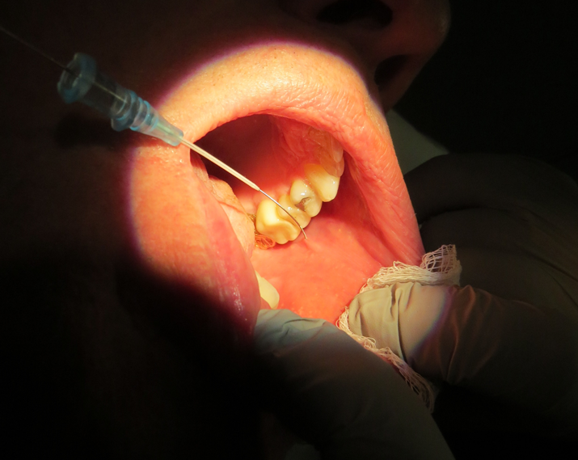
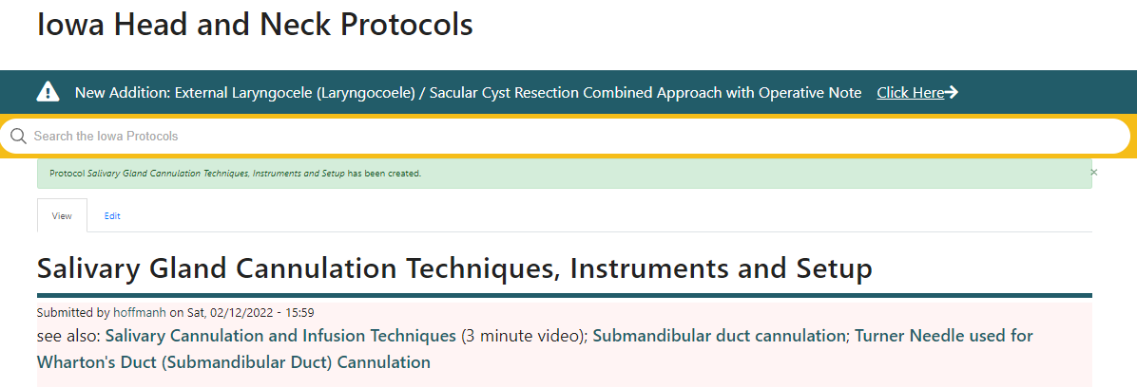
Henry Hoffman
Conflict of interest:
UpToDate Author
Consultant COOK Medical
Access to Papilla
Cannulation Techniques, Instruments and Setup
Equipment
Technique
  Ensure patient is hydrated
  Use a microscope
  3. Know the anatomy
  4. Manipulate soft tissue adjacent duct orifice
  5. Cannulate with 0.015 inch guidewire
  6. Dilate over guidewire (don’t lose the lumen)
What Salivary Endoscopy Can & Cannot Do:
A Primer to Effectively Work with
Your Colleague
Moderator: David S. Cohen, MD Southern Cal Permanente
Panelists: Margaret A. Ogden MD Washington U St. Louis
Henry Hoffman MD U of Iowa
AAO-HNS Philadelphia
10:45 AM – 11:45 AM Sunday September 11, 2022
Rarely used a diagnostic tool (for me)
Useful tool as an adjunct for treatment

Slide 2
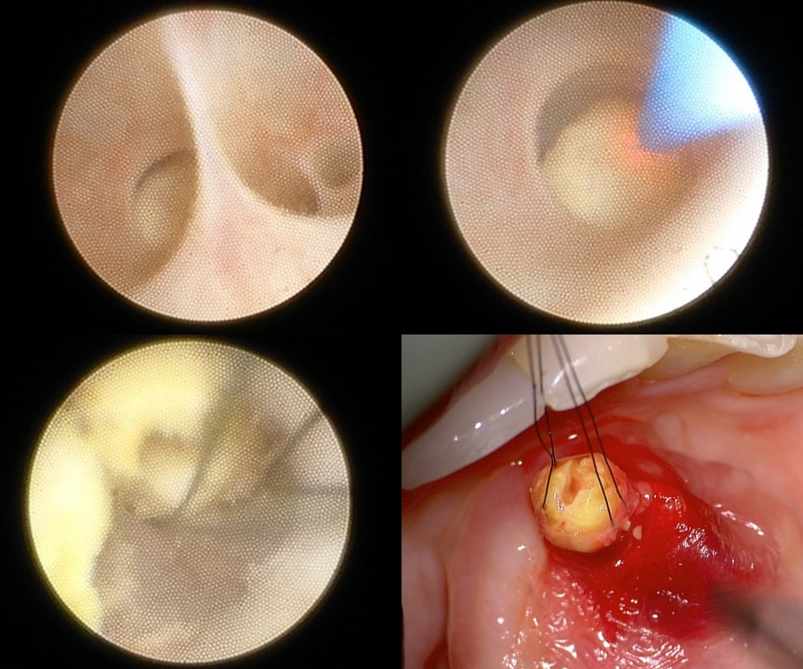
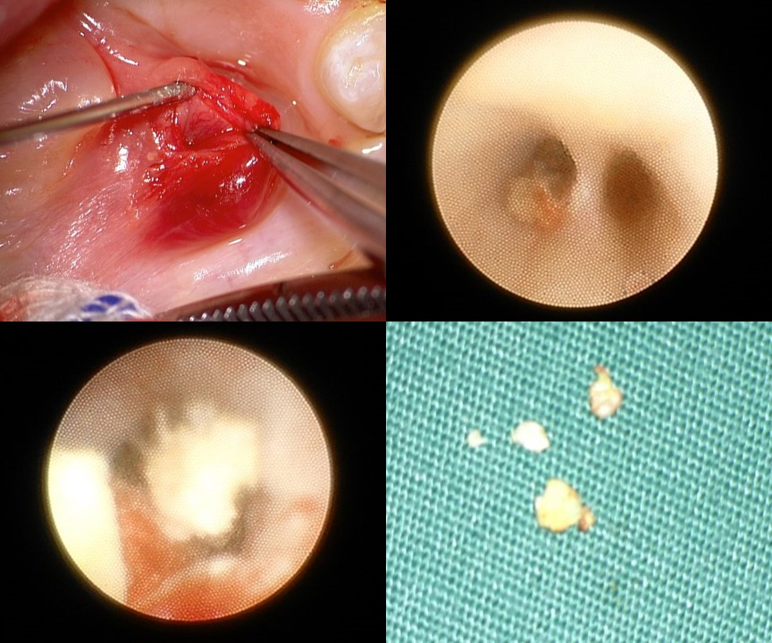
Sialendoscopy: Diagnosis and Treatment
Henry Hoffman MD U of Iowa
10:45 AM – 11:45 AM Sunday September 11, 2022
Rarely a diagnostic tool (for me)
Useful tool as an adjunct for treatment
Sialendoscopy is needed for treatment
To deploy laser, forceps, drill, basket for deeper stones
Sialendoscopy is useful but alternatives exist
Help preserve duct when operating around it
Evaluate duct remnant after gland resection
Identify location of duct for open procedures
Help deploy dilators for stricture
Help deliver steroid insufflation

Slide 3
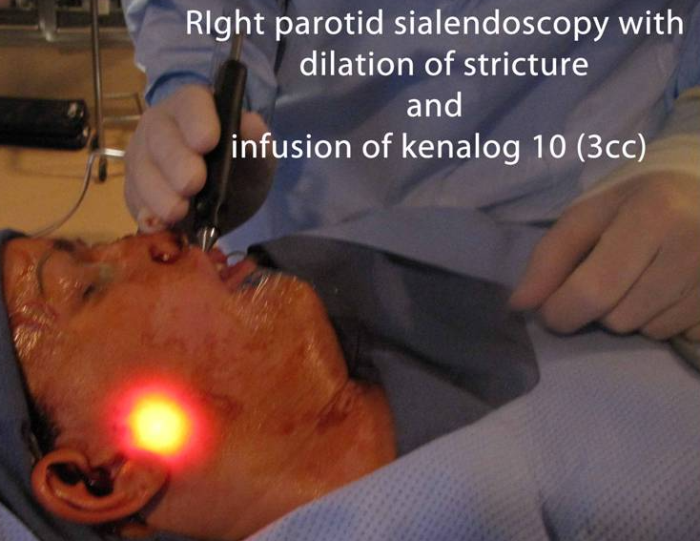
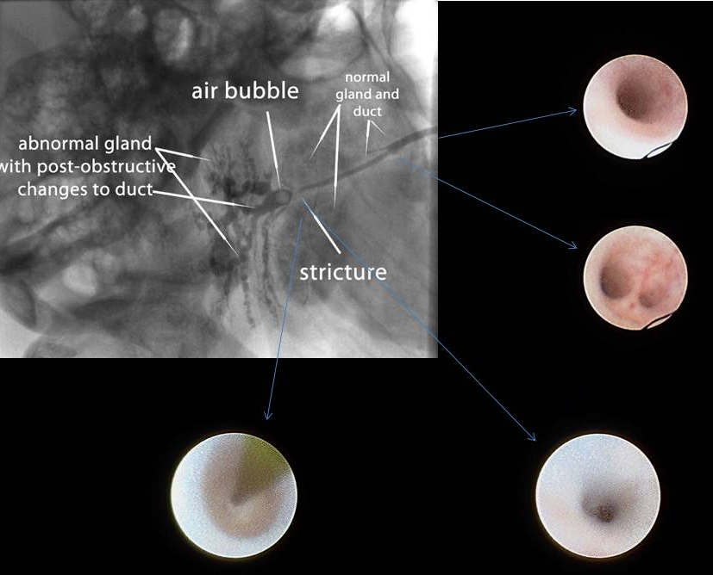
Sialendoscopy As a Diagnostic Tool
Sialendoscopy offers a minimally invasive option for the diagnosis and management of chronic inflammatory disorders of the salivary glandsHernandez S, Busso C, Walvekar RR. Parotitis and Sialendoscopy of the Parotid Gland. Otolaryngol Clin North Am. 2016 Apr;49(2):381-93. doi: 10.1016/j.otc.2015.12.003. Epub 2016 Feb 22. PMID: 26912292.
“For patients who have failed medical and conservative management, sialendoscopy is the next step in assessing the ductal anatomy. Sialendoscopy is diagnostic and also therapeutic at the same time.”
2. “Sialendoscopy can provide direct, accurate and reliable visualisation of the salivary duct lumen and ductal pathologies”Liao GQ, Su YX, Zheng GS, Liang LZ. Sialendoscopy-based diagnosis and treatment of salivary ductal obstructions. Chin J Dent Res. 2010;13(1):17-22. PMID: 20936187.
3. “Diagnostic sialendoscopy was used for classifying ductal lesions as sialolithiasis, stenosis, sialodochitis, or polyps.”
Marchal F, Dulguerov P, Becker M, Barki G, Disant F, Lehmann W. Submandibular diagnostic and interventional sialendoscopy: new procedure for ductal disorders. Ann Otol Rhinol Laryngol. 2002 Jan;111(1):27-35. doi: 10.1177/000348940211100105. PMID: 11800367.
Shortcomings (Su et al 2009):
“..as a diagnostic approach, the sialendoscopy has several substantial drawbacks.
  the insertion of a sialendoscope can cause destruction of the orifice
  some branches will inevitably stay unreachable
  the ductal system proximal to the obstructions cannot be detected
  Su YX, Feng ST, Liao GQ, Zhong YQ, Liu HC, Zheng GS. CT virtual sialendoscopy versus conventional sialendoscopy in the visualization of salivary ductal lumen: an in vitro study. Laryngoscope. 2009 Jul;119(7):1339-43. doi: 10.1002/lary.20504. PMID: 19507221
Hoffman (6-2-2022): “minimally invasive procedure - usually general anesthesia - time and resource consuming”

Slide 4
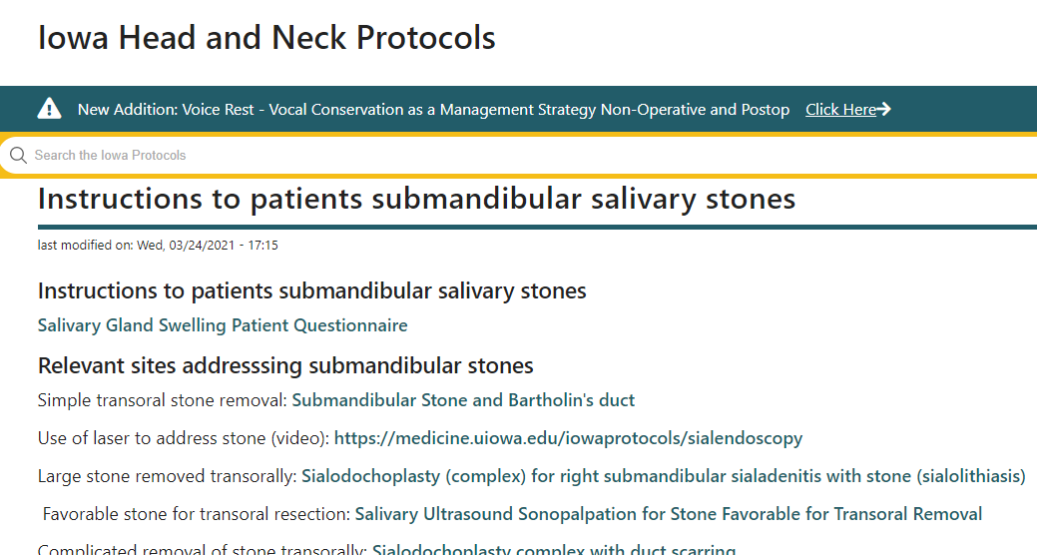
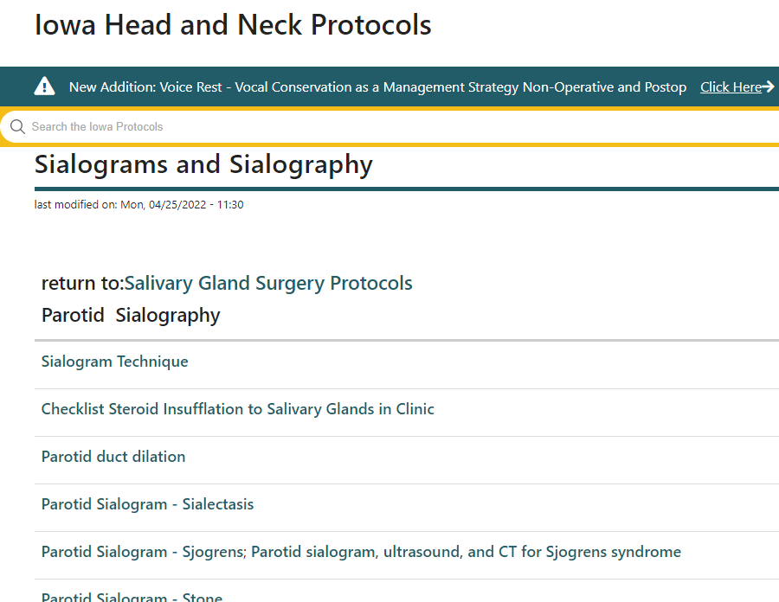
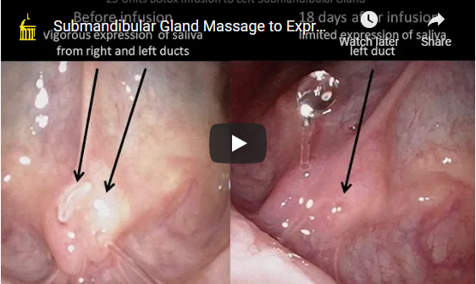
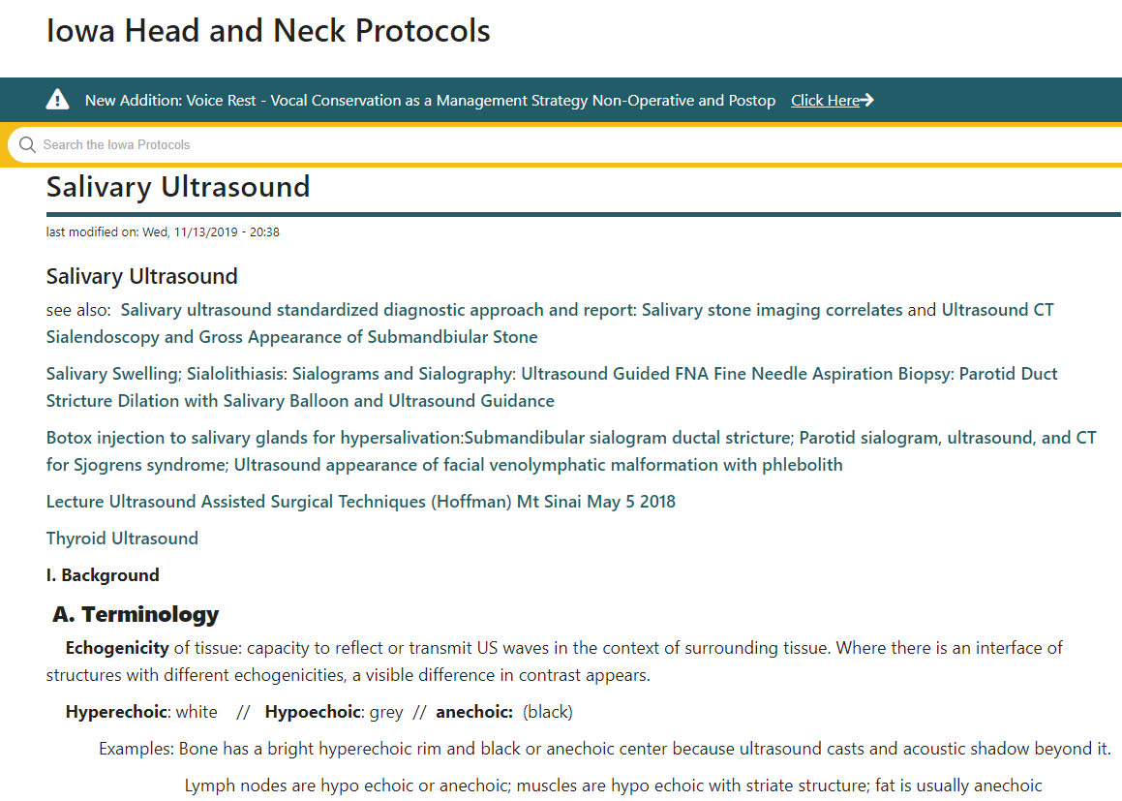
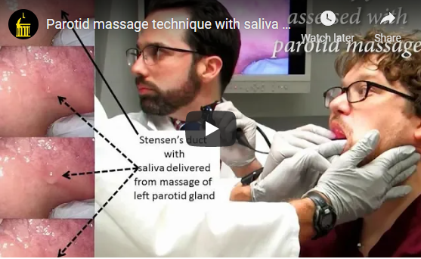
Submandibular Stone
schedule clinic visit
(likely pre-op)
Salivary Swelling or Pain
Diagnostic Tools
Video-Telemedicine
History
Physical Exam
Review CT imaging
No Stone Identified / Most Parotid Stones
schedule clinic visit
(with sialogram- possible preop)
In Clinic – 5. Ultrasound
In Clinic – 4. Massage the Glands
In Clinic – 4. Massage the Glands

Slide 5
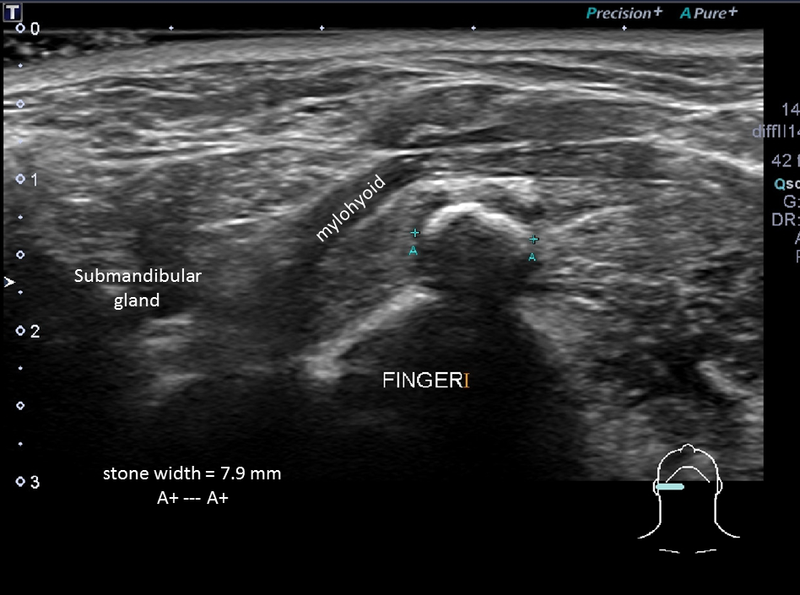
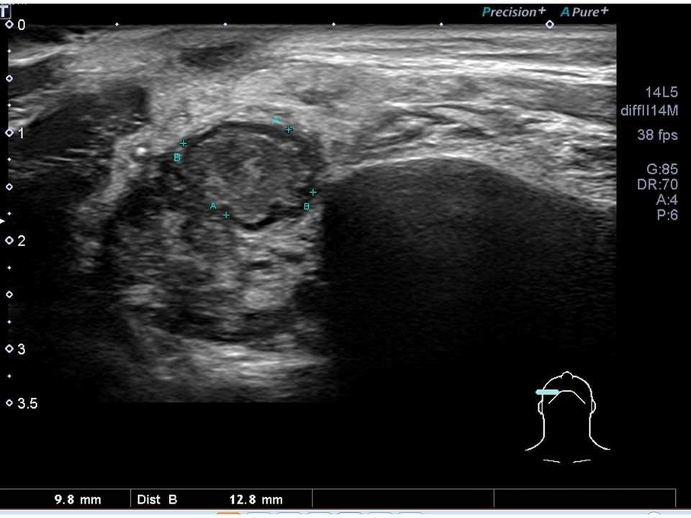
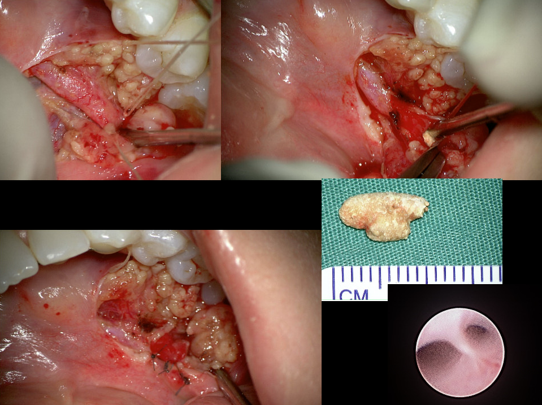
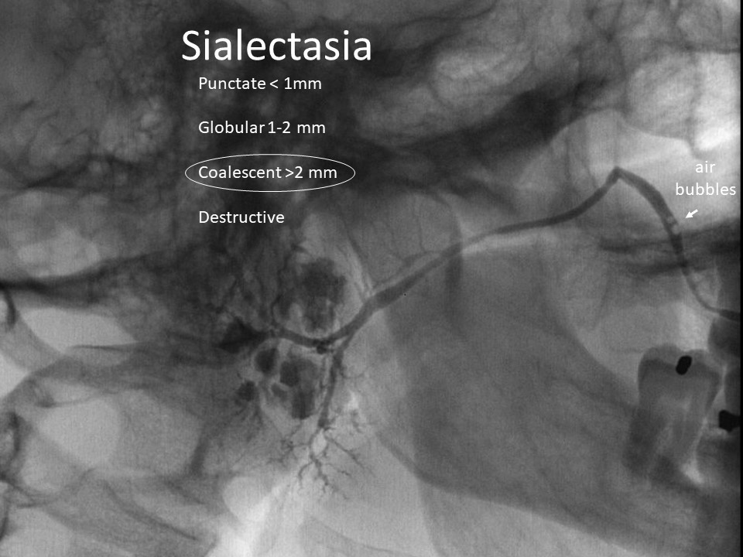
Submandibular Stone
clinic visit
(pre-op)
Salivary Swelling or Pain
Diagnostic Tools
Video-Telemedicine
History
Physical Exam
Review CT imaging
No Stone Identified / Most Parotid Stones
clinic visit
(with sialogram- possible preop)
In Clinic – 5. Ultrasound
February 2022
12.8 x 9.8 mm
acute parotitis
with abscesses
In Operating Room
Open Ductoplasty
Assisted with
Sialendoscopy
In Radiology (Fluoroscopy)
Salivary duct cannulation, dilation with radiocontrast insufflation
May 2022
after 8 weeks
of augmentin

Slide 6
2021 Jun;54(3):553-565. Otolaryngol Clin North America
Transoral Sialolithotomy Without Endoscopes: An Alternative Approach to Salivary Stones
Janyn Quiz ¹, M Boyd Gillespie ²
Abstract
Sialoendoscopy is a valuable technique for a variety of obstructive and nonobstructive disorders of the major
salivary glands. However, the utility of sialoscopes is limited for salivary stones, which frequently required open
removal. Transoral sialolithotomy without scopes is an efficient, low-cost alternative with excellent outcomes
available for most of the submandibular stones.
2022 Apr;132(4):754-760. Laryngoscope
Outcomes of Submandibular Stone Removal With and Without Salivary Endoscopes
K Coca, E Benaim, L Reed, M Mamidala, M Boyd Gillespie
Abstract [30 with smg stones; 14 used sialendoscopes – 16 no sialendoscopes]
Conclusions: Sialendoscopy is an important diagnostic and therapeutic tool in the management of salivary
disorders, but is not associated with improved outcomes in gland-preserving treatments for routine
submandibular sialolithiasis. Transoral stone removal alone may have equivalent symptomatic outcomes
in the management of select sialoliths.
“In this study use of scopes increased ability to identify and potentially treat associated ductal scar”
Sialendoscopy useful for scar, parotid stones, multiple smg stones, flushing out debris, treat I131 sialadenitis,

Slide 7
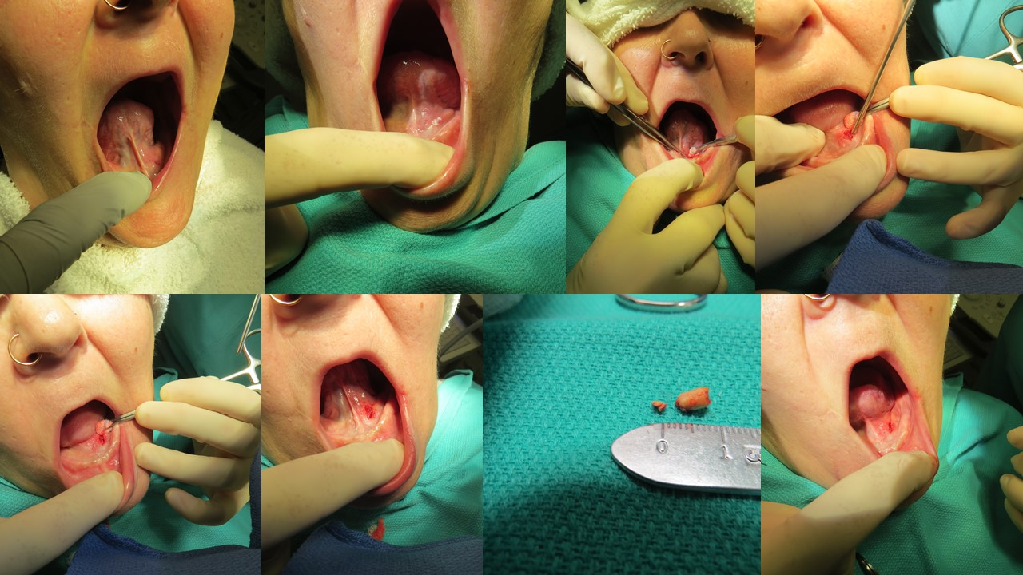
Transoral Stone Removal In Clinic

Slide 8
Sialendoscopy: Diagnosis and Treatment
Henry Hoffman MD U of Iowa
10:45 AM – 11:45 AM Sunday September 11, 2022
Rarely a diagnostic tool (for me)
Useful tool as an adjunct for treatment
Sialendoscopy is needed for treatment
To deploy laser, forceps, drill, basket for deeper stones
Sialendoscopy is useful but alternatives exist
Help preserve duct when operating around it
Evaluate duct remnant after gland resection
Identify location of duct for open procedures
Help deploy dilators for stricture
Help deliver steroid insufflation

Slide 9
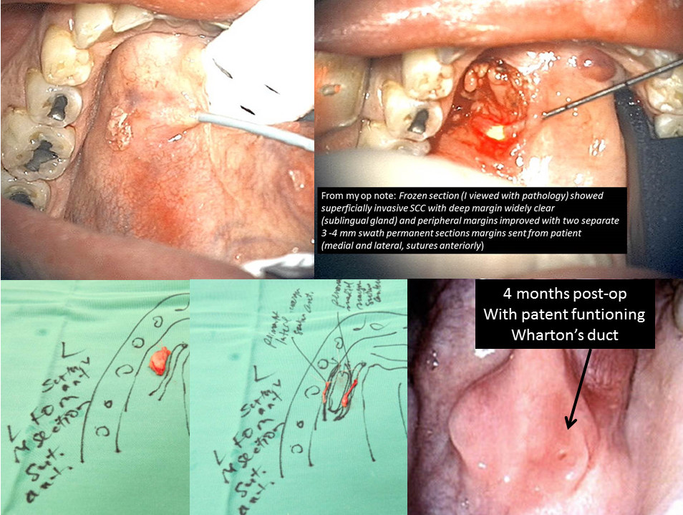
Sialendoscopy
as an adjunct
1. Help preserve duct when
operating around it
Resection of floor of mouth
T1 cancer

Slide 10
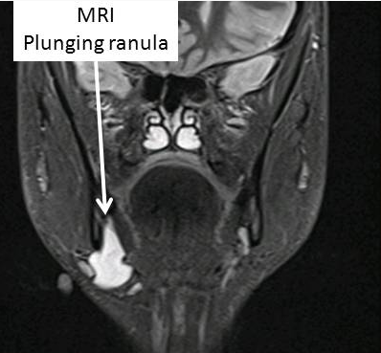
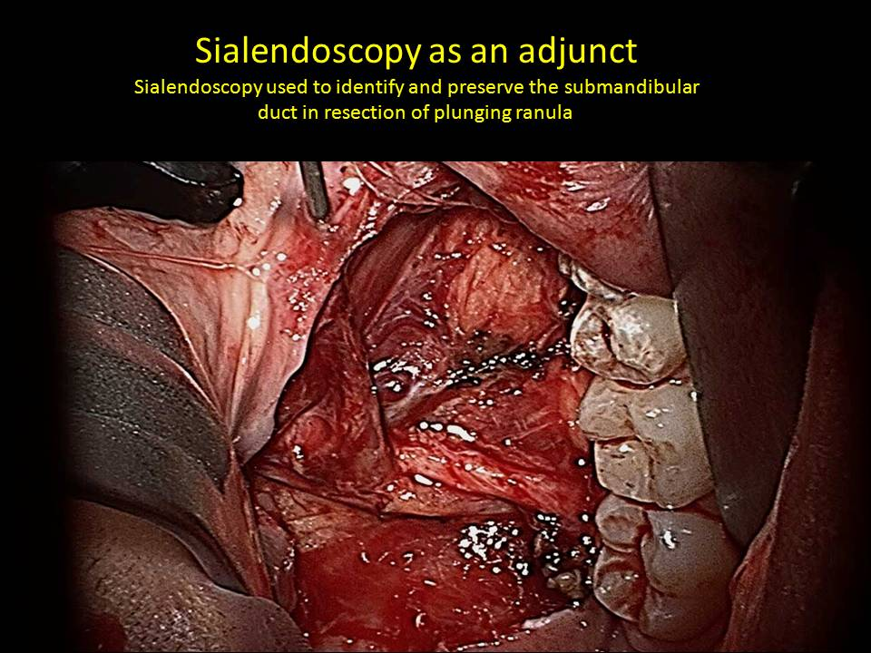
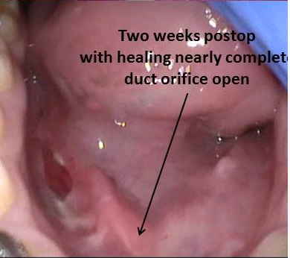
Two Weeks Postop
Duct orifice open

Slide 11
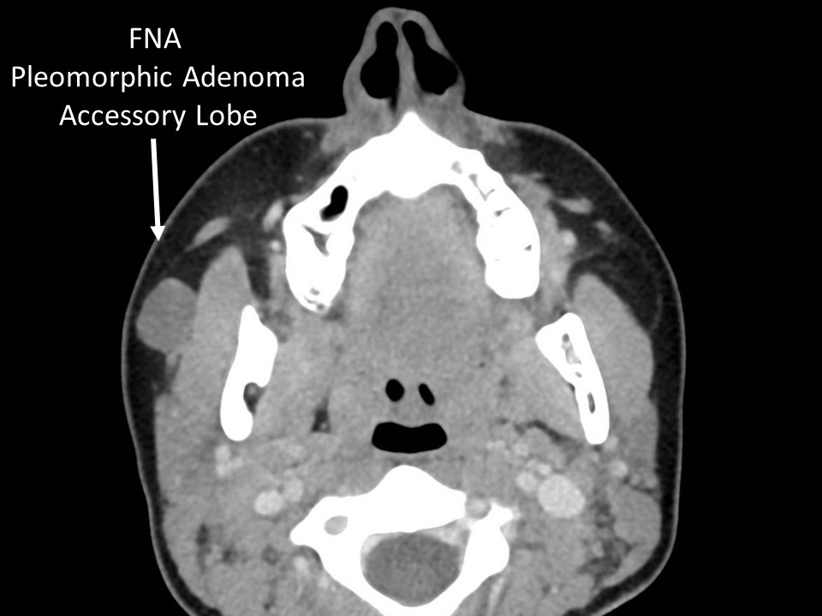
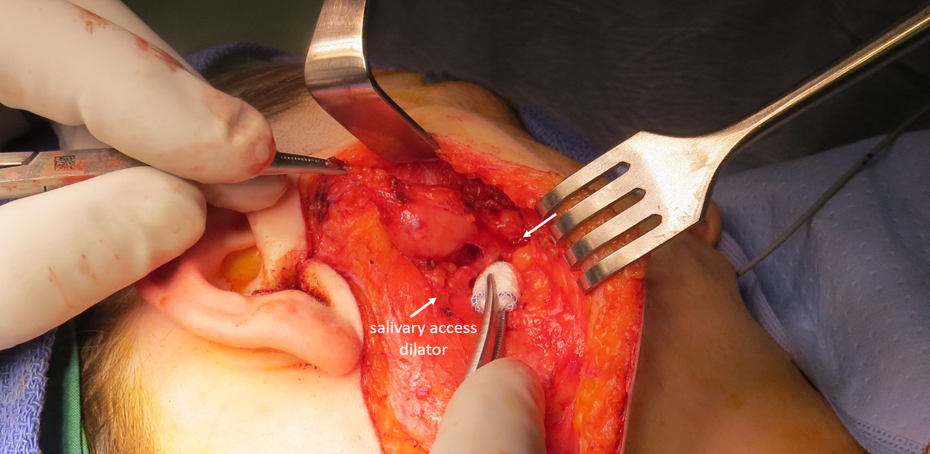
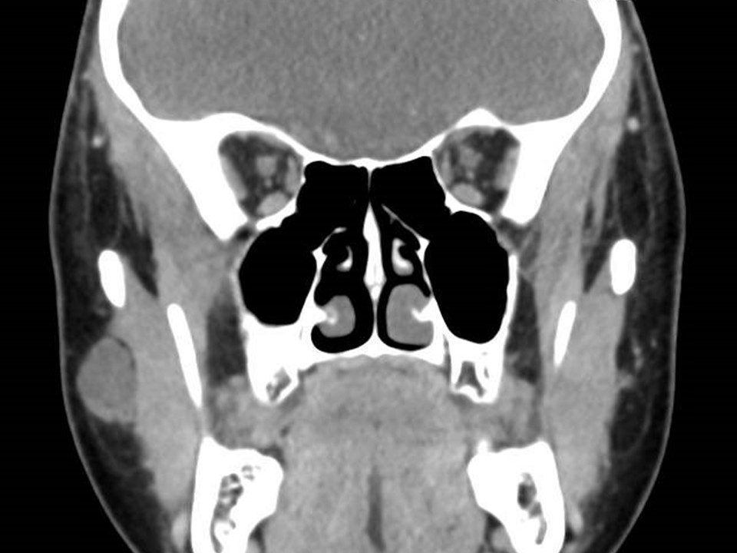
Sialendoscopy as an adjunct

Slide 12
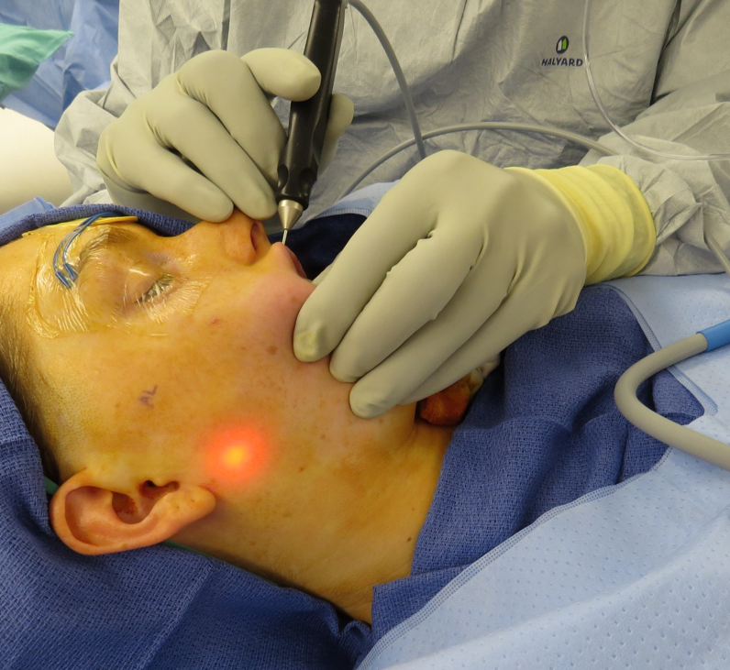
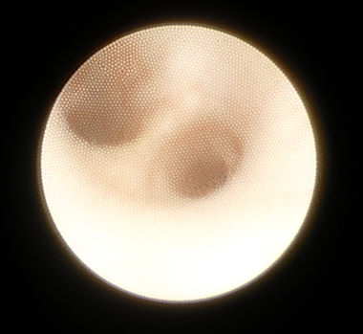
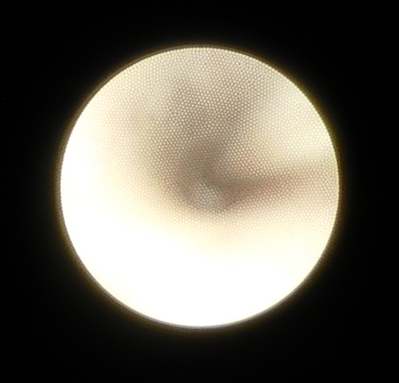
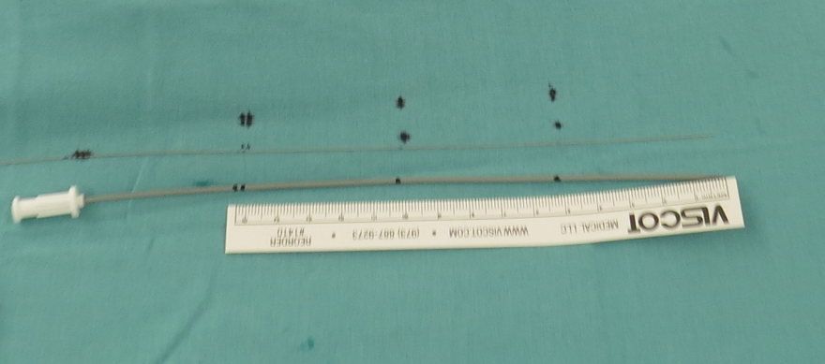
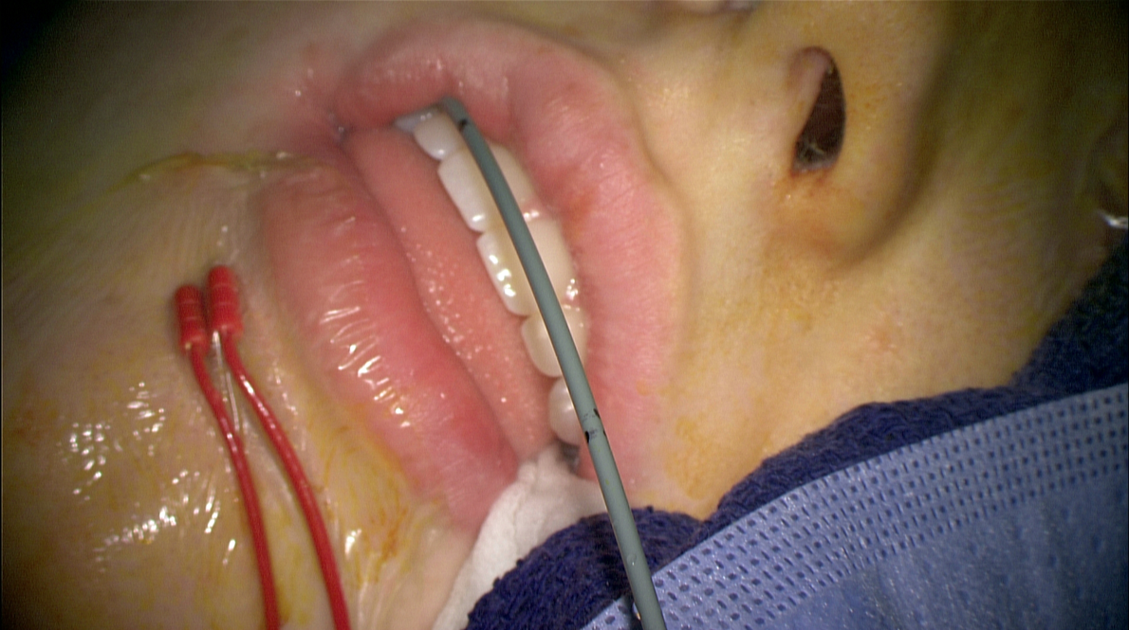
Sialendoscopy as an adjunct

Slide 13
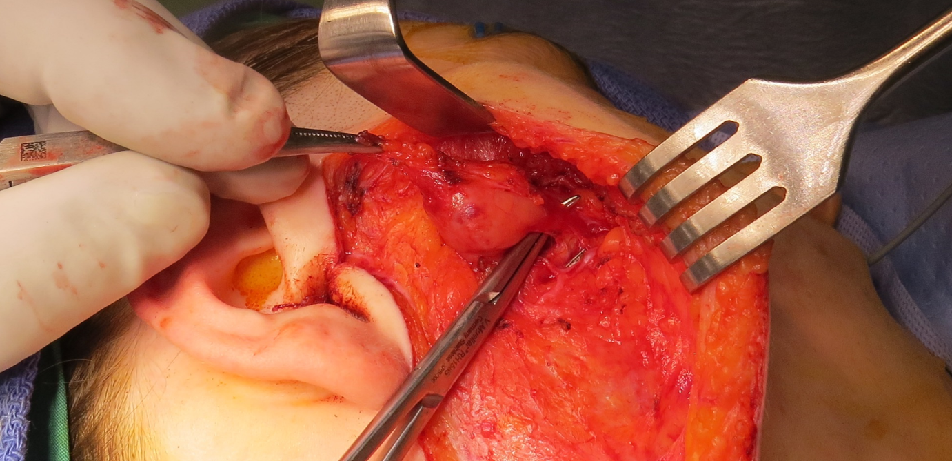
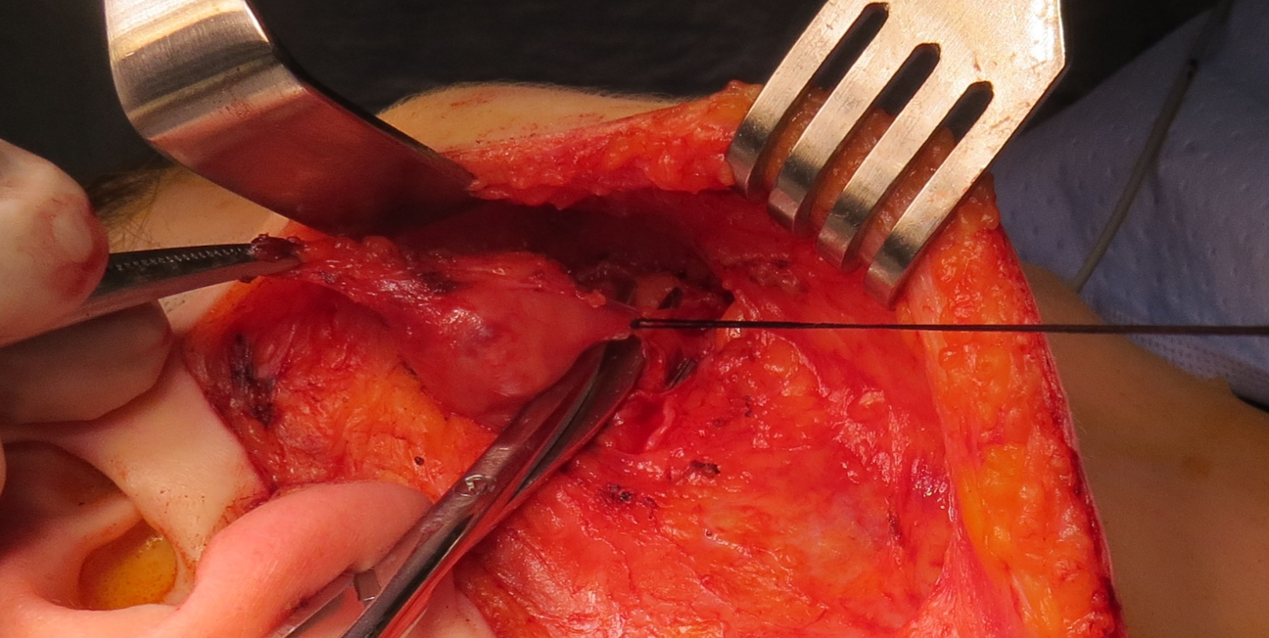
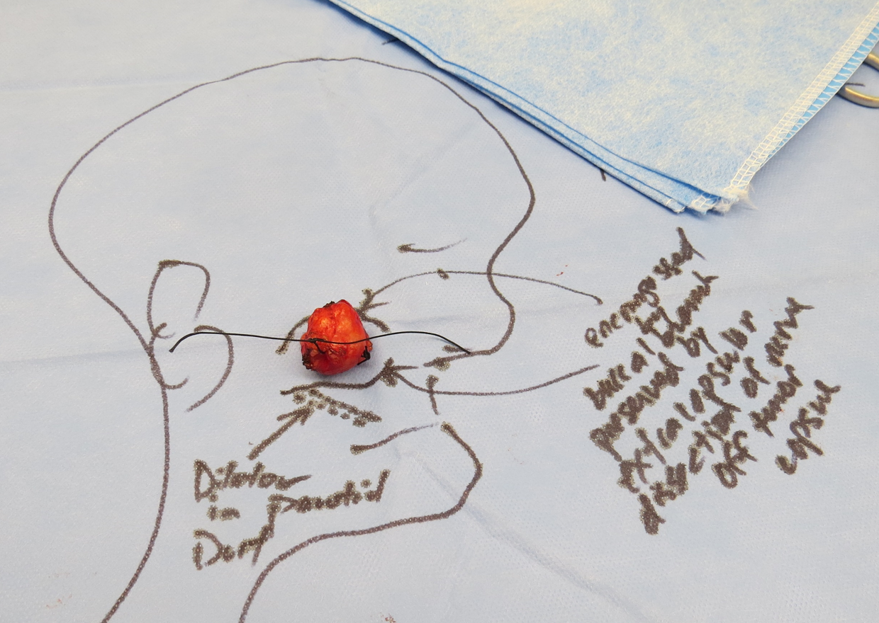
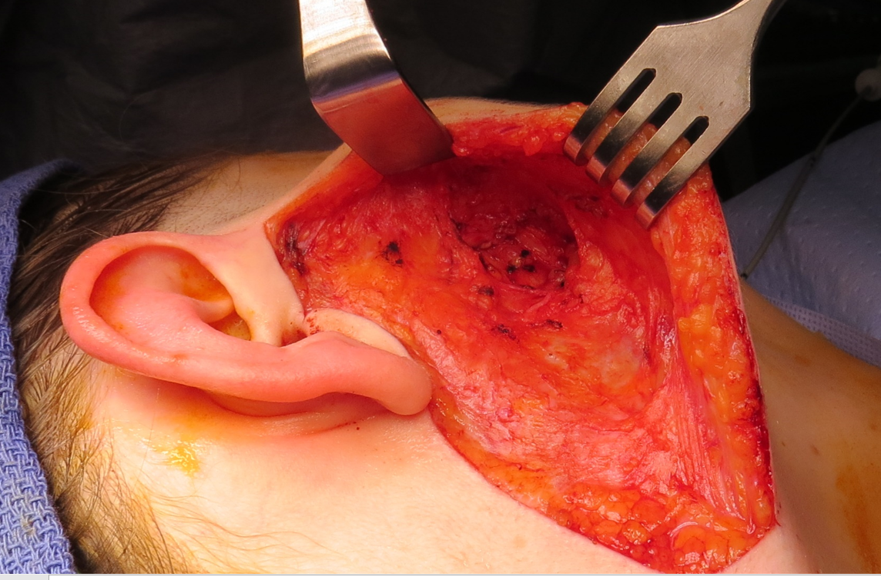
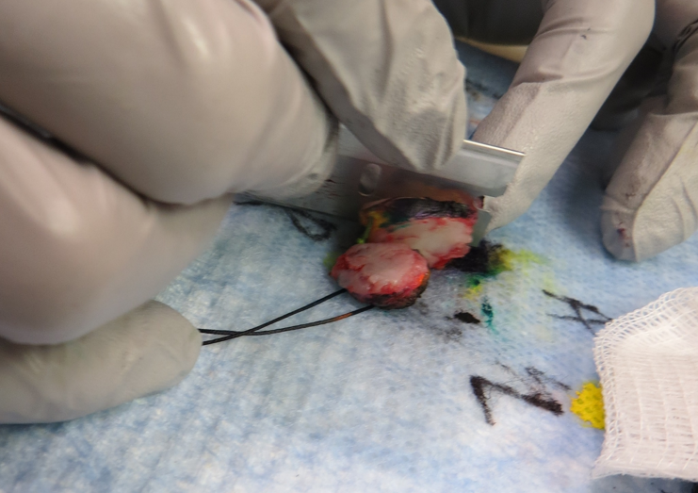
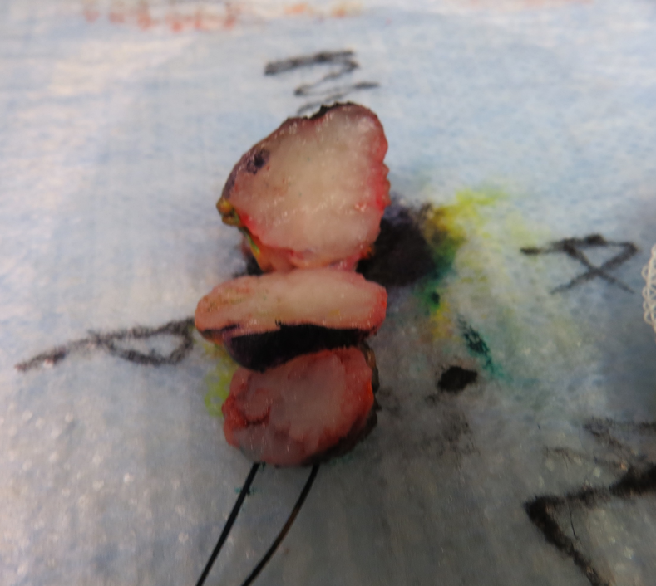
Sialendoscopy as an adjunct

Slide 14
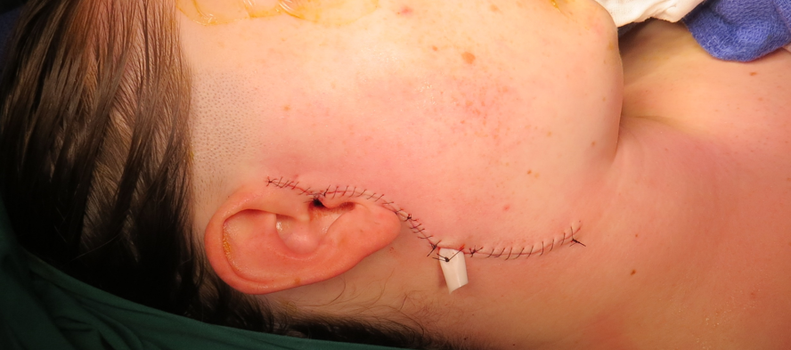
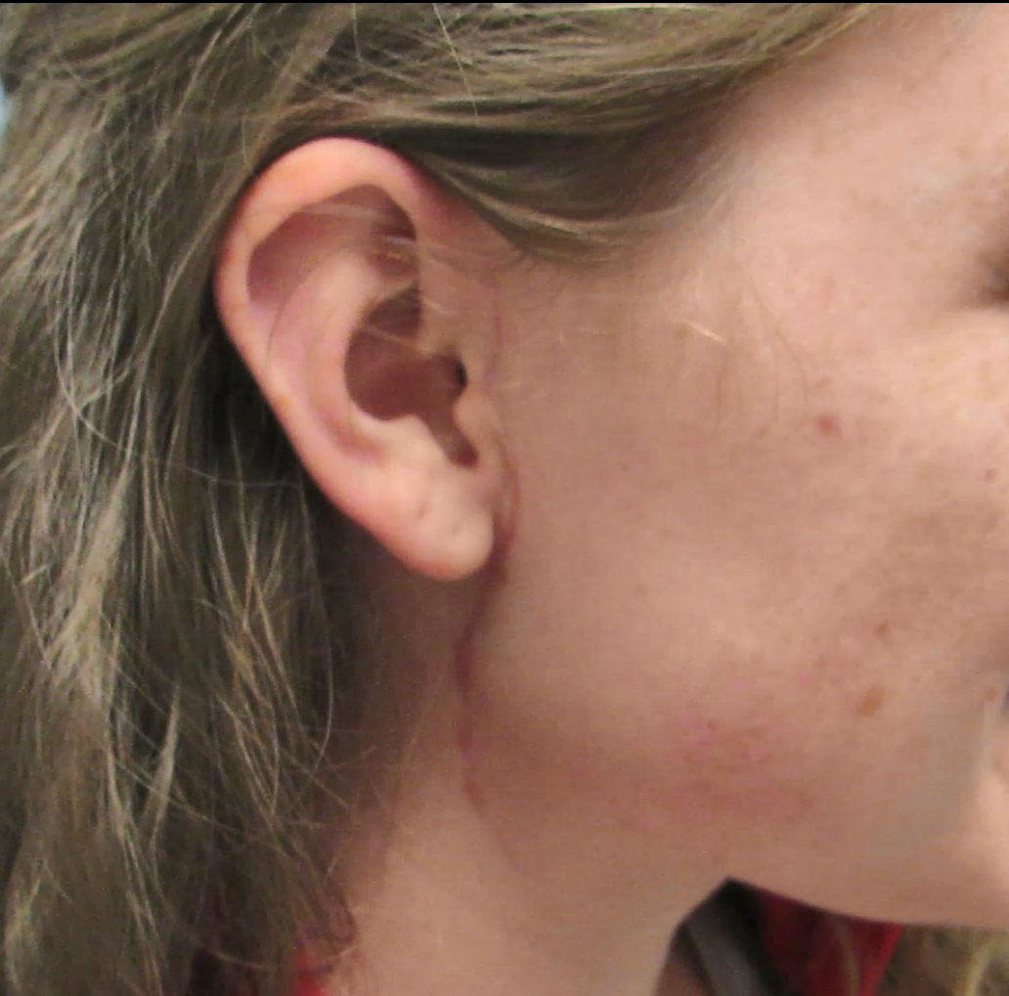
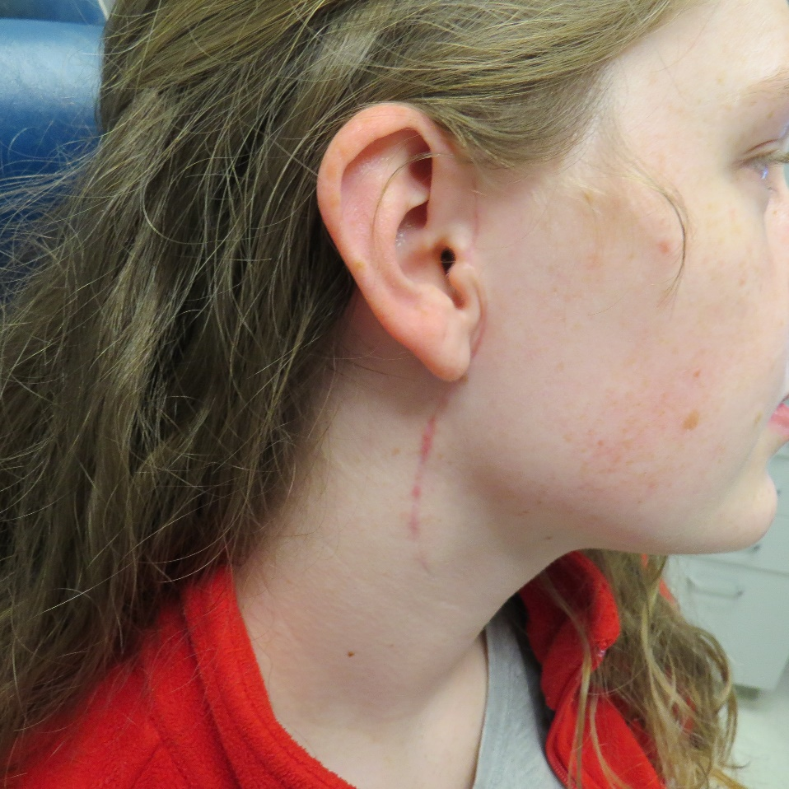
Sialendoscopy as an adjunct
Salivary Access Dilators –
to cannulate and help preserve ducts
with resection of adjacent tissue
Sialendoscopy
used
to position
salivary
access
dilator

Slide 15
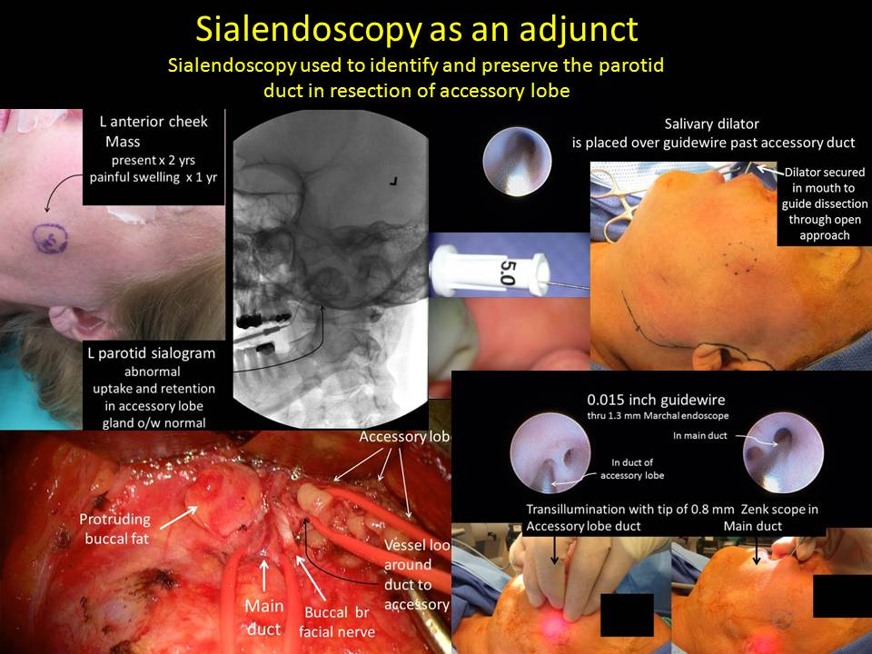

Slide 16
Sialendoscopy: Diagnosis and Treatment
Henry Hoffman MD U of Iowa
10:45 AM – 11:45 AM Sunday September 11, 2022
Rarely a diagnostic tool (for me)
Useful tool as an adjunct for treatment
Sialendoscopy is needed for treatment
To deploy laser, forceps, drill, basket for deeper stones
Sialendoscopy is useful but alternatives exist
Help preserve duct when operating around it
Evaluate duct remnant after gland resection
Identify location of duct for open procedures
Help deploy dilators for stricture
Help deliver steroid insufflation

Slide 17
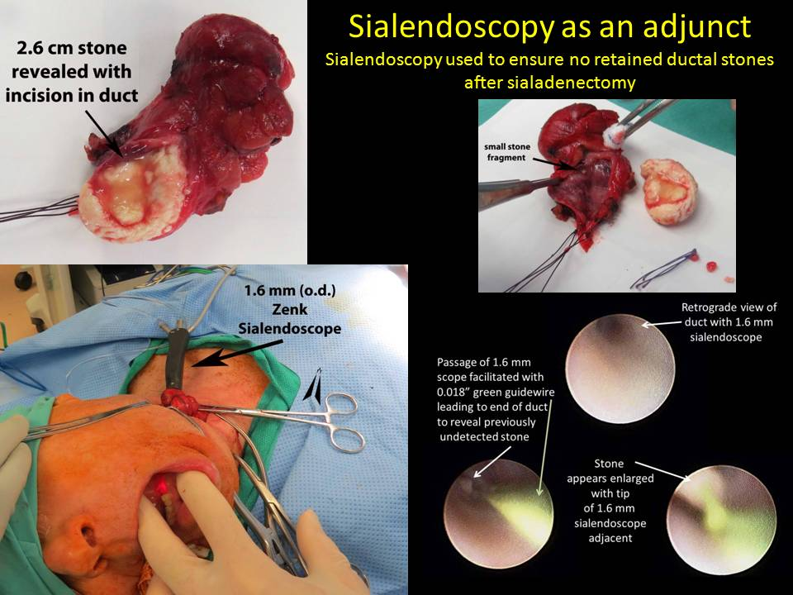
Potash A, Hoffman HT. Retrograde sialendoscopy:
a new technique for avoiding retained ductal stones.
Ann Otol Rhinol Laryngol. 2012 Jan;121(1):38-43

Slide 18
Sialendoscopy: Diagnosis and Treatment
Henry Hoffman MD U of Iowa
10:45 AM – 11:45 AM Sunday September 11, 2022
Rarely a diagnostic tool (for me)
Useful tool as an adjunct for treatment
Sialendoscopy is needed for treatment
To deploy laser, forceps, drill, basket for deeper stones
Sialendoscopy is useful but alternatives exist
Help preserve duct when operating around it
Evaluate duct remnant after gland resection
Identify location of duct for open procedures
Help deploy dilators for stricture
Help deliver steroid insufflation

Slide 19
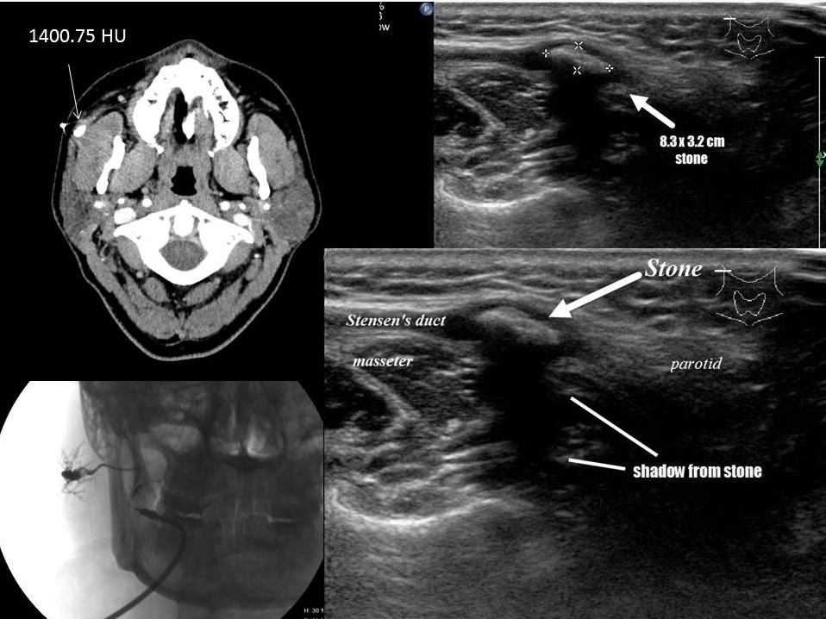

Slide 20
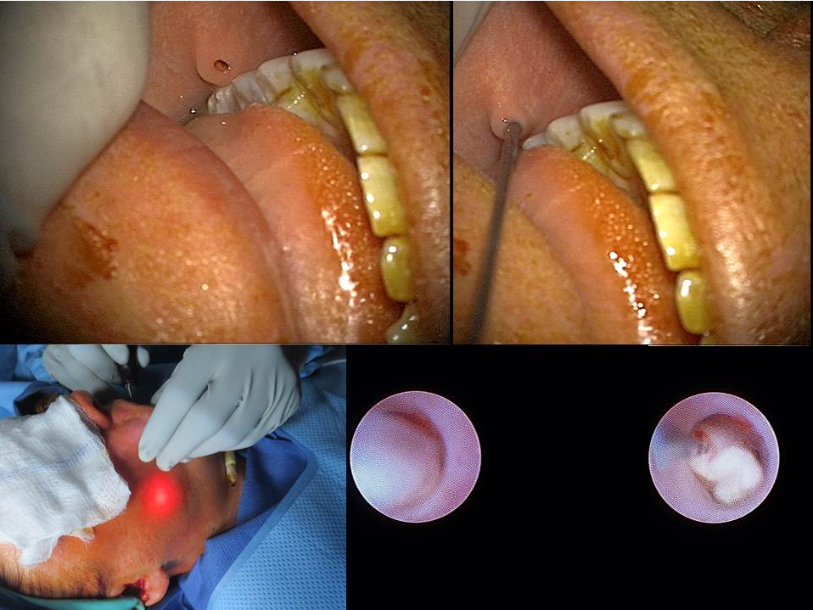

Slide 21
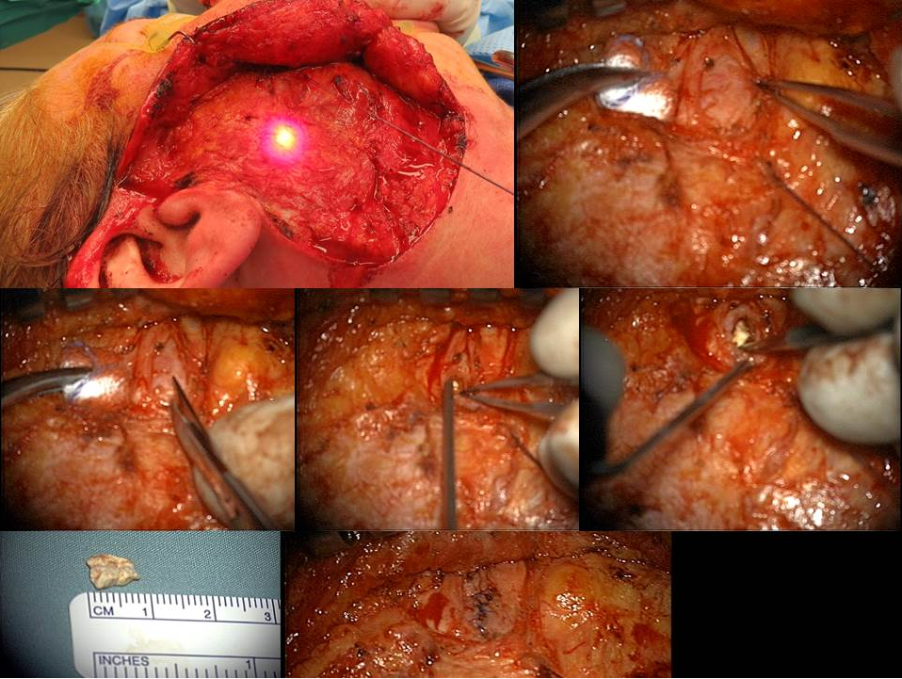

Slide 22
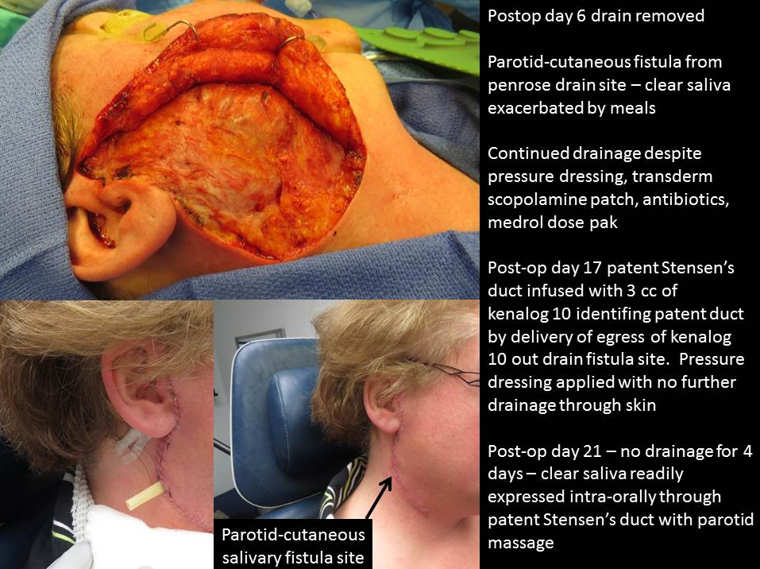

Slide 23
Sialendoscopy: Diagnosis and Treatment
Henry Hoffman MD U of Iowa
10:45 AM – 11:45 AM Sunday September 11, 2022
Rarely a diagnostic tool (for me)
Useful tool as an adjunct for treatment
Sialendoscopy is needed for treatment
To deploy laser, forceps, drill, basket for deeper stones
Sialendoscopy is useful but alternatives exist
Help preserve duct when operating around it
Evaluate duct remnant after gland resection
Identify location of duct for open procedures
Help deploy dilators for stricture
Help deliver steroid insufflation

Slide 24
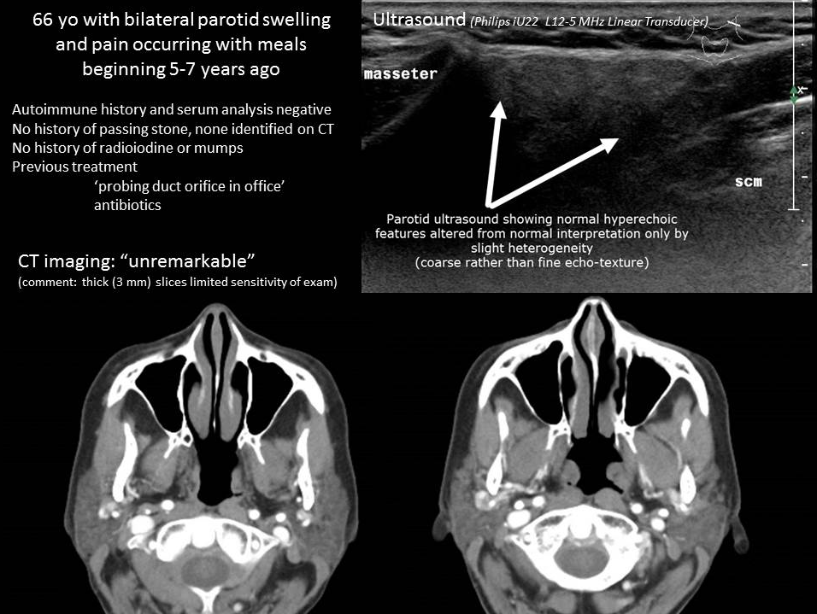

Slide 25
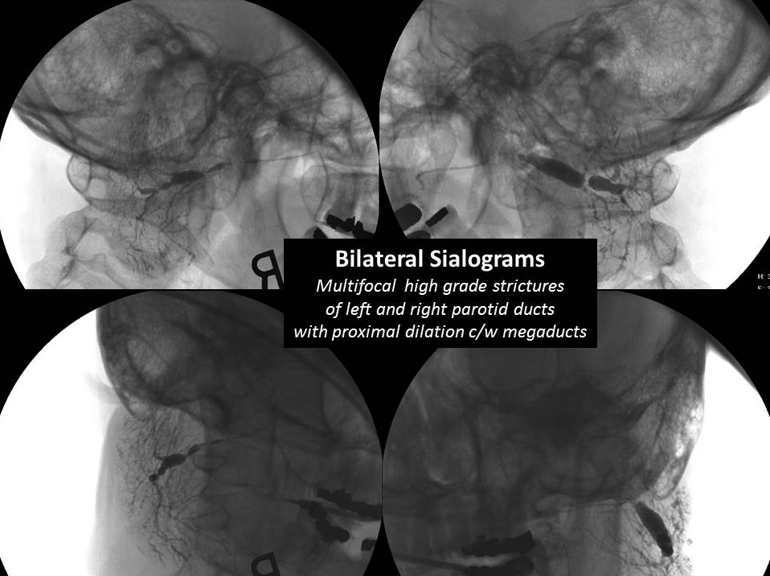

Slide 26
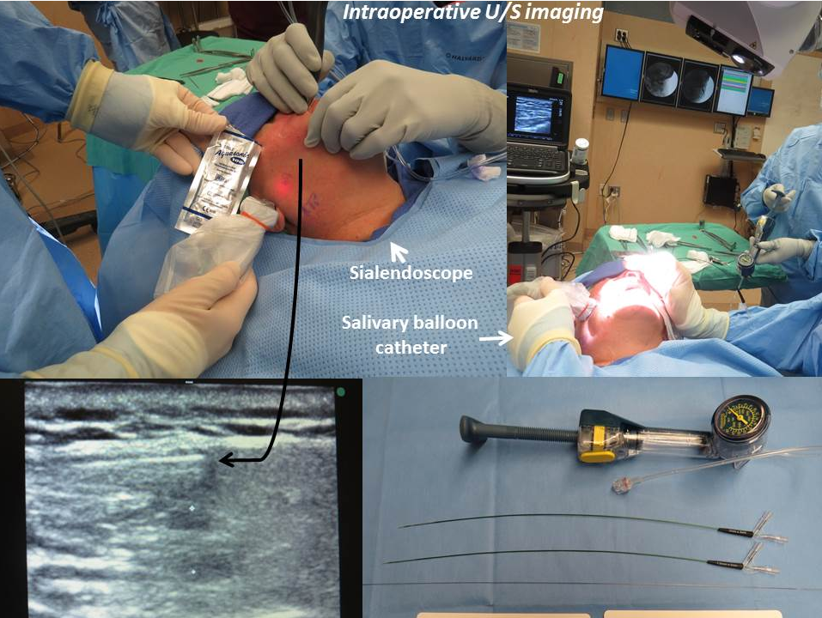

Slide 27
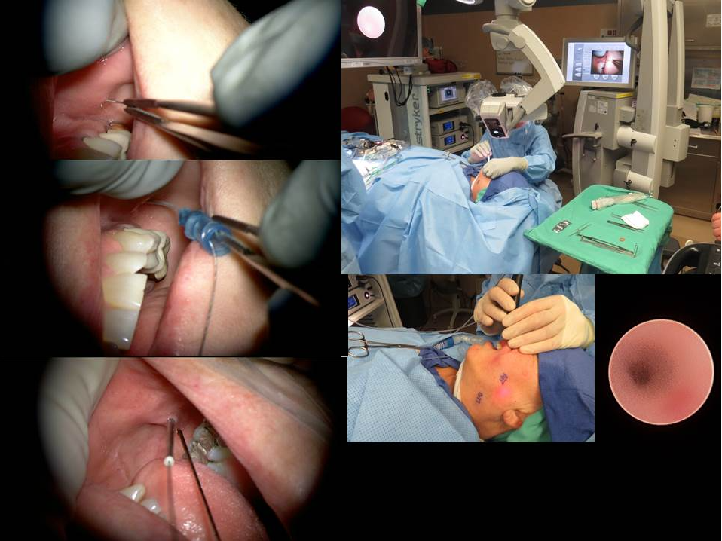

Slide 28
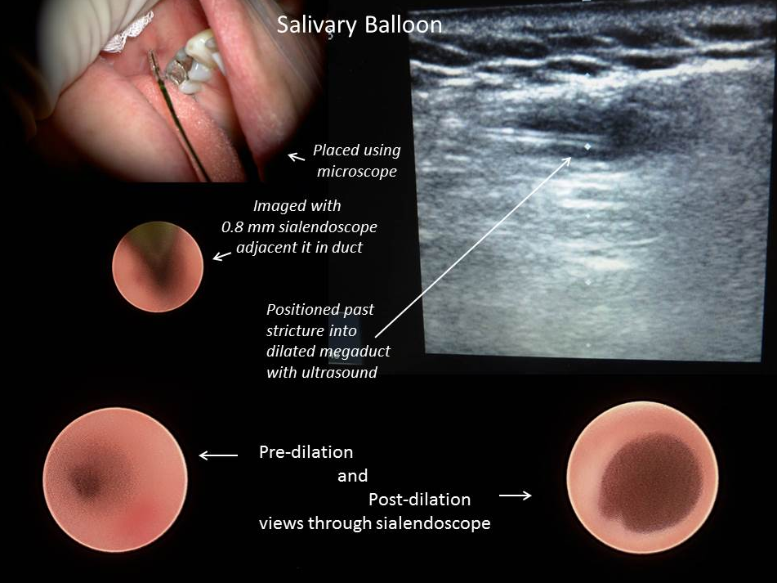

Slide 29
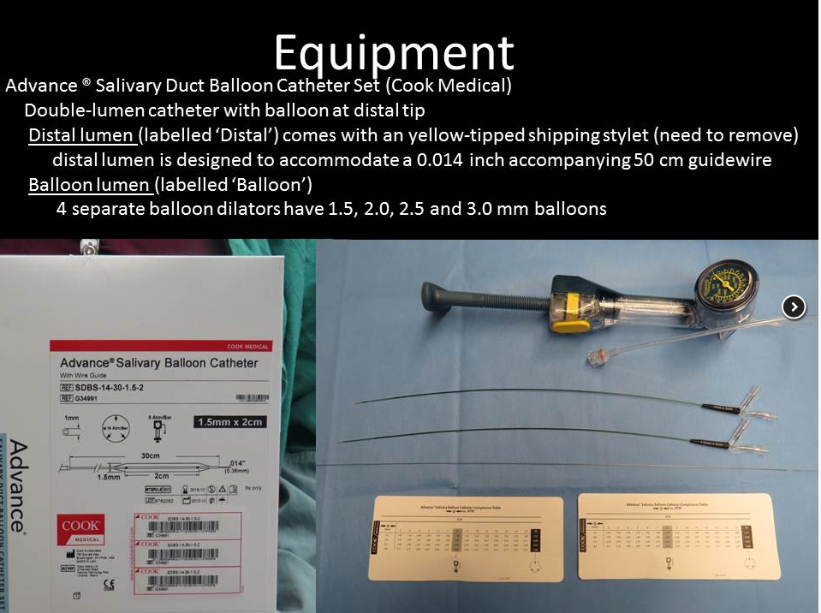

Slide 30
Sialendoscopy: Diagnosis and Treatment
Henry Hoffman MD U of Iowa
10:45 AM – 11:45 AM Sunday September 11, 2022
Rarely a diagnostic tool (for me)
Useful tool as an adjunct for treatment
Sialendoscopy is needed for treatment
To deploy laser, forceps, drill, basket for deeper stones
Sialendoscopy is useful but alternatives exist
Help preserve duct when operating around it
Evaluate duct remnant after gland resection
Identify location of duct for open procedures
Help deploy dilators for stricture
Help deliver steroid insufflation

Slide 31
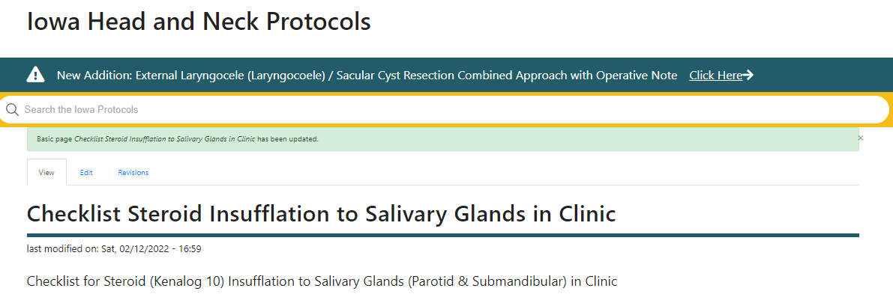




Instrumentation

Slide 32


floppy end to
0.015” guidewire
0.015”
Fixed Core
Wire Guide
slot
Ziegler Double Ended
Lacrimal Dilator
22 gauge
angiocatheter
Debakey Forceps

Slide 33


Slide 34






Floppy End Stiff End

Slide 35



Slide 36


use .015” rather than .018”

Slide 37



Show balloon
Dilators for contrast

Slide 38


Slide 39





Slide 40





Slide 41


Slide 42




Slide 43



the floppy end
Not advised to shorten the floppy end as is demonstrated here

Slide 44

Ensure patient is well hydrated
“ace-in-the-hole”: massage gland to identify duct through production of saliva
Hints: may massage contralateral normal gland to see where duct should be on abnormal side
in OR anesthesiologists are not comfortable with giving pilocarpine but they are with neostigmine
a. In clinic local anesthesia – “come in well fed and well hydrated”
b. Oral rinse dilute betadine; often pre-medicate anti-staph antibiotic
c. In OR before surgery: arrive >1 hour early – IV lactated ringers
- 500 cc over first hour; 200 cc per hour until surgery

Slide 45



2. Use Microscope to
Identify Anatomy and Cannulate Ducts
Parotid from the side
Submandibular from above

Slide 48

3. Know normal
and abnormal anatomy
Submandibular Gland
Wharton's duct - Also known as submandibular duct;
the main duct of the submandibular gland that drains
into the floor of mouth through the sublingual caruncula
(distinguish from "Warthin's tumor")
Sublingual caruncula, caruncle, or sublingual papilla -
Prominences on either side of the base of Lingual
Frenulum representing the sites through which
Wharton's duct drains.
Lingual Frenulum - Band of connective tissue that is
attached along the ventral tongue to the floor of mouth
Plica- Derived from the Latin word plicare, to fold
(Merriam-Webster online dictionary 2021)
Plica Fimbriata - Derived from the Latin word, fimbria,
meaning fringe; Plica Fimbriata are mucosal folds on
the ventral side of the tongue running laterally on each
side of the frenulum.
Sublingual Gland
Bartholin's Duct - Common duct of sublingual gland
that joins Wharton's duct to drain into the sublingual
caruncle
Ducts of Rivinus - Series of short ducts that drains saliva
from the sublingual gland directly onto the floor of mouth
Sublingual Fold or Plica Sublingualis - Elevated fold of
mucosa along the floor of mouth indicating the sublingual
gland through which the ducts of Rivinus drain

Slide 49

3. Know the normal and the abnormal anatomy
plica sublingualis
Sublingual fold
frenulum

Slide 50

3. Know the normal and the abnormal anatomy

Slide 51


Sialendoscopy reveals stone in Wharton’s duct
Removed with basket and ductoplasty

Slide 52

3. Know normal
and abnormal anatomy
Zhang L, Xu H, Cai ZGet al. Clinical and anatomic study on the ducts of the submandibular and sublingual glands. Journal of oral and maxillofacial surgery : official journal of the American
Association of Oral and Maxillofacial Surgeons 2010; 68:606

Slide 53





Slide 54



A
Swelling and pain right level I for many years
A ? Normal submandibular gland
B ? One normal sublingual gland
C ? Two submandibular glands
A
B
C
B
C

Slide 55


Slide 56

Relevant Anatomy
Parotid: Anomalous drainage acquired and congenital

Slide 57


Slide 58









4. Manipulate soft tissue: lateral cheek traction; forceps or Kittners for FOM

Slide 59

4. Manipulate soft tissue: lateral cheek traction; forceps or Kittners for FOM

Slide 60



4. Manipulate soft tissue: lateral cheek traction (parotid)
Forceps or Kittners for FOM (submandibular)
“traction + counter-traction”

Slide 61






Slide 62
5. Cannulate – if possible with 0.015 inch guidewire -
  DeBakey forceps with slot for guidewire
  Turner needle (aka Rosen pick)
  Use 2% viscous lidocaine (local) or K-Y gel (general anesthesia)

Slide 64

6. Dilate (don’t lose the lumen)
  ‘Modified seldinger technique’ (COOK history)
  Progressive dilation – 24 – 22 – 20 (if possible) angiocath –
  Can place 0.8 mm Zenk scope through 18 but not 20 angio
  If 20 angiocath won’t progress, use hollow Marchal dilators
  Progress to COOK salivary access dilators 4Fr – 5Fr – 6Fr – 7Fr
Permission is granted to
do what the f**k you want to with this document
under the terms of the WTF Public License
Downloaded with permission from Wikimedia
https://commons.Wikimedia.org/wiki/File:Catheter_Schema_3_ret....

Slide 65






Slide 66
For the difficult to dilate- if even the tip of the 24 gauge angiocatheter gets in
-then through it infuse saline (in OR); radiocontrast (Isovue 370 for sialography)
Arjun Joshi’s team: viscous lidocaine infusion at time of in-clinic local anesthesia sialendoscopy
‘stenting and dilating injection of the viscous lidocaine within the duct facilitates easy insertion and continued visualization”
“While the available salivary access dilating catheters range
from 4–0 to 7–0 Fr, usually only one size is needed per case.
The authors mainly utilize the 5–0 or 6–0 Fr sizes for the
purpose of salivary papilla dilation and access, though the
4–0 Fr can be useful in cases with papillary stenosis and
the 7–0 Fr catheter can help prepare the duct for passage
of a larger endoscope, such as the Erlangen 1.6 mm”

Slide 67
References
Walvekar RR, Carrau RL and Schaitkin B: Sialendoscopy: Minimally invasive approach
to the salivary ductal system. Operative Techniques in Otolaryngology
Head and Neck Surgery Volume 20, Issue pp 131-135, June 01 2009
Schwalje AT, Hoffman HT. Intraductal Salivary Gland Infusion With Botulinum Toxin.
Laryngoscope Investig Otolaryngol. 2019 Sep 3;4(5):520-525.
doi: 10.1002/lio2.306. PMID: 31637296; PMCID: PMC6793609.
Thorpe RK, Foggia MJ, Marcus KS, Policeni B, Maley JE, Hoffman HT. Sialographic Analysis
of Radioiodine-Associated Chronic Sialadenitis. Laryngoscope. 2020 Nov 17.
doi: 10.1002/lary.29279. PMID: 33200832.
Foggia MJ, Peterson J, Maley J, Policeni B, Hoffman HT. Sialographic analysis of parotid
ductal abnormalities associated with Sjogren's syndrome. Oral Dis. 2020
Jul;26(5):912-919. doi: 10.1111/odi.13298. Epub 2020 Mar 3. PMID: 32031309.
Truong K, Hoffman HT, Policeni B, Maley J. Radiocontrast Dye Extravasation During Sialography.
Ann Otol Rhinol Laryngol. 2018 Mar;127(3):192-199. doi: 10.1177/0003489417752711.
Epub 2018 Jan 7. PMID: 29308655
Hoffman HT, Walvekar RR, Tracy CR, Kolenda J, Pagedar N. Endoscopic Salivary Stone Fragmentation
with Pneumatic Lithotripsy in a Simulation Model. Otolaryngol Head Neck Surg. 2016
Mar;154(3):454-9. doi: 10.1177/0194599815626138. Epub 2016 Jan 19. PMID: 26786265.
Squires L, King J, Hsieh TY, Joshi AS. Rapid, Effective Cannulation for Salivary Duct Access:
Use of Hydro-Dilation With Viscous Lidocaine. Laryngoscope.
2021 Aug;131(8):E2432-E2435. doi: 10.1002/lary.29456. Epub 2021 Mar 15. PMID: 33720416.
Marchal F: Chapter 6 “Sialendoscopy” pp 127-147 in
Salivary Gland Disorders eds Myers EN and Ferris RL Springer-Verlag Berlin 2007
Saban Y, Sozen T, Palhazi P, and Polselli R: Chapter 1 “Salivary Gland Anatomy” pp 2-11
in Surgery of the Salivary Glands Robert Witt 2021 Elsevier
Zhang L, Xu H, Cai, Z, Mao C, Wang Y, Peng X, Zhu Z and Yu G: Clinical and Anatomic Study
on the Ducts of the Submandibular and Sublingual Glands Journal of Oral and
Maxillofacial Surgery, 2010-03-01, Volume 68, Issue 3, Pages 606-610, 2010

Slide 68
References
Goates AJ, Lee DJ, Maley JE, Lee PC, Hoffman HT. Pneumoparotitis as a complication
of long-term oronasal positive airway pressure for sleep apnea. Head Neck. 2018 Jan;40(1):
E5-E8. doi: 10.1002/hed.25003. Epub 2017 Nov 17. PMID: 29149468.
Blake Sullivan C, Hoffman H. Dynamic imaging with sialography combined with
sialendoscopy to manage a foreign body in Stensen's duct. Am J Otolaryngol.
2018 May-Jun;39(3):349-351. doi: 10.1016/j.amjoto.2018.03.001. Epub 2018 Mar 3. PMID: 29525141.
Marcus KS, Zhu VL, Eigsti RL, Hoffman HT. Fibrous Salivary Ductal Stricture: A Novel Histopathologic Correlate.
Ear Nose Throat J. 2021 Dec;100(10):NP429-NP431.
doi: 10.1177/0145561320927553. Epub 2020 May 26. PMID: 32453645.
Walvekar RR, Hoffman HT, Kolenda J, Hernandez S. Salivary Stone Pneumatic Lithotripsy in a
Live Porcine Model. Otolaryngol Head Neck Surg. 2016 Jun;154(6):1023-6.
doi: 10.1177/0194599816638313. Epub 2016 Apr 5. PMID: 27048662.
Truong K, Guerin LA, Hoffman H. Value of sialendoscopy-assisted transoral sublingual gland resection
for a plunging ranula: case report and review. J Laryngol Otol. 2015 May;129(5):509-12.
doi: 10.1017/S0022215115000948. Epub 2015 Apr 16. PMID: 25877148.
Diggelmann HR, Hoffman HT. Intraductal infusion of steroids in patients with Sjögren syndrome
to treat painful salivary swelling: Report of 2 cases. Ear Nose Throat J. 2015 Jun;94(6):238-9.
doi: 10.1177/014556131509400611. PMID: 26053983.
Potash A, Hoffman HT. Retrograde sialendoscopy: a new technique for avoiding retained ductal stones.
Ann Otol Rhinol Laryngol. 2012 Jan;121(1):38-43.
doi: 10.1177/000348941212100107. PMID: 22312926.
Goates AJ, Kung RW, Tracy CR, Hoffman HT. Intraductal Laser Fiber Tip Fracture and Retrieval During
Sialendoscopic Laser-Assisted Lithotripsy. Ann Otol Rhinol Laryngol. 2017 Nov;126(11):774-777.
doi: 10.1177/0003489417728736. Epub 2017 Sep 12. PMID: 28895432.

Slide 69


Slide 70



Slide 71






Slide 72





Slide 73



Slide 74








Slide 75





Slide 76


Slide 77


Henry Hoffman
Conflict of interest:
UpToDate Author
Consultant COOK Medical
Access to Papilla
Cannulation Techniques, Instruments and Setup
Equipment
Technique
  Ensure patient is hydrated
  Use a microscope
  3. Know the anatomy
  4. Manipulate soft tissue adjacent duct orifice
  5. Cannulate with 0.015 inch guidewire
  6. Dilate over guidewire (don’t lose the lumen)
Presentation Online: The Iowa Protocols

Slide 78
Sialendoscopy As a Diagnostic Tool
Sialendoscopy offers a minimally invasive option for the diagnosis and management of chronic inflammatory disorders of the salivary glands
Hernandez S, Busso C, Walvekar RR. Parotitis and Sialendoscopy of the Parotid Gland. Otolaryngol Clin North Am. 2016 Apr;49(2):381-93. doi: 10.1016/j.otc.2015.12.003. Epub 2016 Feb 22. PMID: 26912292.
“For patients who have failed medical and conservative management, sialendoscopy is the next step in assessing the ductal anatomy. Sialendoscopy is diagnostic and also therapeutic at the same time.”
2. “Sialendoscopy can provide direct, accurate and reliable visualisation of the salivary duct lumen and ductal pathologies”
Liao GQ, Su YX, Zheng GS, Liang LZ. Sialendoscopy-based diagnosis and treatment of salivary ductal obstructions. Chin J Dent Res. 2010;13(1):17-22. PMID: 20936187.
3. “Diagnostic sialendoscopy was used for classifying ductal lesions as sialolithiasis, stenosis, sialodochitis, or polyps.”
Marchal F, Dulguerov P, Becker M, Barki G, Disant F, Lehmann W. Submandibular diagnostic and interventional sialendoscopy: new procedure for ductal disorders. Ann Otol Rhinol Laryngol. 2002 Jan;111(1):27-35. doi: 10.1177/000348940211100105. PMID: 11800367.
Shortcomings (Su et al 2009:
“..as a diagnostic approach, the sialendoscopy has several substantial drawbacks.
  First, the insertion of a sialendoscope can cause destruction of the orifice, which leads to the possibility of consequent scarring. This consequent scarring may induce iatrogenic stenosis and duct obstruction.
  Second, as a semirigid telescope, the sialendoscope is incapable of changing its angle and direction according to the different paths of the branches. Because of the complexity and the crooked paths of the three-dimensional ductal system, some branches will inevitably stay unreachable for the physicians.
  Finally, in patients with obstructive salivary gland disease, the ductal system proximal to the obstructions cannot be detected before successful removal of the obstructions. Thus, the morphology and pathologies of the whole ductal system couldn’t be detected by physicians before surgical intervention.”
Su YX, Feng ST, Liao GQ, Zhong YQ, Liu HC, Zheng GS. CT virtual sialendoscopy versus conventional sialendoscopy in the visualization of salivary ductal lumen: an in vitro study. Laryngoscope. 2009 Jul;119(7):1339-43. doi: 10.1002/lary.20504. PMID: 19507221

Slide 79
Submandibular Stone
schedule clinic visit
(likely pre-op)
Salivary Swelling/Pain
Diagnostic Tools
Video-Telemedicine
History
Physical Exam
Review CT imaging
No Stone Identified / Parotid Stone
schedule clinic visit
(with sialogram- possible preop)
In Clinic – 5. Ultrasound
In Clinic – 4. Massage the Glands
In Clinic – 4. Massage the Glands

Slide 80
Submandibular Stone
schedule clinic visit
(use as likely preop)
Salivary Swelling/Pain
Diagnostic Tools
Video-Telemedicine
History
Physical Exam
Review CT imaging
No Stone Identified / Parotid Stone
schedule clinic visit
(with sialogram)
In Clinic – 4. Massage the Glands
In Clinic – 5. Ultrasound
In Clinic – 4. Massage the Glands

