Slide 1
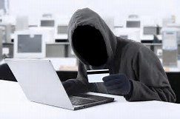
Identity Theft

Slide 2
Agenda
Basic Definitions
Why?
How
Prevention
If You’re a Victim
References

Slide 3
Definitions of Identity Theft
Merriam-Webster
The illegal use of someone else's personal information (such as a Social Security number) especially in order to obtain money or credit
U.S. Department of Justice
Identity theft and Identity fraud are terms used to refer to all types of crime in which someone wrongfully obtains and uses another person’s personal data in some way that involves fraud or deception, typically for financial gain.

Slide 4
Definition of Non-Public Personal Information (NPI)
Paraphrased from the State of Iowa Security Breach Law.
An individual’s first name or first initial and last name in combination with any one or more of the following data elements;
Social Security Number
Driver’s License Number
Financial Account Number
Unique electronic identifier or routing code, in combination with any required security access code, or password that would permit access to an individual’s financial account
Unique biometric data
Notes:
Paraphrased from the State of Iowa Security Breach laws.

Slide 5
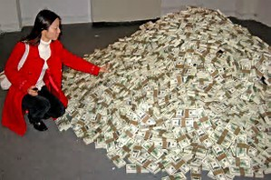
Why?
Why do identities get stolen?
What do the bad guys do with that data?
Sell it for $$
Use it to commit fraud for $$

Slide 6
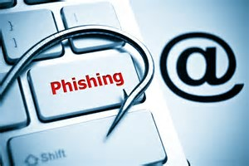
How do the “Bad Guys” get the data or NPI?
Take it
Purchase it

Slide 7
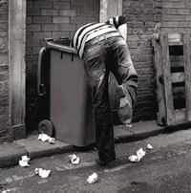
Physical Theft
Theft of purse or wallet
Mail theft
Dumpster diving

Slide 8
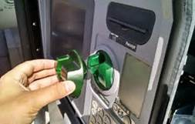
Skimming & Shoulder Surfing
Skimming refers to the act of stealing credit or debit card numbers by capturing the data when the card is swiped. This can happen at a Point of Sale terminal or ATM.
Shoulder surfing refers to using direct observation techniques, such as looking over someone's shoulder or using a camera, to capture information.
Notes:
Inexpensive, miniature closed-circuit television cameras can be concealed in ceilings, walls or fixtures to observe data entry.
To prevent shoulder surfing, it is advised to shield paperwork or the keypad from view by using one's body or cupping one's hand.

Slide 9
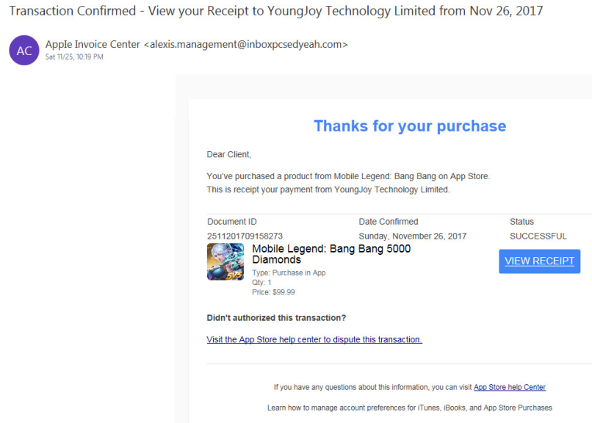
Social Engineering
Phishing is used to acquire information such as usernames, passwords or credit card details by masquerading as a trustworthy entity in electronic communication.

Slide 10
Pretexting
Using an invented scenario to engage a targeted victim in a manner that increases the chance the victim will divulge information or perform actions that would be unlikely in ordinary circumstances.
You may be contacted in a wide variety of ways (Call, Text, Social Media, Fax, Etc.)

Slide 11
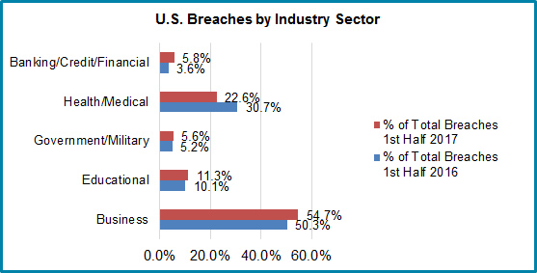
Hacking/Data Breaches
Equifax – 145.5 million people
Yahoo – 1 billion accounts
Uber – 57 million users
Population of US is approximately 325 million
Notes:
Equifax – Names, SSN, DOB, addresses, credit card #s, some drivers license #s
Yahoo – Username and passwords
Uber – Names, addresses, email addresses

Slide 12
Deep/Dark Web
Surface Web = Anything that can be indexed by a search engine.
Deep Web = Anything that can’t be found via a search engine
Dark Web = Hidden Portion of the Deep Web not accessible by standard browser
Entire Hidden Data Economy where criminals buy and sell products and services.
Social Security Numbers
Credit Card Numbers
Account Info (Facebook, Twitter, etc.)
Botnets
Notes:
What do the bad guys do with it once they acquire data they can sell or use? Target breach as an example.

Slide 13
What Kinds of Fraud are Committed?
Spending your money
Opening Loans or Credit Cards in your name
When they don’t make payments, your credit is impacted.
Using gathered data for social engineering.

Slide 14
Why is it so Popular?
Cybercrime as an industry in 2016
$400B Industry (GDP of Ireland was a little over $300B)
Lucrative
Light Punishment
Low odds of getting caught or going to jail
Notes:
Aggravated Identity Theft carries a minimum of 2 years in prison, Computer Fraud and abuse has up to 10 year sentence. One of the yahoo hackers pleaded guilty, 250K fine

Slide 15
General Prevention
Reconcile bank and credit card statements monthly.
Review your credit report.
Order free credit report from Annualcreditreport.com
Look for
Accounts you don’t recognize
Incorrect information regarding current accounts
Guard your PIN’s and passwords. Keep PIN numbers separate from your credit/debit cards.
Report lost or stolen cards immediately.

Slide 16
General Prevention - Continued
Pay bills online and sign up for eStatements when possible. Your personal information is more likely to be stolen from your mailbox than online.
Shred all documents containing personal information before discarding.
Keep devices up to date and install anti-virus/anti-malware if possible.
Properly secure social media accounts.
Do not disclose personal information to someone who contacts you via phone/email/social media.

Slide 17
If You’re a Victim
Keep a log of actions.
Contact local police.
Contact your financial institution.
Close compromised accounts.
Place a fraud alert on your accounts.
Change your online passwords.
Contact the FTC at 1-877-IDTheft or www.consumer.gov/idtheft

Slide 18
References
Identitytheft.net
Brightplanet.com
Merriam-webster.com
Thebalance.com
Databreachtoday.com
Idtheftcenter.org
Census.gov
Wikipedia.com

