Slide 1
University of Iowa Scientific Careers Retreat Nori Ueno, PhD (2011) Associate Director of Business Development Cell and Gene Therapy

Slide 2
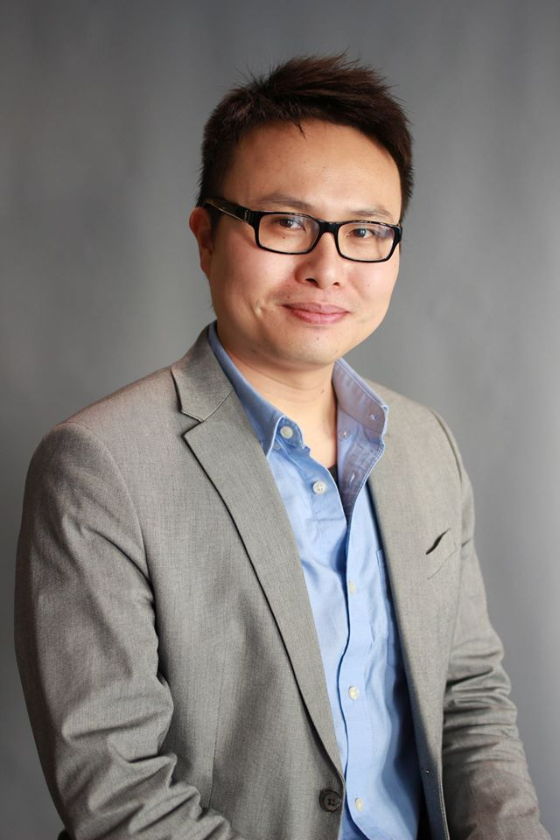
From academia to commercial role in biotech
Nori Ueno
BA, Microbiology
Anaerobic microbes
PhD, Microbiology
Mary Wilson’s lab
Lic phagocytosis
AHA Postdoc
Melissa Lodoen’s lab
T. gondii dissem.
Applications Scientist
Flow, ELISA, Luminex, RNA-ISH
CA sales team lead
RUO antibody sales
DEI education leader
BD Assoc. Director
Single cell DNAseq
Cell & Gene Therapy

Slide 3
“DOES ANYONE HERE WANT TO GET INTO SALES?”

Slide 4
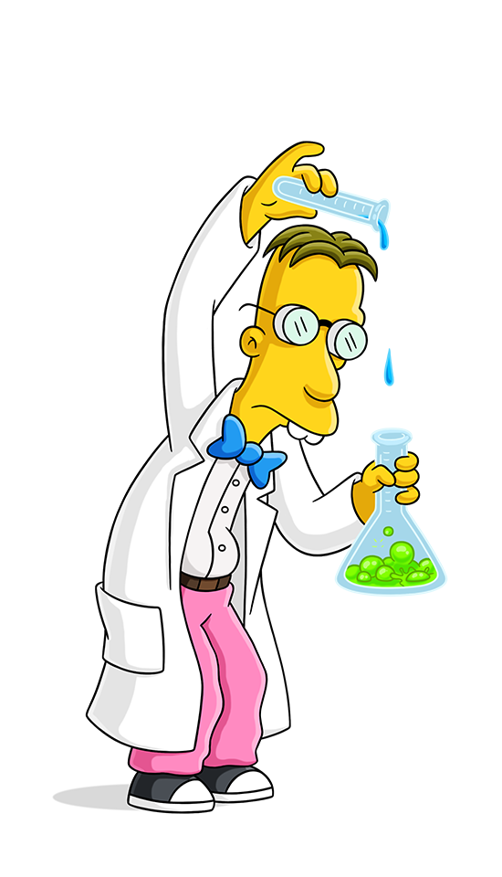
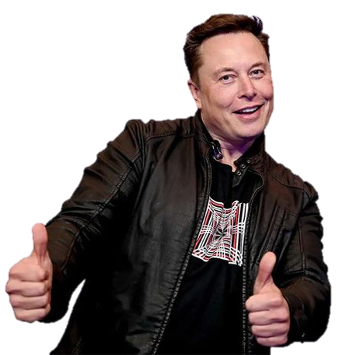
What about my training?
10+ years as a bench scientist
13 publications and co-authorships
Extramural grant funding
Conference presentations
Wasn’t I training to become:
NOT:
???

Slide 5
Science = Selling (not always for money)!
Scientific papers: Selling to the reviewers your experimental plan, convincing data, and a clear understanding of how the results fit into the broader biological context
Conference presentations: Selling to the audience your research progress and the reasons it deserves attention from your colleagues or competitors
Grant support: Selling to the funding agency your exciting hypothesis, how the findings will benefit the field, and why you should be paid to study it
Thesis defense: Selling to the committee that you’re worthy of a degree
Selling = presenting your value
Your value = your scientific acumen

Slide 6
The value PhD scientists bring to commercial
Experience in academia
Performing experiments
Submitting grant proposals
Writing papers
Presenting at conferences
Training undergrads
Value in biotech
Familiarity with products, use cases, troubleshooting
Testing a hypothesis with a set of logical experiments
Compiling, visualizing, interpreting, describing data
Narrating a biological mechanism to a broad audience
Transferring knowledge, working within a diverse team matrix

Slide 7
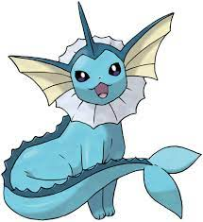
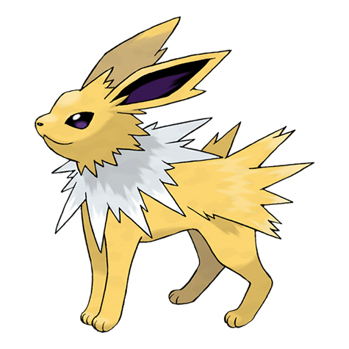
Positioning yourself to ascend “diagonally”
Team Lead (Management)
Onboard new FAS
Nurture FAS growth and continued success with sales
Scientist (R&D)
Platform development
New product introduction
Marketing
Product Management
Business Development (Sales)
Prospecting for new business
Grow existing business
Your performance = $$$
Field Applications Scientist (Support)
Client trainings / product demos
Experimental troubleshooting
Liaise between sales and science

Slide 8
How do we get started?
Reassess your true value: Recognize all the ways your training is applicable and desirable to biotech
Put these values on paper: Sell yourself with concrete, quantifiable examples; write what you accomplished vs. just what you did on your resume
Align with needs of a specific company: Study the company and landscape; understand what they sell; distinguish your biological vs. technical expertise
NETWORK: Most get in through “a friend of a friend” - Cohorts - Alumni - Career-building events - Salespeople Consider: Meeting up for coffee is your first “real” interview

Slide 9
Thank you!

Slide 10
Entry point: Field Applications Scientist
Responsibilities Support sales as technical advisor for product line(s) Support clients adopt product and troubleshoot if necessary
Day-to-day Train clients on flow cytometry, immunoassays, Luminex, RNA-ISH assays Technical seminars to spread awareness Remote and on-site technical support Join sales calls
Work dynamic Fully remote Fly or drive to client labs (every 1 - 2 weeks)
Benefits ~$90K base + 15% bonus + full fringe + car + iPhone + miles (2016) Client success

