Slide 1
Behind the Curtain: Scientific Editing at Immunity
Jodi Gullicksrud
Scientific Editor

Slide 2
Overview
My path
Immunity and Cell Press
The editorial process and how decisions are made
Editorial as a career
Q&A

Slide 3
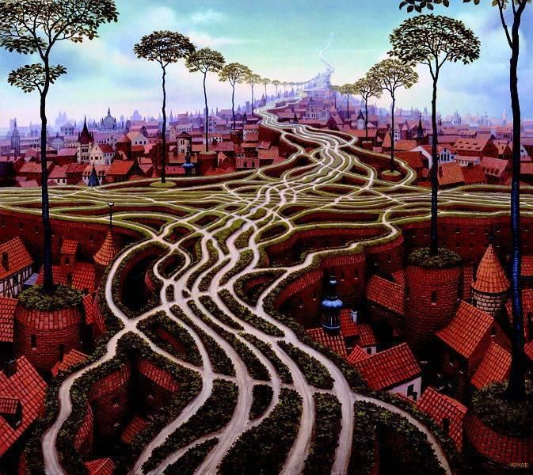
My path to editorial
2008 B.S. Biology, Math – Drake University
Research: Cell Biology and Ornithology
2008-2012 Undergrad Biology Lab Instructor
2012-2017 PhD Immunology – U of Iowa
2017-2020 Postdoc – U of Pennsylvania
2020-present – Editor at Immunity
Focus: Mucosal immunology, Infectious diseases, T cells and ILCs

Slide 4
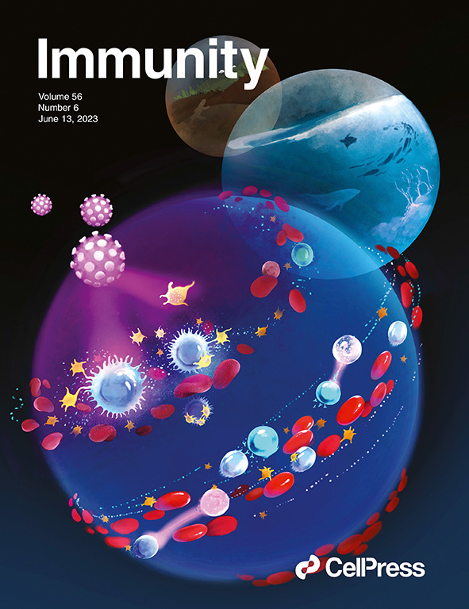
General stats on Immunity
Founded in 1994 (we turn 30 next year!)
5 full-time editors – all are science PhDs
https://www.cell.com/immunity/home
Follow us on Twitter (X): @ImmunityCP
Manuscript formats: Research, Resource, Report
Immunity receives >1500 articles per year Every abstract is read by all editors Every paper is read in detail by its HE ~30% are sent out for review

Slide 5
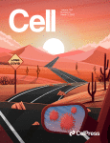
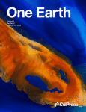
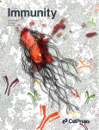
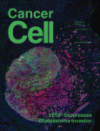
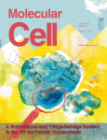
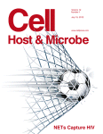
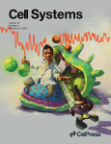
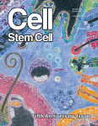
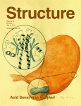
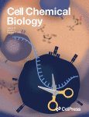
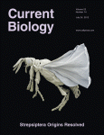
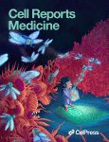
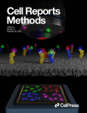
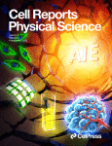
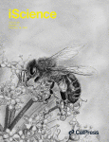
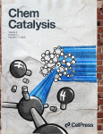
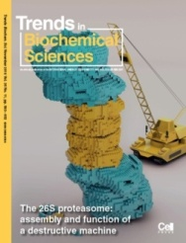
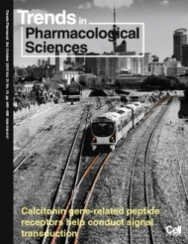
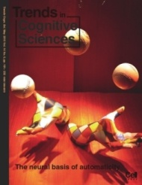
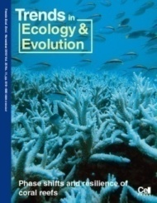
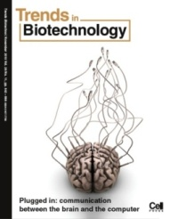
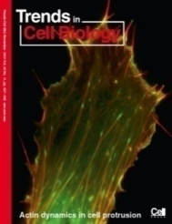
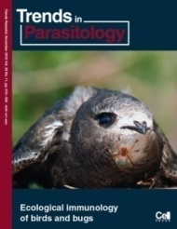
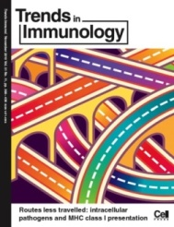
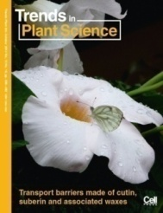
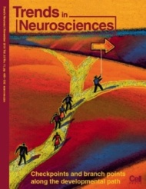
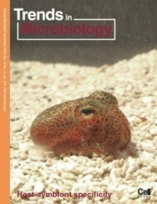
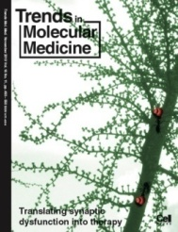
The Cell Press Journal Portfolio
30 Primary Research Journals (covering life, physical, medical, and environmental sciences) – 9 gold OA journals
16 Trends Review Journals
11 society partner journals (e.g. Mucosal Immunology)

Slide 6
The Editorial Process at Immunity

Slide 7
What happens after you click “Submit”?
Manuscript is submitted
What we look for in a paper
Editorial evaluation
Key question being addressed
Scope – Who will be interested?
Biological relevance – *Context* When/Why is this phenotype important?
Conceptual advance – Where does this move the field?
Depth of understanding – How does it work?
This is also dictated by the paper format

Slide 8
Initial editorial decision
Components of a
(Structured) Reviewer report
Manuscript is submitted
Editorial evaluation
No and why
Summary
Significance
Major Concerns
Minor Comments
Clarity of Reporting
→ Cross-review
Out for Review

Slide 9
Rendering a Decision
Manuscript is submitted
What we take into consideration:
Interest and enthusiasm in the overall message
An understandable and reasonable path for a revised manuscript?
Would the concerns/revisions impact the overall message of the current manuscript?
Editorial evaluation
Out for Review
Editorial evaluation of ms and reviewer reports
Never a yes/no tally.
Rarely a tidy and unanimous
recommendation.

Slide 10
Post-review paper trajectories
Manuscript is submitted
Accepted
in Principle
Editorial evaluation
No and why
Editorial feedback on journal style and scientific clarity
Out for Review
Editorial evaluation of ms and reviewer reports
Finalize
Revise and resubmit
Out for Review
Editorial evaluation of ms and reviewer reports
ACCEPTED!

Slide 11
Editorial as a Career Path

Slide 12
What does an editor do?
Handle manuscripts –
Read, evaluate, and discuss
Edit for scientific clarity, but not proofread
COMMUNICATE – Authors and reviewers, sometimes other editors
Immunity, as a journal
Commission and manage reviews, previews, etc.
Strategic development, special issues, etc.

Slide 13
What (else) does an editor do?
Cell Press-wide
Community review
Collections with other journal editors across Cell Press
Cell Symposia and other conferences and webinars
Immunology community engagement
Attend conferences and participate in Meet-the-Editors sessions
Lab visits and 1-on-1 talks with the research community
Keep abreast of themes and advances across the field immunology

Slide 14
Should I be an editor?
My highlights
Being at the forefront of science
Learning new things across the field
Talking to researchers about their science
Flexibility
Skill set
Time management and delivery on deadlines
Professional and courteous communication
Networking
What can you to do now?
Expand your knowledge base (and see if you like it)
Talk to an editor – conferences, lab visits, or email
Cell Press internships

Slide 15
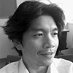
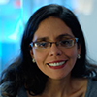
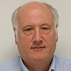
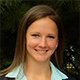
Thank you!
Peter Lee,
Editor-in-Chief
Fabiola Rivas
Deputy Editor
Bruce Koppleman
Kavitha Scranton
Jodi Gullicksrud

