Slide 1
Professional experiences and career opportunities
Joshua Powell Ph.D.
Notes:
Univ. Iowa- appreciate committee inviting me.

Slide 2
The disclaimer slide
As an NIH scientific review officer (SRO)-
This presentation is not formal NIH outreach. I can’t talk specifics about peer review. No guidance information is provided on fellowships or grant applications processes.
Represents candid discussion. My career experiences only….what I learned from them, etc.

Slide 3
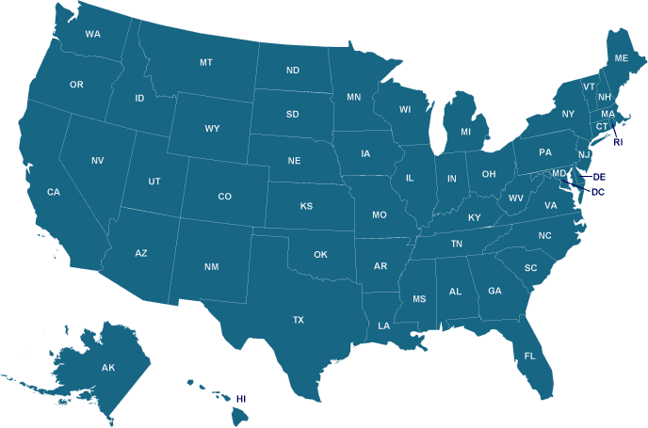
2014-2017
2004- B.S Univ. Oregon
2007- M.S. Oregon St Univ.
2012- Ph.D. Oregon St. Univ
2012-2014- Post Doc.
Univ. Georgia
2014-2017- Staff Scientist
Pacific NW National Laboratory
2017-2018- Battelle Corp
2018-2022- USDA
National Animal Disease Center
Senior Virology Scientist
Contractor via Oak Ridge
Ames, Iowa
2022-present- NIH
Center of Scientific Review
(stationed out of Ames Iowa)
2004-2012
2018-present
2017-
2018
2012-2014

Slide 4
Academia
Medical/doctor
Industry/contract
Federal/govt

Slide 5
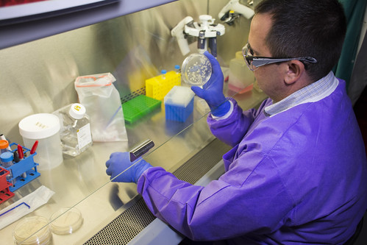
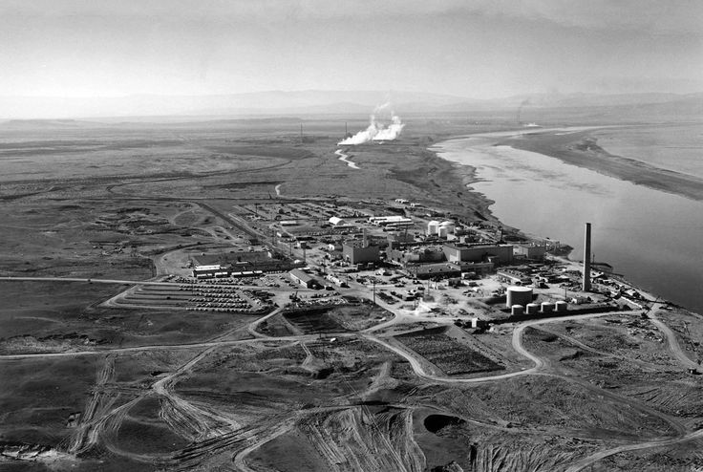
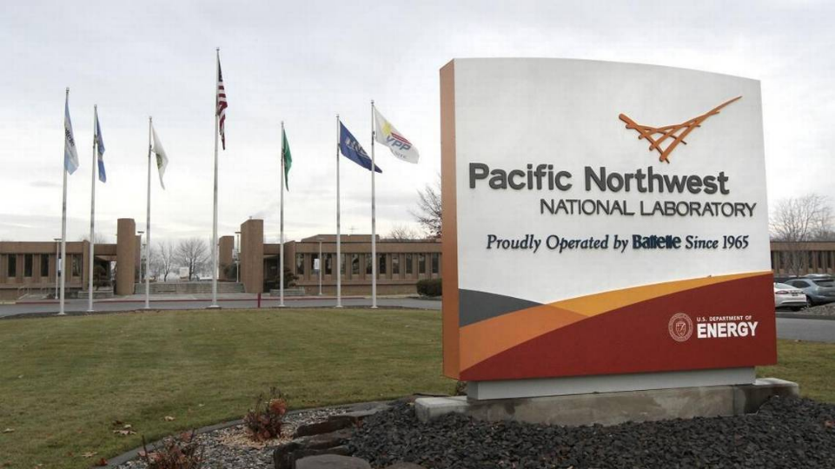
National Lab- 2014-2017
I worked at Pacific Northwest National Laboratory (PNNL) as a staff scientist.
PNNL- biology projects on bioremediation but also govt projects- DARPA, DTRA, DHS on biosecurity use of pathogens (how to detect them).
Hanford Nuclear site- Richland, Washington

Slide 6
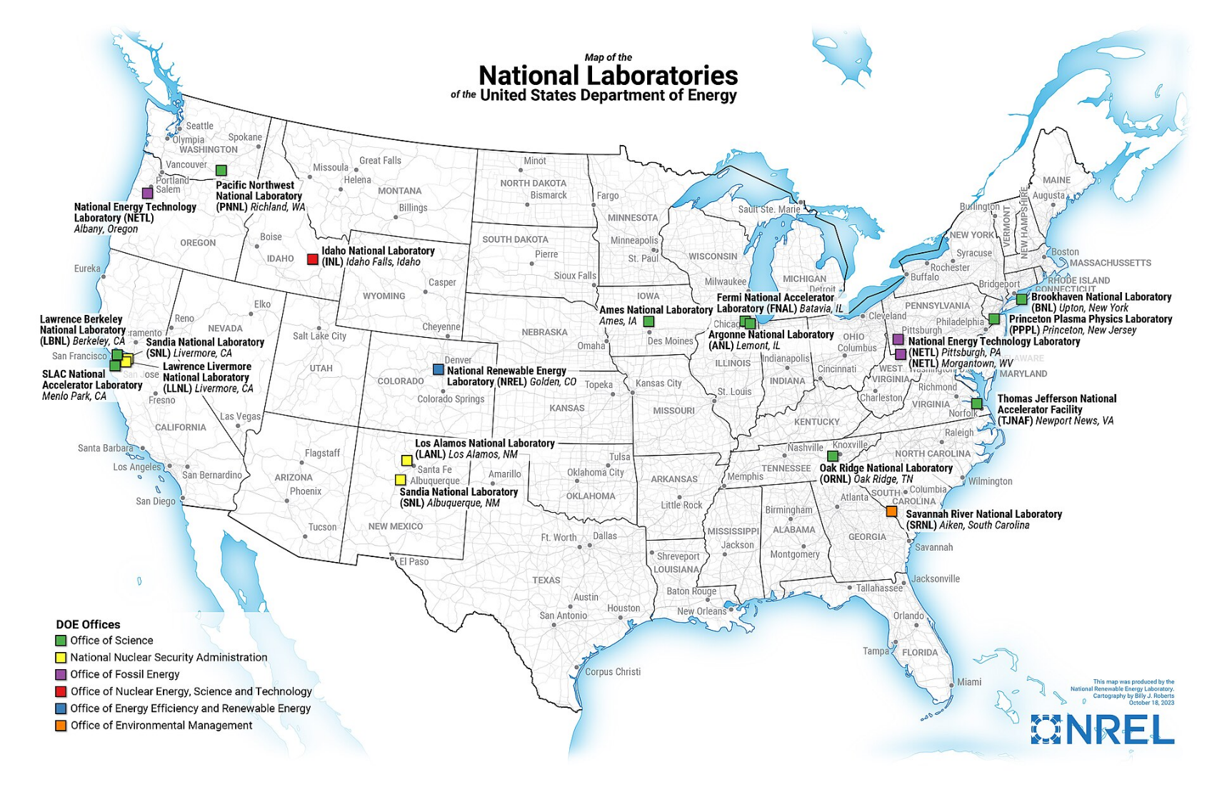

Slide 7
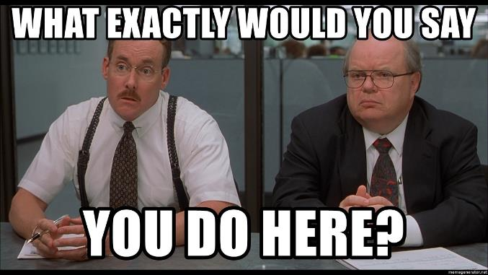
National Laboratory model (you are not a federal employee)-
many different managers, projects, funding sources.
Can pay ~$20K more than an academic postdoc.
Reliant on project funding, $ dries up = so does your job
Ideally suited for bioinformatics, analytical instrumentation specialists and engineering degree specialists
I wish I would have stayed as postdoc and not sought promotion as staff scientist (charge rate = project recruitment).

Slide 8
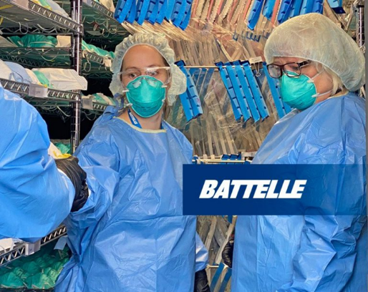
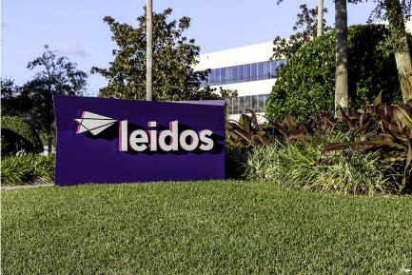
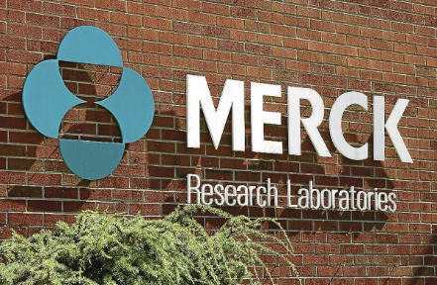
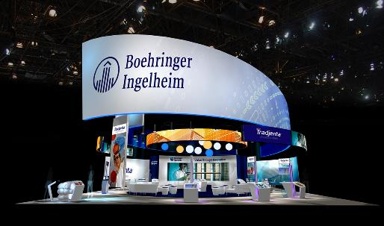
2017-2018- corporate contract work
Pays great (devil in details)
Not great job security
Often charge by the hour (sometimes a cushion)
Location is major cities.
Usually not research, even if advertised that way.

Slide 9
……..I was laid off without warning, on my birthday (with 300 others- about 10% of company)

Slide 10
Take job at National Biodefense Contractor
(Battelle still my employer in Maryland)
Head to Ames Iowa-
USDA contract work on swine influenza
2018

Slide 11
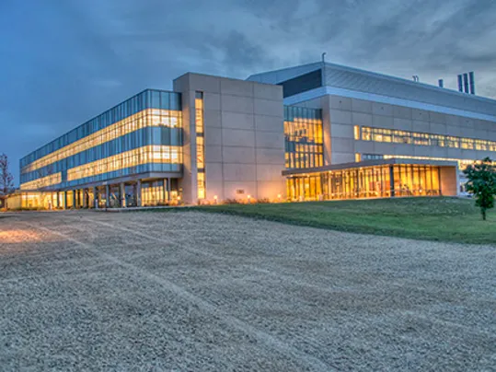
NADC- Ames, IA (2018-2022)
Senior Virology Scientist
Contract work for ~80% of people (through ORISE), connection with ISU.
Stable multi-year funding
Amazing research, great experience…but its still temporary (albeit ~5yrs)
Depends on the unit group you are in (freedom to do independent research can vary).
Considered a stipend “training position” (responsible for own taxes).
Located in Ames Iowa (USDA-
National Veterinary Services Laboratories (NVSL)
National animal disease center (NADC)
Great UDSA research opportunities in Manhattan, KS. National Bio and Agro-Defense Facility (NBAF), partnered with KSU.

Slide 12
The traditional postdoc model at federal agencies has been upended in the last 5 years. ORISE, or similar contractors are now the major employer, not the government itself

Slide 13
NIH Scientific Review Officer (SRO) [2022-present]

Slide 14
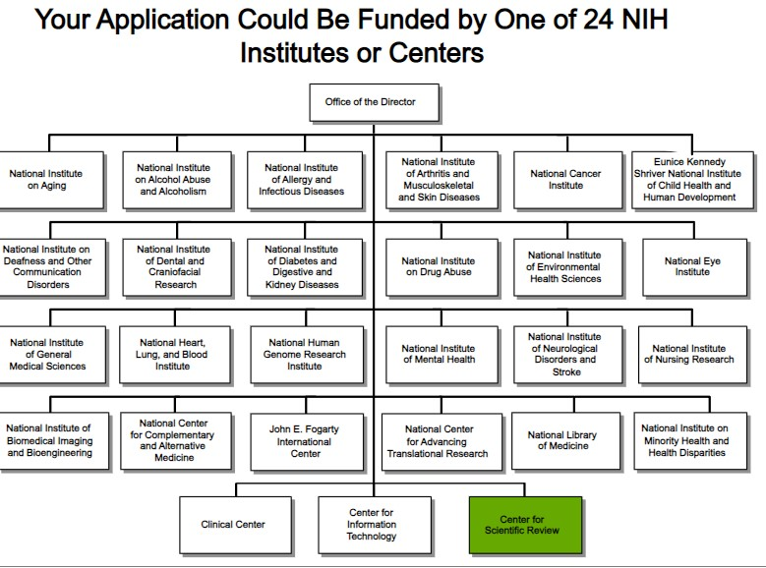

Slide 15
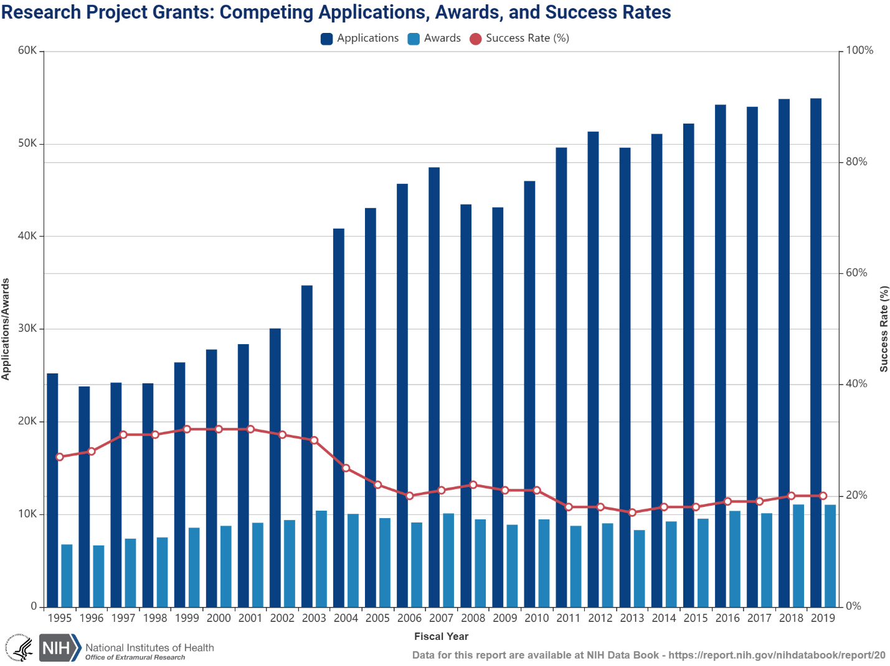
CSR = peer review of applications
(not all >55,000.. but still quite a few)
55,000 applications

Slide 16
Peer review study sections and special emphasis panels
I spend 95% of my time in Ames, Iowa.
I travel to Washington DC- 2 to 3x a year
Most of my time on Zoom conference calls, but usually work ~40hrs a week (maybe 50hrs a week before a big meeting).
3 big cycles each year, stressful months are March, July and November

Slide 17
NIH- Center of Scientific Review (CSR).
Scientific Review Officer (SRO) [2022-present]
What do SRO’s do?
a scientific “referee”. Ensure NIH grants get fair/unbiased peer review
Recruit reviewers/expertise
Coordinate study sections meetings (3x year)
Write summary statements for applicants and for program office
What SROs NOT do
We don’t make funding decisions
We don’t discuss ideas with applicants or reviewers.

Slide 18
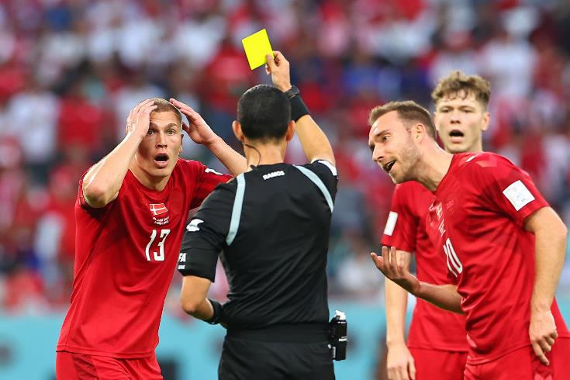
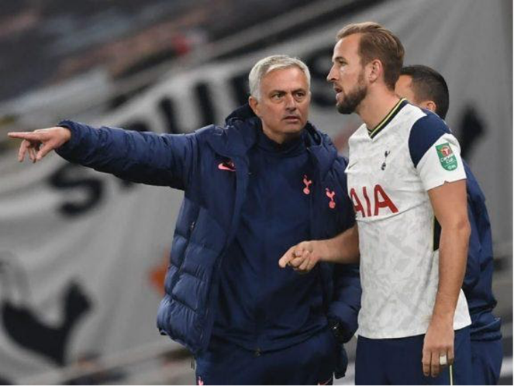
A bit of humor- difference between a SRO and a PO at the NIH
SRO (scientific review officer)
PO (program officer)
Make sure policy/rules are followed for applicants and reviewers
Work with applicants, discuss projects, make funding decisions.

Slide 19
What I love about being an SRO
I have an integral role on the decision-making process for >$800 million worth of applications annually (but not who gets funded)
meet wonderful people in person and virtually
I stay current and up-to-date in the virology field. Go to conferences, recruit panel members, etc.
Long term job stability. Work remotely ~95% of the time.
Some stress but not excessive hours.

Slide 20
Success in the filed of life-sciences requires a graduate degree
A masters degree opens doors, a doctorate provides mobility and career advancement (but maybe not immediately?)

Slide 21
Take-aways for people in Iowa
Look up “ORISE” online for postdoc/staff scientist opportunities at government agencies (USDA, CDC, etc.) usually aren’t posted on LinkedIn and Indeed.
Look up “SRO- scientific review officer” online via NIH for usajobs.gov opportunities
Be very careful of contract work, (ask questions, funding in writing?). Go in with eyes wide open, more pay doesn’t mean you are doing better science.
Be mobile, refrain from planting roots if the job is temporary (<3 yrs).
An academic/govt postdoc does wonders for the career even if you don’t want to stay in academia. Scientific success comes in many shapes and forms.

Slide 22
-Joshua Powell
josh.powell@nih.gov (questions and career advice, but not about grants/fellowships))

