Slide 1
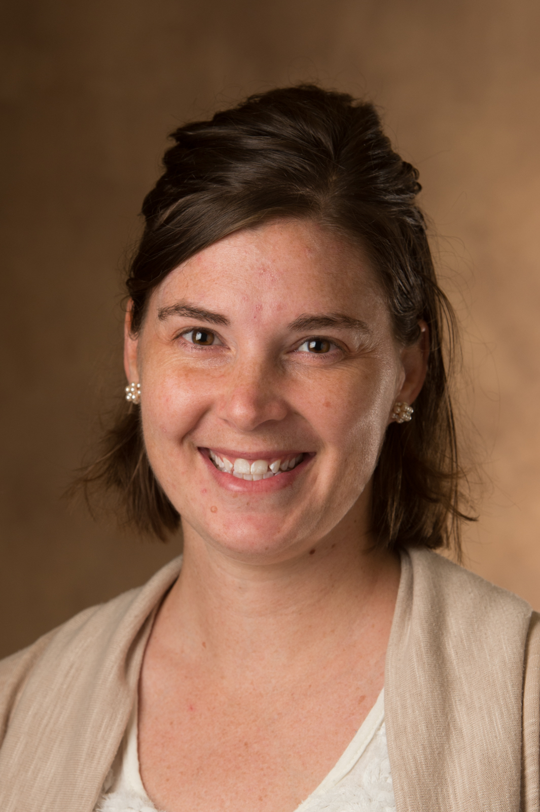
Assistant Professor at a primarily undergraduate institution (PUI)
Scientific Careers Retreat, University of Iowa
20231104
Emily Petruccelli, PhD
epetruc@siue.edu

Slide 2
In undergrad, what do I want to bee when I grow up…
a Medical Doctor?
a Teacher?
something with job security, livable wage, pride..?
Keep many options open!

Slide 3
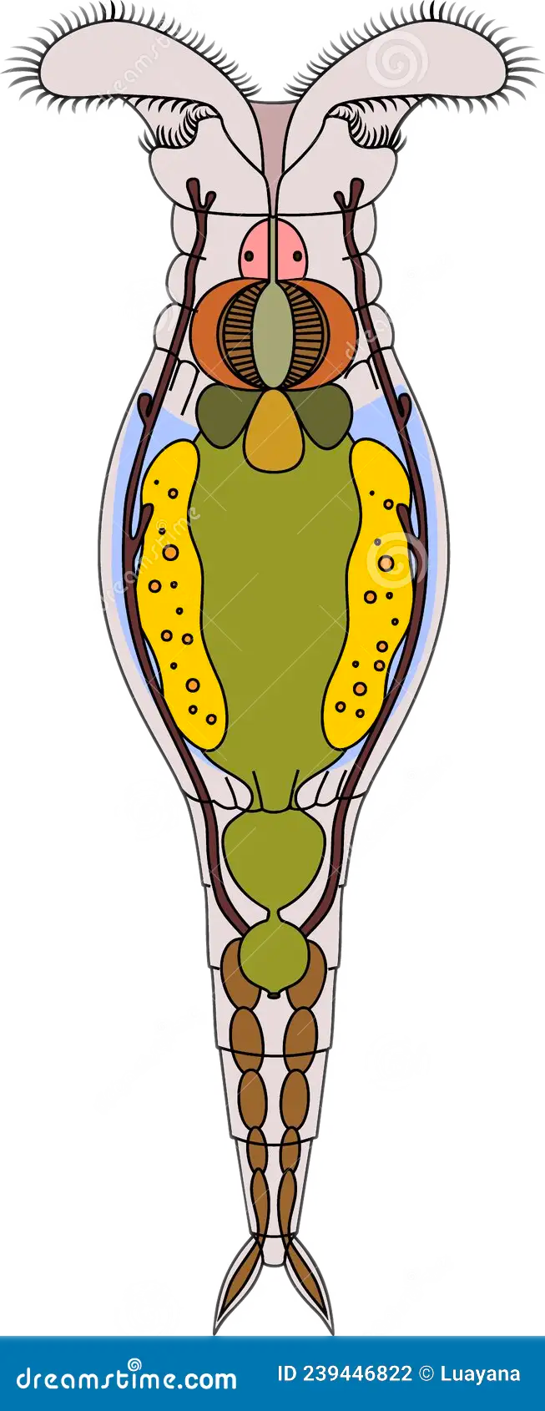
Research Assistant at University of Iowa
Find meiotic genes in genomes of organisms at the base of the Tree of Life: are obligately asexual rotifers secretly having sex?
SKILLZ: basic cell bio – DNA isolation, cleaning, primer design, PCR, Sanger Sequencing; bioinformatics – contig creation, phylogenetics

Slide 4
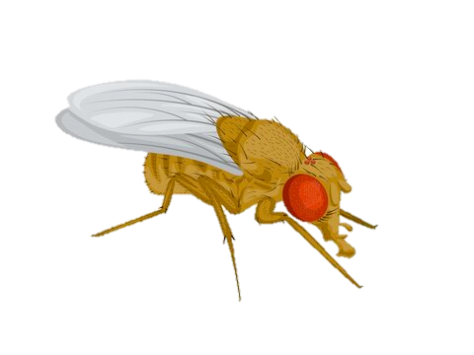
PhD in Genetics at University of Iowa
Drosophila neurogenetics to study complex behaviors like sleep, seizures, and response to alcohol.
Sleep in epileptic NaV channel mutants
Unique insect DA receptor, DopEcR, has a role in alcohol behaviors
SKILLZ: Drosophila– husbandry, genetic crosses, dissections, behavioral assays; cell bio – Westerns, RT-PCR; immunostaining and confocal microscopy; presentation creation and delivery

Slide 5
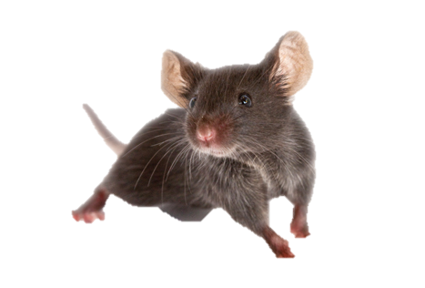
Should I switch model organisms?
...
or

Slide 6
The post-doc
Choice 1: Skip the post-doc! Go straight into teaching.
Choice 2: Stay in flies, but change things up by learning electrophysiology. (Dr. Bing Zhang at Mizzou)
Choice 3: Stay in flies, but learn new strategies for measuring addiction-like behavior (Dr. Karla Kaun at Brown)

Slide 7
Post-Doc at Brown University
Exploring neuromolecular underpinnings of alcohol addiction using Drosophila.
Role of Notch signaling in fly memory of intoxication
Lasting transcriptomic changes in ‘addicted’ fly memory neurons
SKILLZ: Drosophila– associative memory behavior, cutting edge genetic tools for neuronal connectivity; cell bio – qRT-PCR, ChIP, nuclear pulldown for RNA isolation; 3D rendering of confocal files; 3D printing; working with my own RA and students; networking

Slide 8
Post-Doc at Brown University
Successfully published a review
Completed major project, rejected by Cell but under review at Neuron
Able to ‘take’ RNA-seq data with me
Got an adjunct position at night
I’m tired and miss aspects of the Midwest.
Maybe I’ll just apply to jobs and get interview practice?

Slide 9
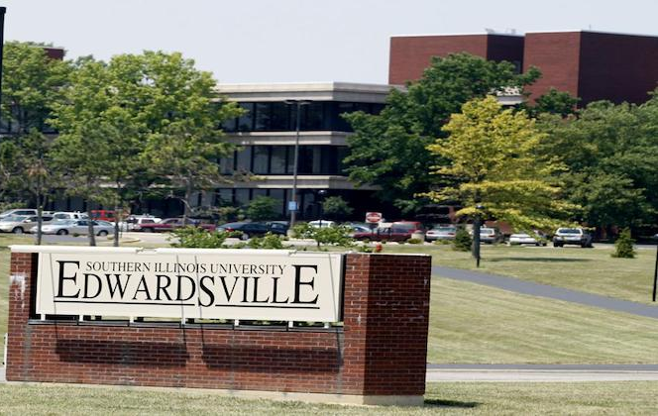
Two Applications, Two Offers!
Luther College
- Small liberal arts, Lutheran
- Teaching only, but with course lab design freedom
Southern IL Univ.
- Medium state school
- Both Teaching & Research
- create Bioinformatics course
Ask mentors for advice and other options.

Slide 10
My academic path…
SAU, Bachelors of Science – 4yrs
Iowa, Research Assistant – 2yrs
Iowa, PhD in Genetics – 6yrs
Brown, Post-Doc – 2yrs
SIUE, Assistant Professor – 6yrs

Slide 11
Life at a primarily undergraduate institution (PUI)

Slide 12
Job Contract:
9 month contract August - May
$3050 semi-monthly ($55K per year; currently at $63K)
Negotiated moving expenses ($3500) and startup funds ($77K)
◆ Teaching (60%)
◆ 3:3 load, so a large ~100 student course with labs or 2-3 smaller courses
◆ Responsible for all instruction, materials, grading, and TAs
◆ Scholarship/Research (30%)
◆ 8 research students = 1 cr teaching release
◆ Whatever time you have left in a day!
◆ Service (10%)
◆ Department meetings (weekly)
◆ Committee meetings Dept. & University level (undergrad, grad, IT/library, Appeals, etc)

Slide 13
Tenure Requirements:
6yr process, submit yearly reviews
full draft at midpoint 3yr
final dossier at the start of 6yr
(Unsat. / Sat. / Meritorious / Excellent)
Teaching
Effective teaching, curriculum development, student and faculty evals, research mentoring, teaching portfolio
Research
Attendance at meetings, two peer-reviewed publications, record of mentoring, at least 1 grant submission
Service
Departmental- and University-level committees, manuscript reviewer, scholarship/grant/award judge

Slide 14
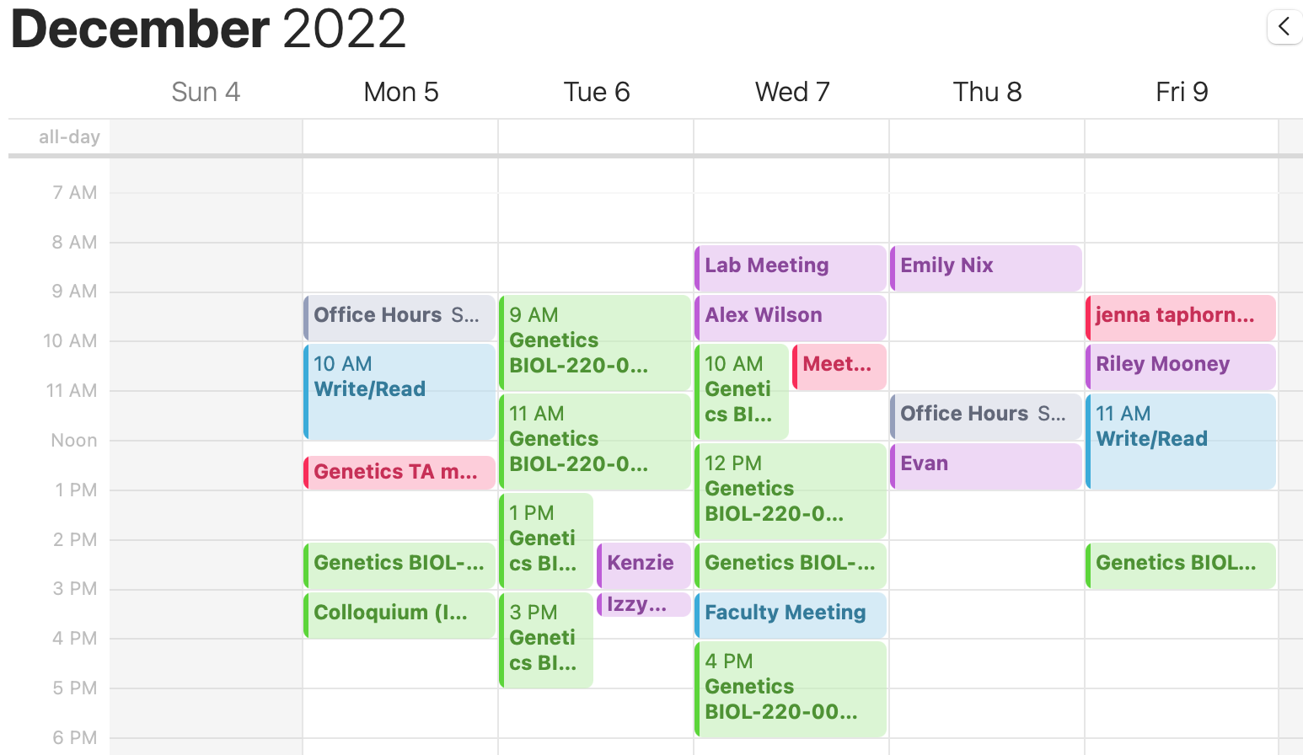
A day in the life…
Arrive on campus ~7am
Check email 7-8am
Flip flies/check lab 8-9am
Prep for class 9-10am
Teach a class 10-11am
Student ?s, blackboard 11-noon
Eat /read a paper noon-1pm
Prep/check weekly labs 1pm-3pm
Go to weekly seminar 3-4pm
Grading, writing, meetings 4-5pm
Leave work ~5-8pm
Teaching: 60%
Research: 20%
Service: 20%

Slide 15
Obtaining a faculty position at a PUI…
Gain teaching experience.
Know the expectations.
Know the position you seek.
4-year program community college, community college?
Research support, resources, expectations
3:3, 4:4, 4:2, etc?
Tenure requirements
Mission and study body
Be an adjuct or visiting faculty
Create lesson plans and syllabi
Example assessment material
Obtaining a faculty position at a primarily undergraduate institution (PUI)
King-Smith et al, 2021 in BMC Proceedings

