Slide 1
Turning a Research Idea into a Successful Project with Minimal Resources or Help
Ingrid Lizarraga MBBS
Clinical Associate Professor
Dec 16, 2019

Slide 2
What resources are you missing?
Knowledge
Methodological
Data sources
Access to data
Personnel
Data collection
Patient recruitment
Statistical support
TIME

Slide 3
Avoiding the academic graveyard…
Short
term
NAE
MRI
And
ILC
Outcomes
after NSM
Cosmesis
after BCT
Surgeon confidence

Slide 4
Tips and Tricks

Slide 5
#1. Take the time to refine your research idea
Doable?
Worth the time?
Fundable?
Even ‘small’ projects take time
Try to avoid ‘one-off’ projects
Define your idea of a successful research project

Slide 6
#2: Find collaborators
Formal and informal opportunities exist
Dept of Public Health
College of Nursing
Holden Comprehensive Cancer Center Research Programs
Cancer Epidemiology and Population Science (CEPS)
Outside of the institution

Slide 7
Caveat regarding collaborators
Understand what you bring to the relationship
Be prepared to work on things may not be directly related to your main research idea
Have respect for your collaborator’ time and effort – don’t overcommit
Deliver

Slide 8
#3: Look for hidden resources
Departmental/College funding sources
Jackie Searls
Research residents
Med student research electives
Data repositories
Local expertise
AIRCORE
Hardin library

Slide 9
#4: The hard truth about working with students/residents/fellows
Choose your residents wisely
One hour spent before data collection is worth 10 after
Keep clear records
Set deadlines
Expect delays

Slide 10
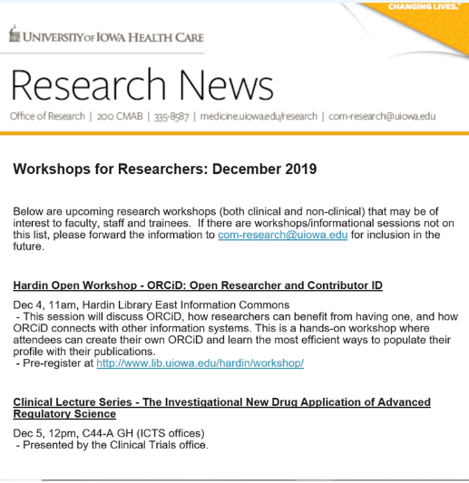
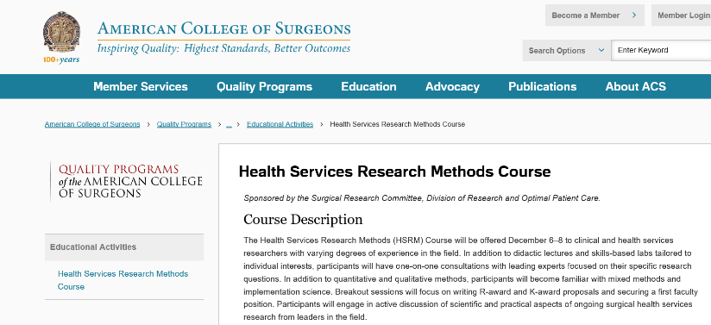
#5: Acquiring knowledge

Slide 11
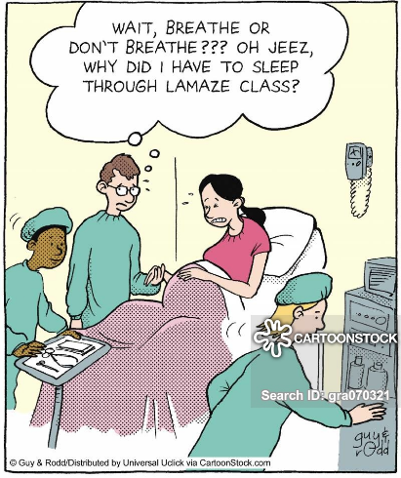
#6: The final push – writing the manuscript

Slide 12
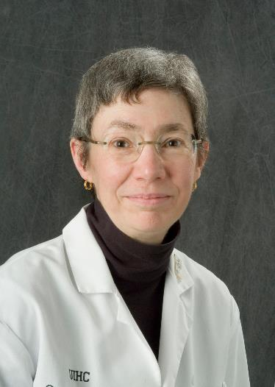
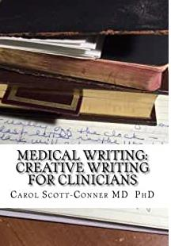
Writing resources

Slide 13
#6: Be persistent

Slide 14
Good luck!!

